Slide 1
Safety precautions for Workshop Hand Tools
Vigyan Ashram
(A center of Indian Institute Of Education)
At. Post Pabal Dist. Pune 412403
www.vigyanashram.com
www.techshala.com
www.renindia.in

Slide 2
In this presentation our focus is on learning safety precautions for hammers, hacksaw, spanners, chisels, vice and pliers

Slide 3
Safety Precautions: hand tools
Commonly used workshop tools :
1. Holding tools : Vice, V-block clamp, C-clamp
2. Cutting tools : Hacksaw, chisels, files
3. Other tools : Hammer, spanners, pliers
These tools are hand tools. The greatest hazards posed by hand tools result from misuse and improper maintenance.

Slide 4
Safety Precautions: hand tools
Hazards are usually caused by misuse and improper maintenance
Do not use:
Adjustable spanners when jaws are sprung
Impact tools (chisels and wedges) when heads have mushroomed
Tools with loose, cracked or splintered handles
A screwdriver as a chisel tools with taped handles – they
may be hiding cracks

Slide 5
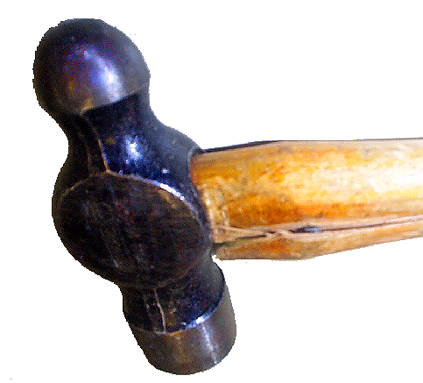
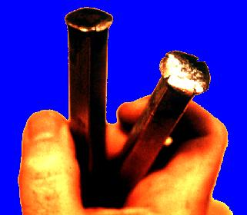
Safety Precautions: hand tools
Mushroomed head
Crack

Slide 6
Safety Precautions: hand tools
Around flammable substances, sparks produced by iron and steel hand tools can be a dangerous ignition source. Where this hazard exists, spark-resistant tools made from brass, plastic, aluminium, or wood will provide for safety

Slide 7
Safety Precautions: hand tools
Precautions
Using a screwdriver as a chisel may cause the tip of the screwdriver to break and fly, hitting the user
Using a tool with a wooden handle (e.g., hammer) if the handle is loose, splintered, or cracked, the head of the tool may fly off and strike the user or another worker;
Using a spanner (wrench) if its jaws are sprung, because it might slip

Slide 8
Safety Precautions: hand tools
Precautions
Using impact tools (e.g., chisels, wedges) if they have mushroomed heads, the heads might shatter on impact, sending sharp fragments flying.
Hecksaw blades, knives or other tools be directed away from passage-way areas and others working in close proximity. Knives and scissors shall be sharp. Dull tools can be more hazardous than sharp ones;
Floors shall be kept as clean and dry as possible to prevent accidental slips with or around dangerous hand tools

Slide 9
Safety Precautions: hand tools
Precautions
Around flammable substances, sparks produced by iron and steel hand tools can be a dangerous ignition source. Where this hazard exists, spark-resistant tools made from brass, plastic, aluminium or wood shall be used.
Disconnect tools when not in use, before servicing and when changing accessories such as blades, bits and cutters

Slide 10
Thanks
For further information:
Website : www.vigyanashram.com
e-Mail : vapabal@gmail.com, director@vigyanashram.com

