Slide 1
Let’s design a pulley structure
I am a businessman having my shop in market
I want to fix a safety door (shutter ) for my shop
This shutter is of 1000 Kg and I don’t want a outside opening provision for this shutter (My labor’s can only open it from inside)
I want to do this work in lowest possible cost.
Design a proper pulley system for shutter door with inputs given on next side -

Slide 2
Inputs for design!
 | Cost per item | Mass per item
Pulley | 1000 rupees | 10 kg
Multi-Pulley | 2000 rupees | 20 kg
 | Cost per metre
Rope | 50 rupees
 | Mass of Door
Door | 1000 kg
 | Cost of electric winch | Pulling force of winch
Winch | 6000 rupees | 2000 N

Slide 3
Remember
Weight (N) = Mass (kg) x gravitational force
Mechanical Advantage = Force Out (N) ÷ Force In (N)
Mechanical Advantage = 2 x number of movable pulleys

Slide 4
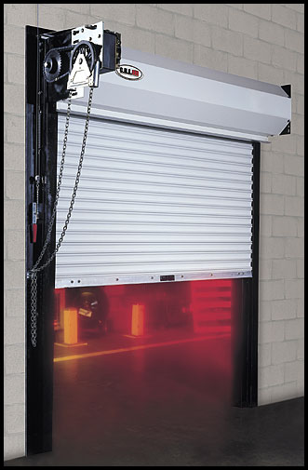
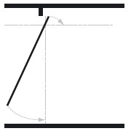
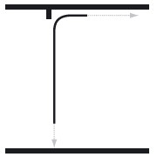
Hint for designing
Few options!

Slide 5
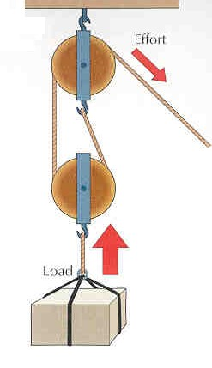
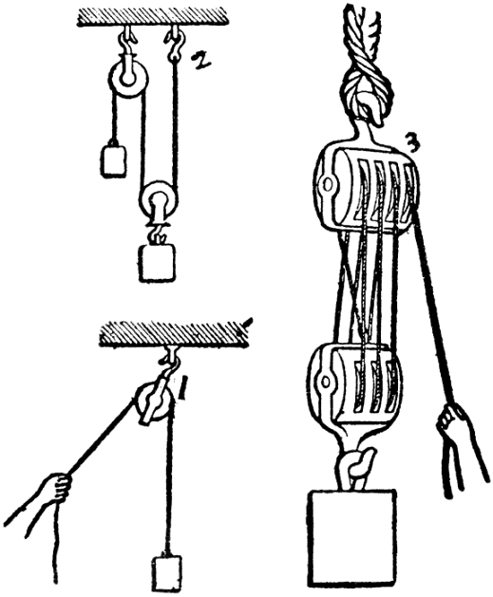
Hint for designing

Slide 6
Prompts
Keep cost of your design as less as possible - more pulleys or more winches?
Find out different force
Find out Mechanical Advantage
Find out number of Pulleys required

Slide 7
Rule for group work
4-5 students in one group
Decide your team leader
10 mins for designing discussion
20 mins load calculation
30 mins design work – Door design , pulleys design
20 mins working on business pitch –Designing calculation , cost calculation ………..

