Slide 1
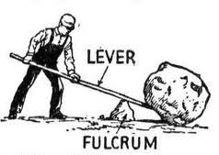
Examples of lever

Slide 2
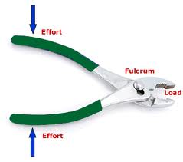
Examples of lever

Slide 3
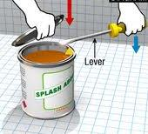
Examples of lever

Slide 4
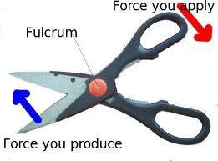
Examples of lever

Slide 5
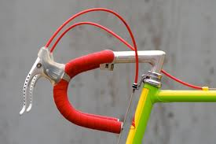
Examples of lever

Slide 6
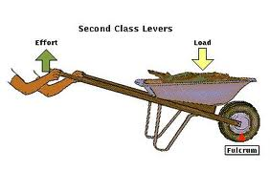
Examples of lever

Slide 7
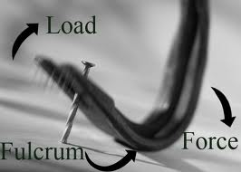
Examples of lever

Slide 8
Examples of lever

Slide 9
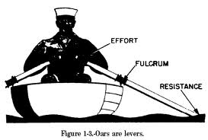
Examples of lever

Slide 10
Forces applied in leaver
Weight (N) = mass (kg) x gravity (m/s²)
Moment (Nm) = Force (N) x distance from pivot (m)
pivot
? Kg*
60 kg
2 m
1 m
Big distance
Small force
Small distance
Big force
Ans = 30 kg

