Slide 1
Examples of Slope

Slide 2
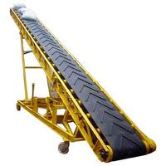
Examples of Slope

Slide 3
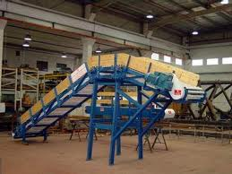
Examples of Slope

Slide 4
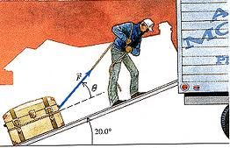
Examples of Slope

Slide 5
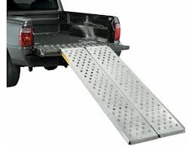
Examples of Slope

Slide 6
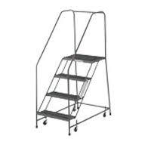
Examples of Slope

Slide 7
Examples of Slope

Slide 8
Examples of Slope

Slide 9
Examples of Slope

Slide 10
Examples of Slope

