Slide 1
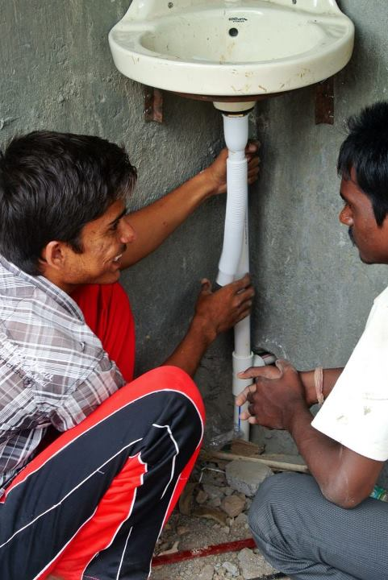
Extra Plumbing Information

Slide 2


Slide 3
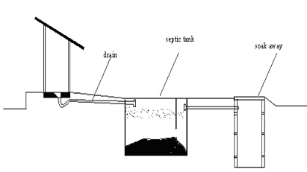
Septic Tanks: Soak Pit
Latrine
Soakaway
Watertight settling tank
Notes:
Revision from soak pits
www.schoolsanitation.org

Slide 4
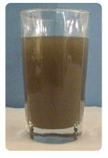
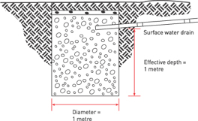

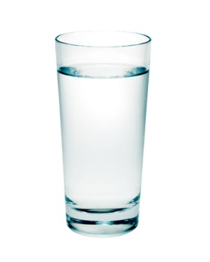
Septic Tanks: Soak Pit
Soil filters water, like a sieve
Microorganisms eat the dirt

Slide 5
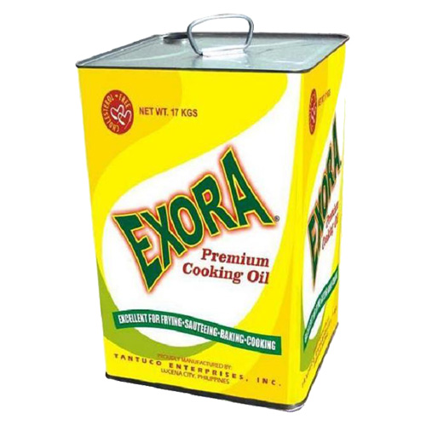
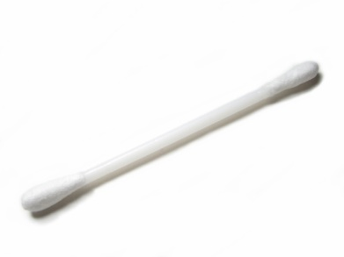
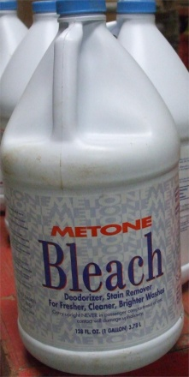
Septic Tanks
Non biodegradable waste will block the tank
Can make the septic tank smell. Need more often emptying
Some chemicals will kill off the bacteria and stop the septic tank working
Notes:
Over time, biofilms develop on the pipes of the drainage field which can lead to blockage. Such a failure can be referred to as "biomat failure". See http://www.septictank.org
Septic tanks by themselves are ineffective at removing nitrogen compounds that can potentially cause algal blooms in receiving waters; this can be remedied by using a nitrogen-reducing technology,^{[3]} or by simply ensuring that the leach field is properly sited to prevent direct entry of effluent into bodies of water.

Slide 6

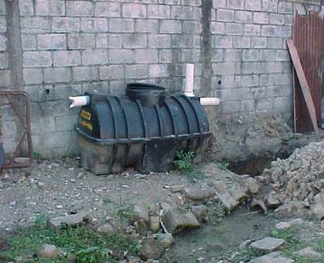
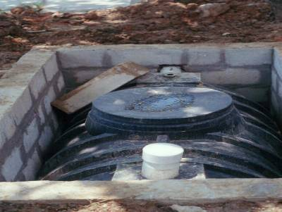
Septic Tanks
The tank needs periodic cleaning to remove scum and built up sludge about every 3 years.
Its called a Septic tank as the waste is degraded under anaerobic conditions (no oxygen)
Waste water needs to remain in tank for minimum 24 hrs to ensure it settles

