Slide 1
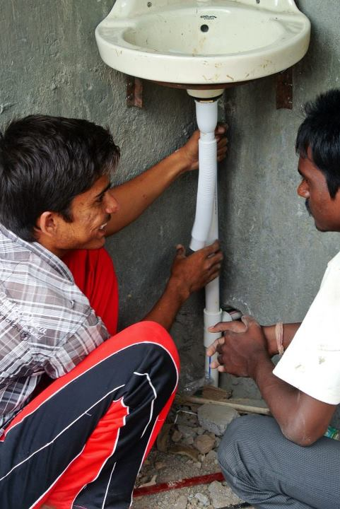
Introduction to Plumbing 2

Slide 2
Here are some things we must consider in the planning process before we begin plumbing:
Materials & Fittings
What to buy
Quantity
Cost
Where to get them
When to buy i.e. before work starts
Blue print; this tells us the number and length of pipes needed.

Slide 3
What must we consider when we begin buying our materials? Discuss and make a list with a friend.
COST
DURABILITY: Will they break easily?( – if they do NOT then they are durable)
WORKABILITY: Will they be easy to use in construction? (Light to carry, portable, flexible and how long will it take to place pipes?)
SUSTAINABILITY: Will they last a long time? (Or will they have to be replaced a lot which can be expensive)
MAINTENCE: Are they easy to maintain or repair?
?
?
?
?
?

Slide 4
There are 3 types of pipe we could use:
GI Pipes can be used for internal work of a building. They are laid perfectly vertical and horizontal and kept 1.5 cm clear of the wall.
Cast Iron pipes are available in long lengths. They have water tight joints and can withstand high pressure and external load. They are corrosion resistant to most natural soils.
PVC Pipes are light in weight, durable and portable.
We usually use PVC pipes

Slide 5
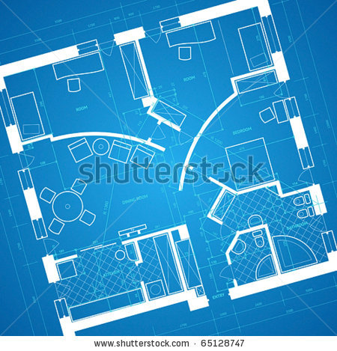

Drawing the Blue Print

Slide 6
Here is how you calculate a rough layout plan or blue print:
Sketch out the new building, supply tank and septic tank, roughly to scale.
Mark out in chalk the route of the basin, sink and toilet etc will be placed.
Plan out waste water and supply water plans separately (never connect these two)
Get a steel measuring tape (or more accurate equipment e.g. ‘Smart measure’ or ‘Geo measure apps)
Measure route for both supply pipes and discharge pipes in the new building (vertical and horizontal).
Mark on the sketch and then total up the amount of pipe needed.
Also mark when you will need joints or fittings and what type you will need.
Now calculate your own rough layout plan, we will need to use this in our next exercise

Slide 7
Its now time for an activity!
Group exercise: Using your blue print calculate the total amount of pipes and fittings you need. Record this information in a table, then visit your local retailer and calculate the total cost of all these materials. E.g:

Slide 8
It’s now time for our next activity!

