Slide 1
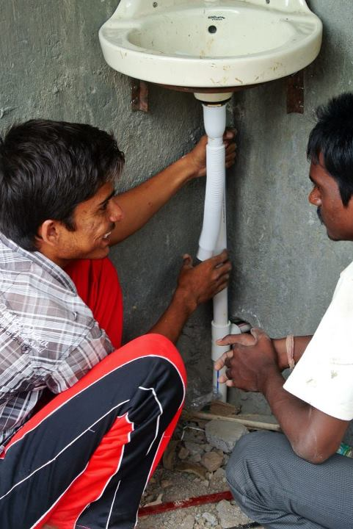
Introduction to Plumbing

Slide 2
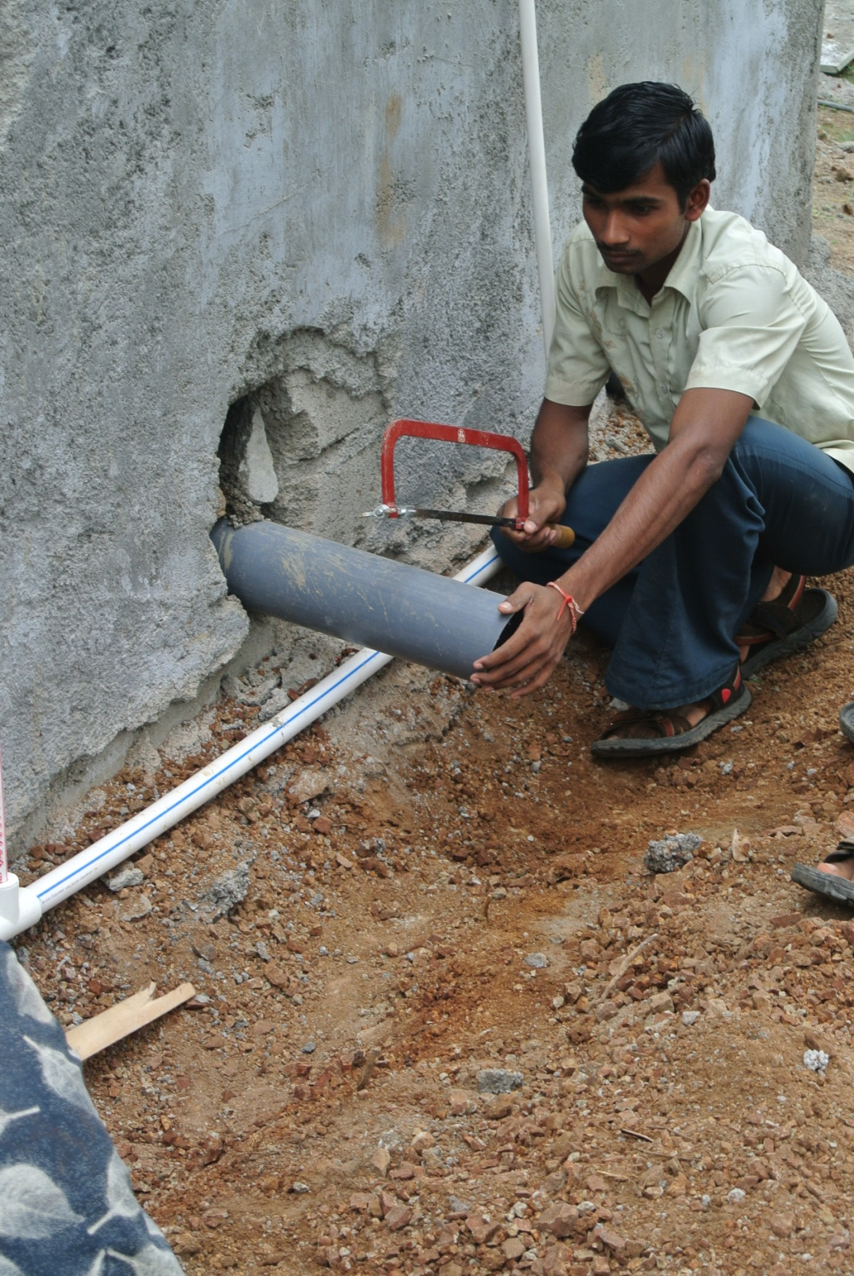
http://www.nswai.com/aboutnswai.php
http://indiasanitationportal.org/sites/default/files/SLWM_20-08-07.pdf
Here is the definition of plumbing
Plumbing refers to the laying and repairing of pipes and fixtures for the distribution of water or gas in a building, and for the disposal of sewage.

Slide 3
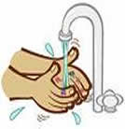

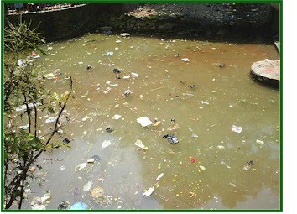
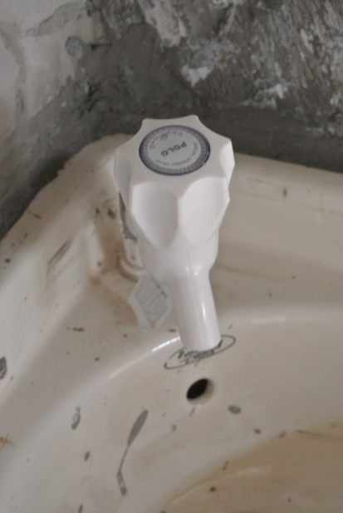
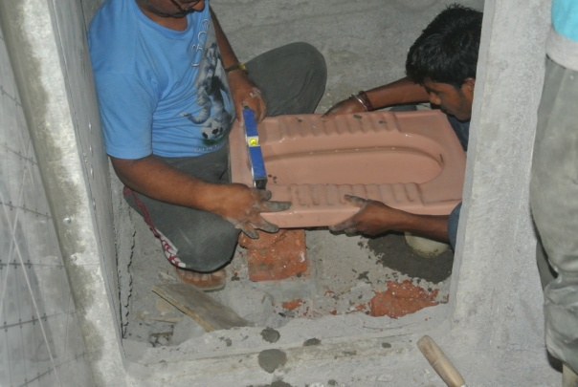
Can you think of the reasons why we need plumbing?
..................................
.............................................................
Good hygiene
Prevents transmission of disease
............................................
Easier access to water
............................................
Human waste removal
............................................
Removal of Dirty Water
Notes:
Rubbish=unwanted or undesired material

Slide 4
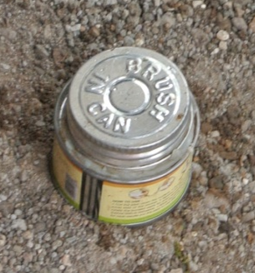
The important things we must consider when plumbing are:
A suitable plan for where discharge pipes will go
Planning of pipe layout prior to plumbing
A suitable supply of water
External pipes are Parallel to building
Secure pipes
Notes:
Use glue to secure the pipes to one another.

Slide 5
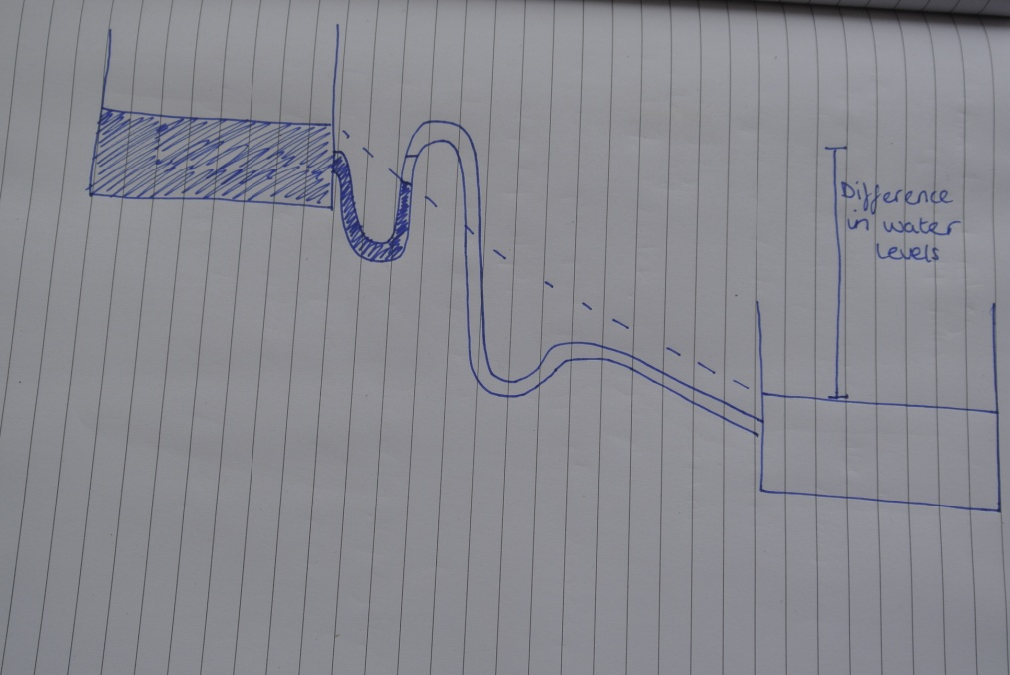
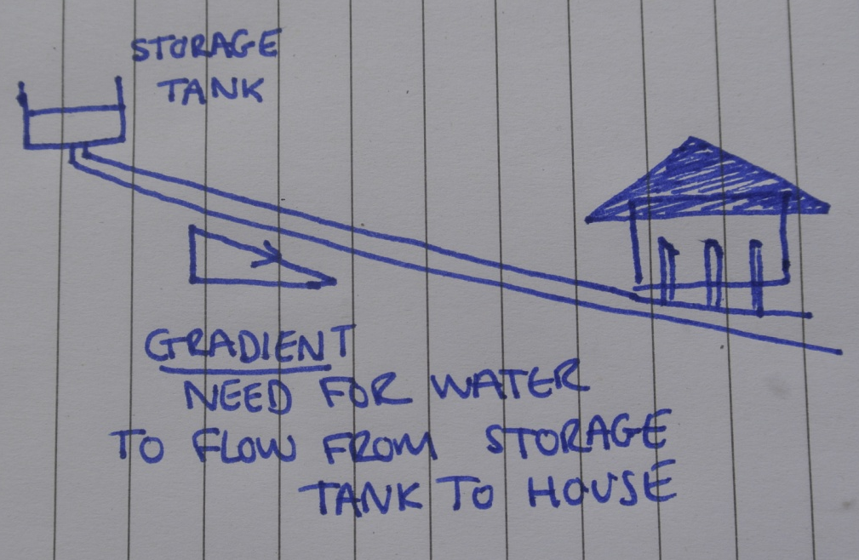
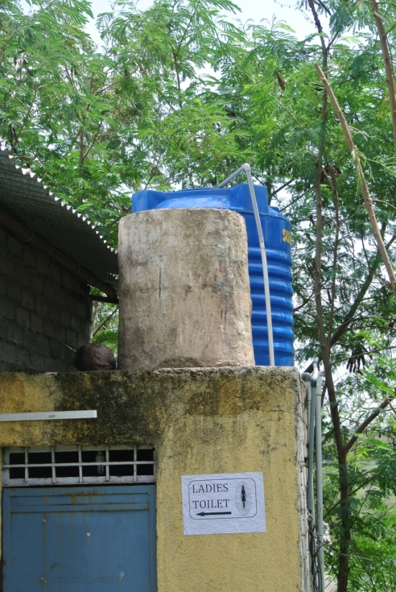
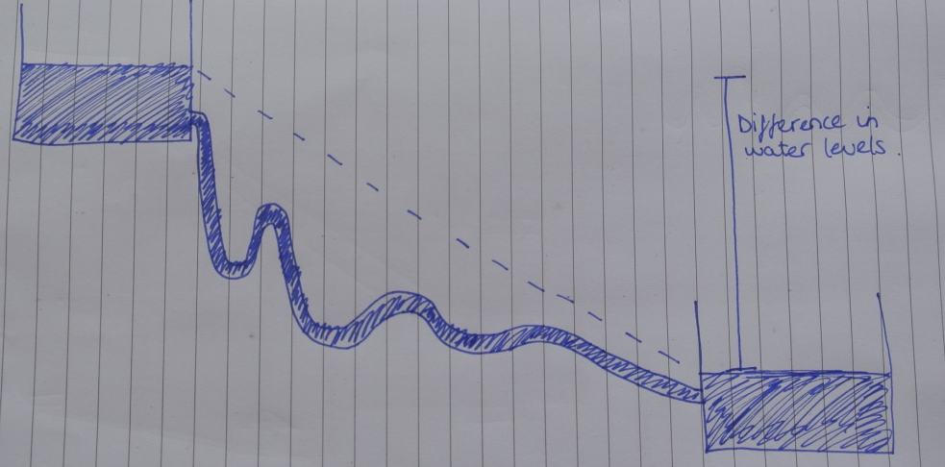
Where does the water come from?
A storage tank
Here water is flowing down
But here water is NOT flowing down as water can not go above gradient line.
GRADIENT

Slide 6
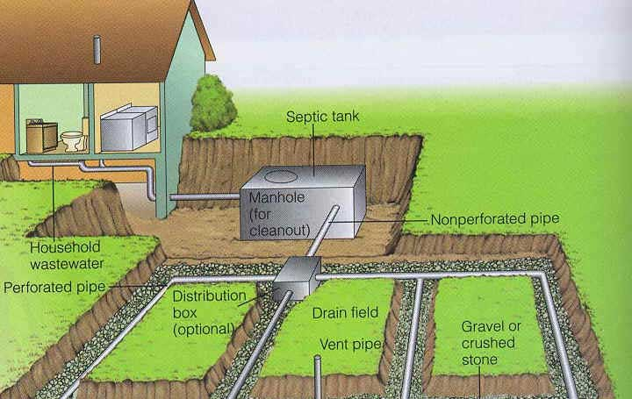
Where does the water go?
Septic Tank

Slide 7
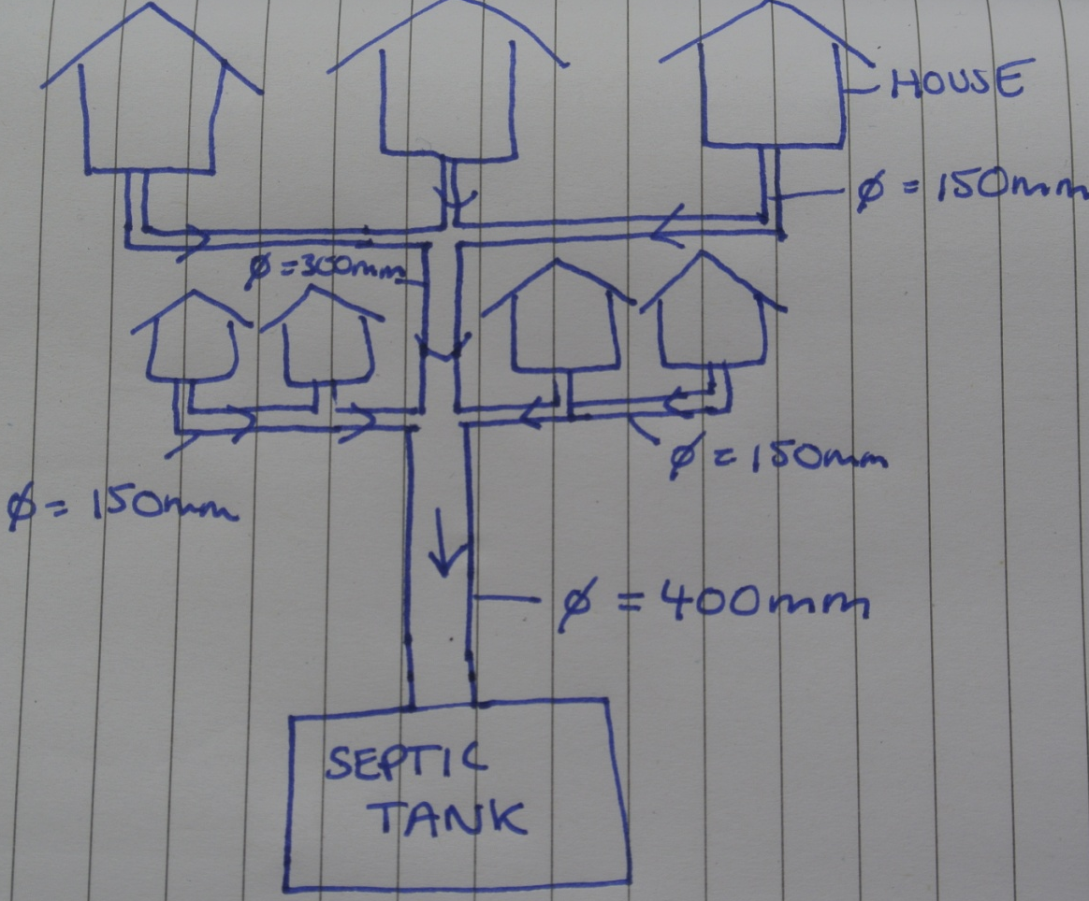
Where does the water go?
If the tank is not nearby: pipes need to get bigger in diameter as more houses are pumped into the discharge pipe.

Slide 8
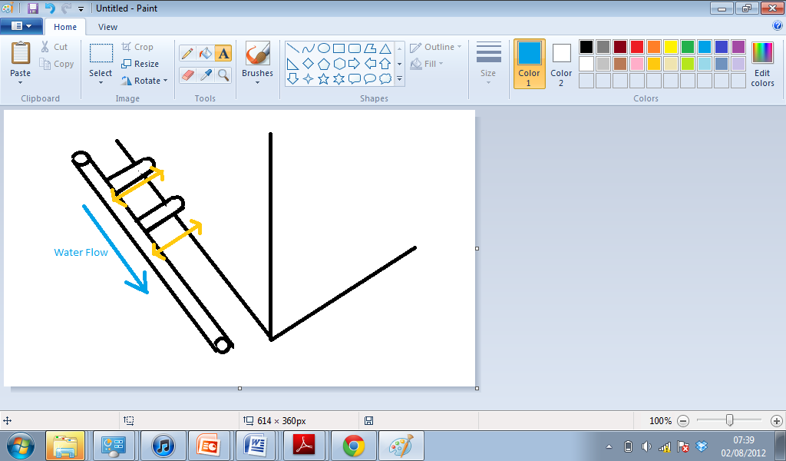
It is important that the main discharge pipe is parallel to the building. Pipes 1 & 2 should be at right angles to both the main discharge pipe and the building. But should distance 1 and distance 2 be the same?
1
2
Answer: Distance 1 and distance 2 must be the same

Slide 9
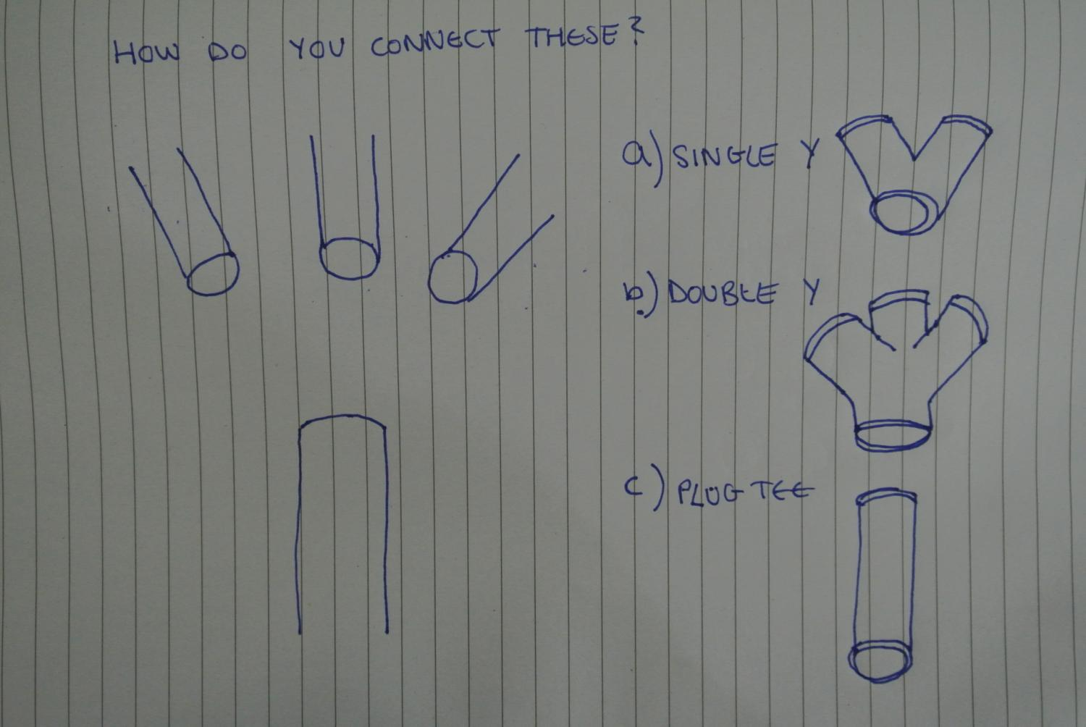
Answer = B

Slide 10
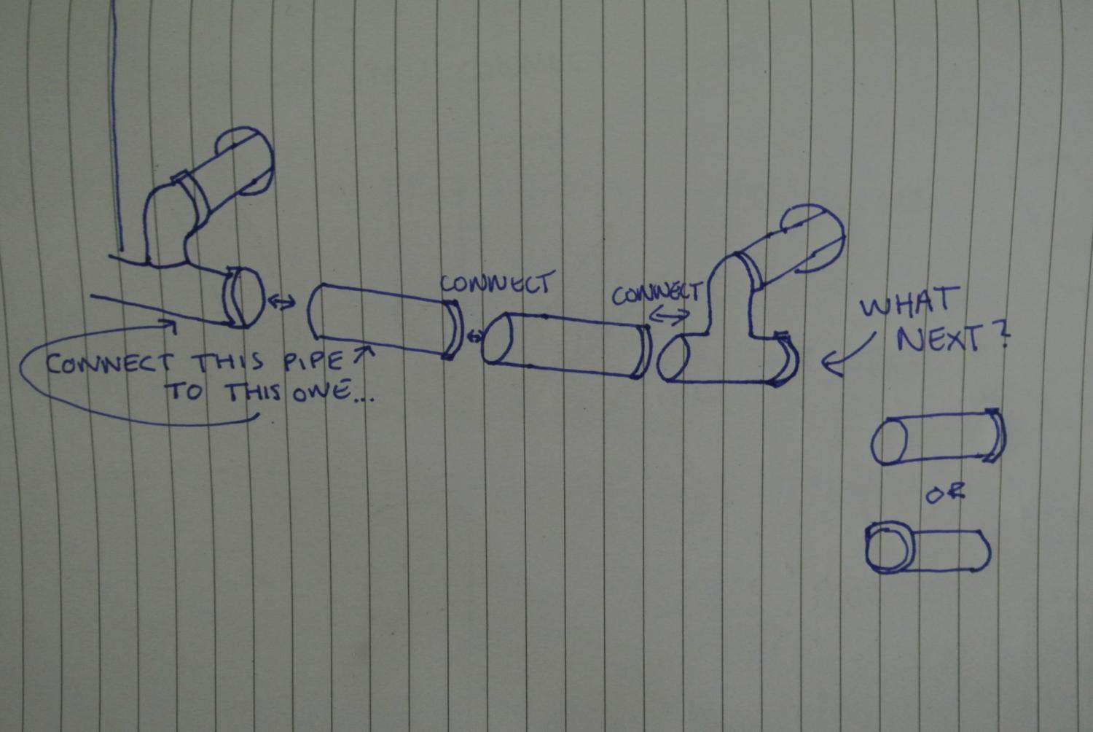
A)
B)
Answer = A

Slide 11
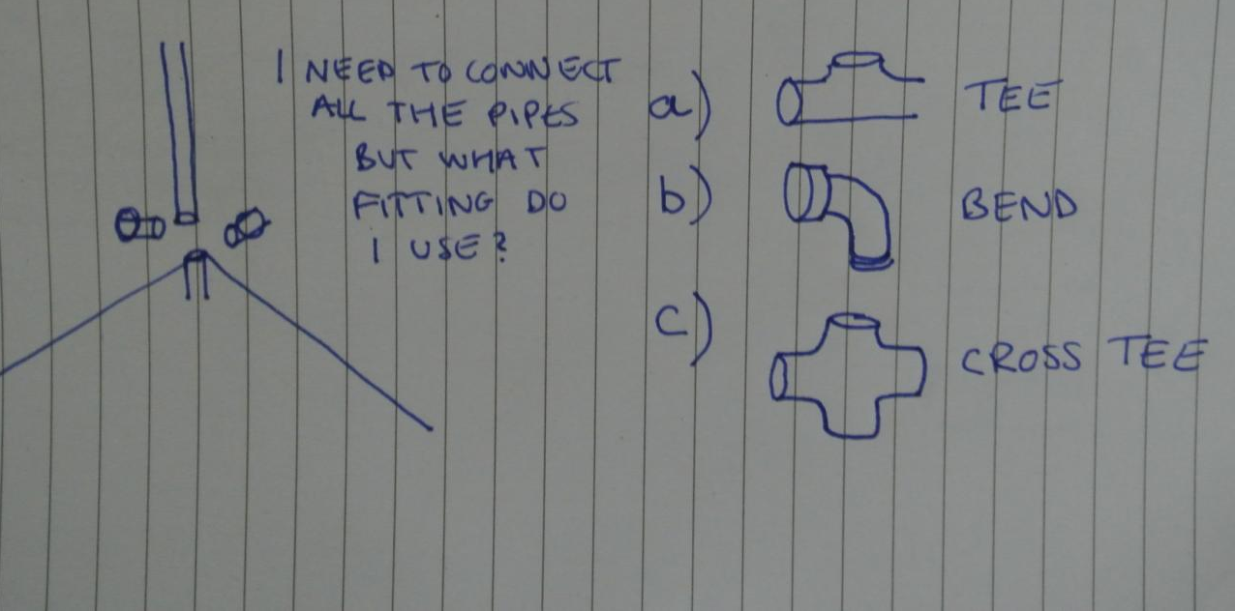
Answer = C

Slide 12
How do you secure the pipes?
How do you get water to flow from one place to another?
........................
Glue
.....................................................
  Ensure GRADIENT of pipe
GRADIENT
Water flowing down
Water NOT flowing down as water can not go above gradient line.

Slide 13
And finally:
Why is Plumbing important?
..................................
.............................................................
Good hygiene
Prevents transmission of disease
............................................
Easier access to water
............................................
Human waste removal
............................................
Removal of Dirty Water
Notes:
Rubbish=unwanted or undesired material

