Slide 1
How do each part of a W.C’s work?
Don’t worry I will explain everything to you.

Slide 2
All W.C’s contain of a pan where human waste is excreted , this waste is then carried away through a soil pipe with the help of water.

Slide 3
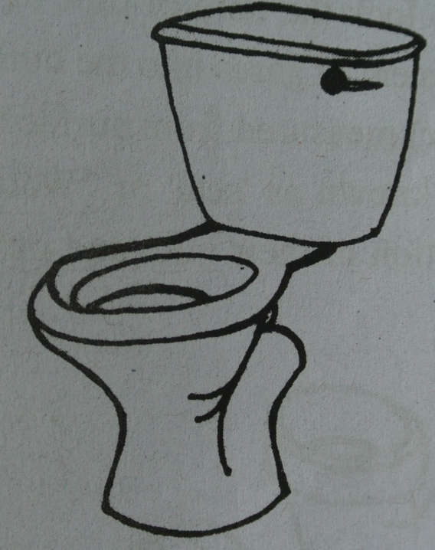
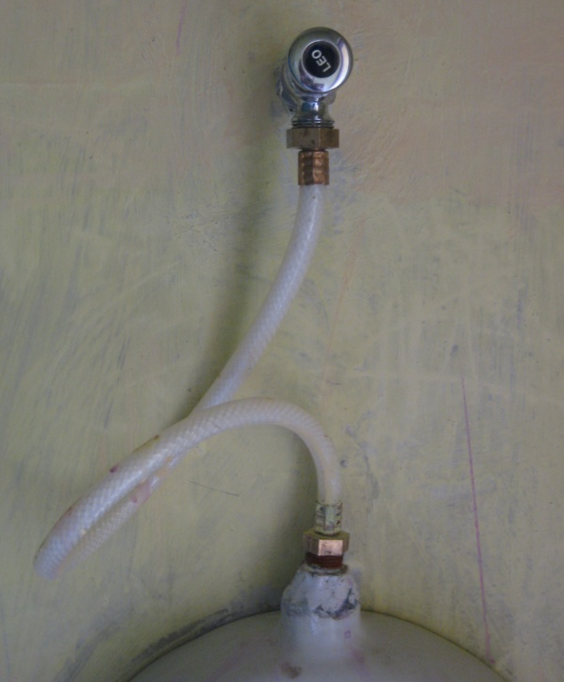
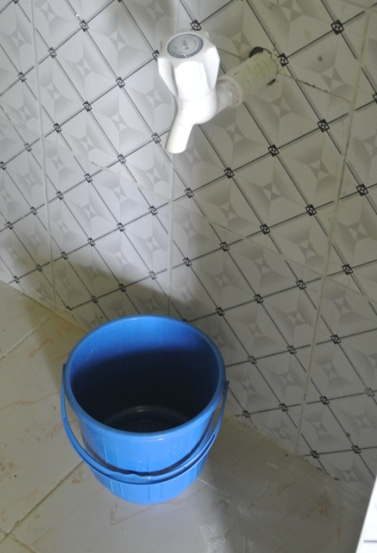
This water comes either from a cistern, a flush valve or from manually putting water into the pan.
Cistern
Flush valve
manually

Slide 4
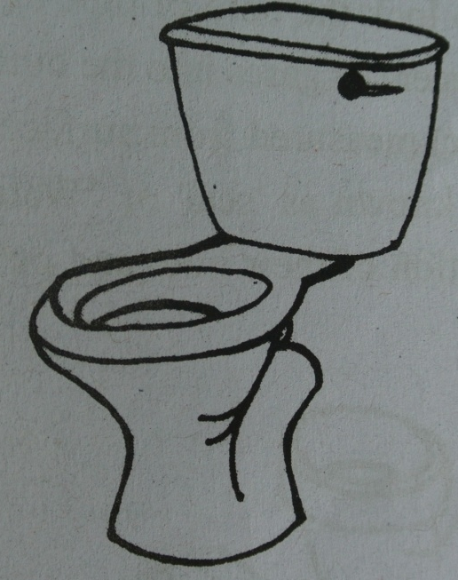
But what is a cistern?
A cistern is used for flushing a W.C.
There are 2 types HLC (high level cisterns)
  And LLC (low level cisterns)
HLC have a capacity of 10.5-14 litres. They have a rapid flushing action so less water is needed to move the excreta along the soil pipe.
LLC have a capacity of 10 litres. They are usually made from plastic and are fitted immediately above the back of the W.C pan, this reduces the flush pipe length and makes then easy to fit.

Slide 5
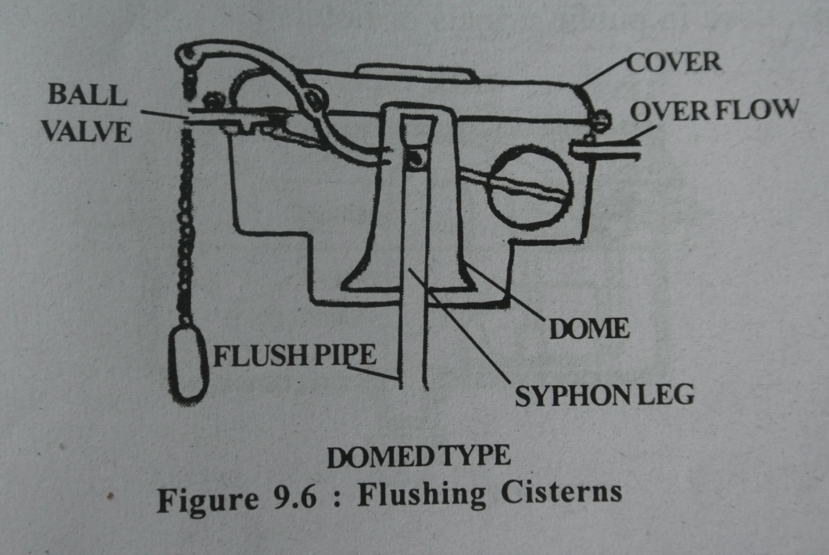
  The most common style of cistern is the
  dome style
  .
in these cisterns water can be flushed by pulling a chain. The chain lifts the dome, when the dome falls rapidly it traps and forces the water up and over the siphon.
The siphon reaction empties the tank until air is admitted under the dome.
when the chain is pulled again this process is repeated.

Slide 6
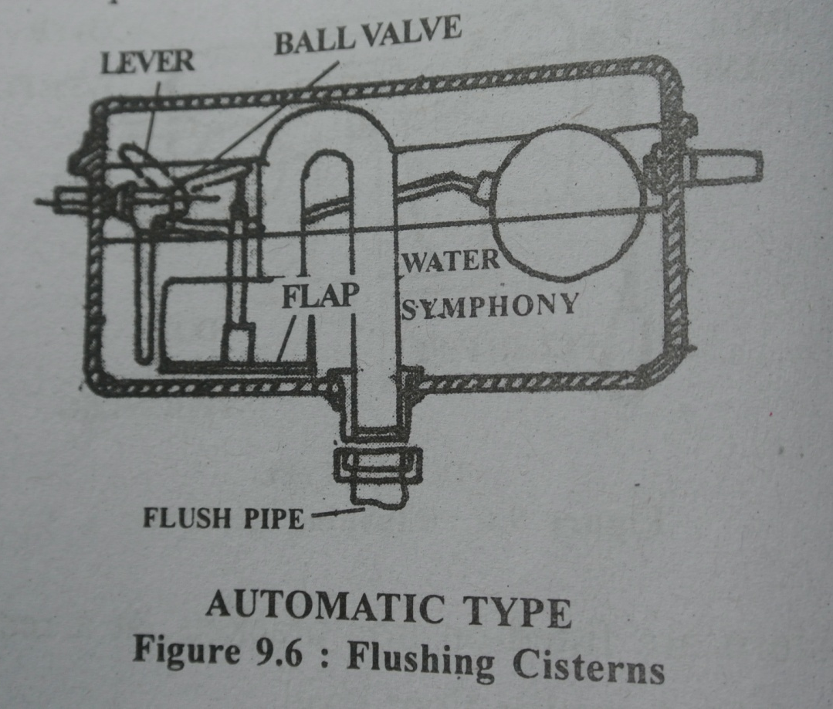
There are also automatic cisterns. These are used in public urinals or hotels etc.

Slide 7
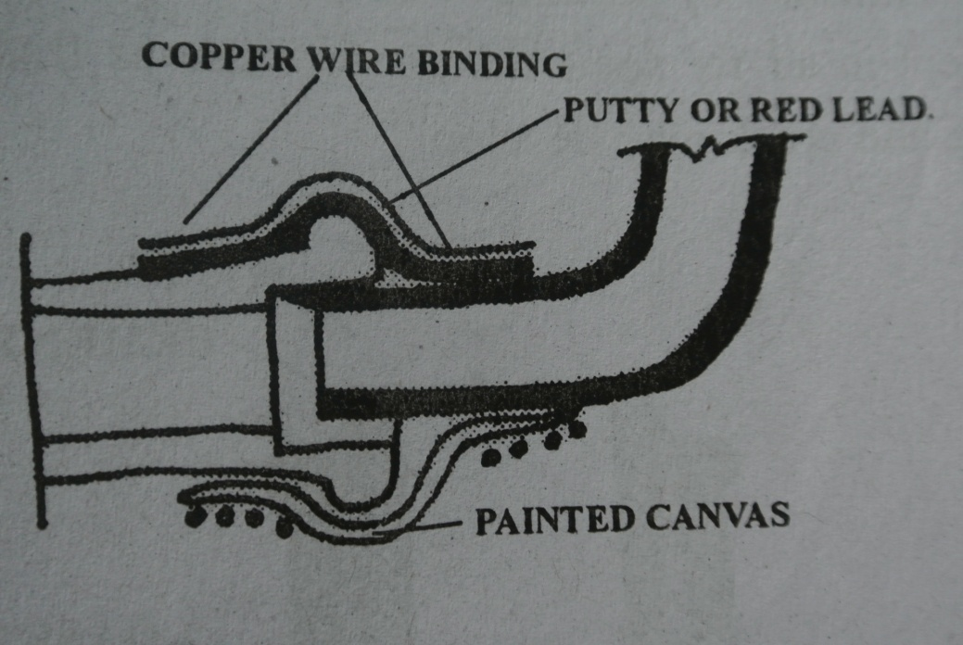
How would I connect a cistern to my W.C?
There are 3 types of joint that can be used to do this:
Wrapped Joint
  Here the end of the flush pipe
  is opened out to fit the socket
  into which it is inserted. The
  space between the pipe and
  socket is packed with red lead
  Putty. The pipe is then tightly
  wrapped with canvas soaked
  in paint and then bound
  in position with copper wire.

Slide 8
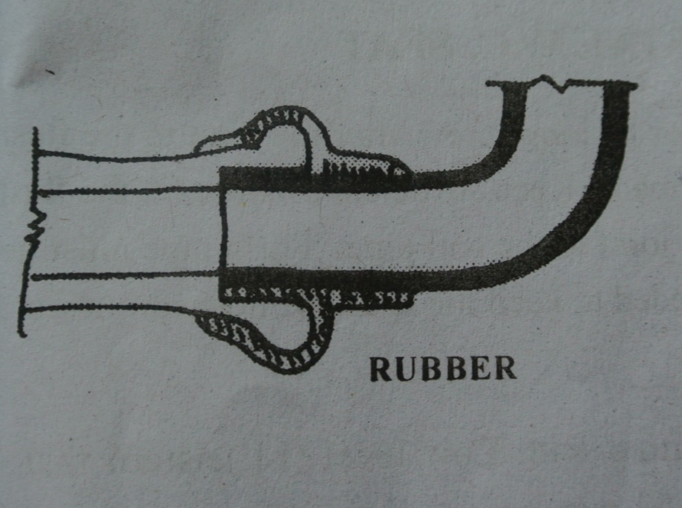
2. Rubber collar joint
  Here the rubber tube seals the space between the pipe
  and the socket. This joint is water tight and slightly
  flexible.

Slide 9
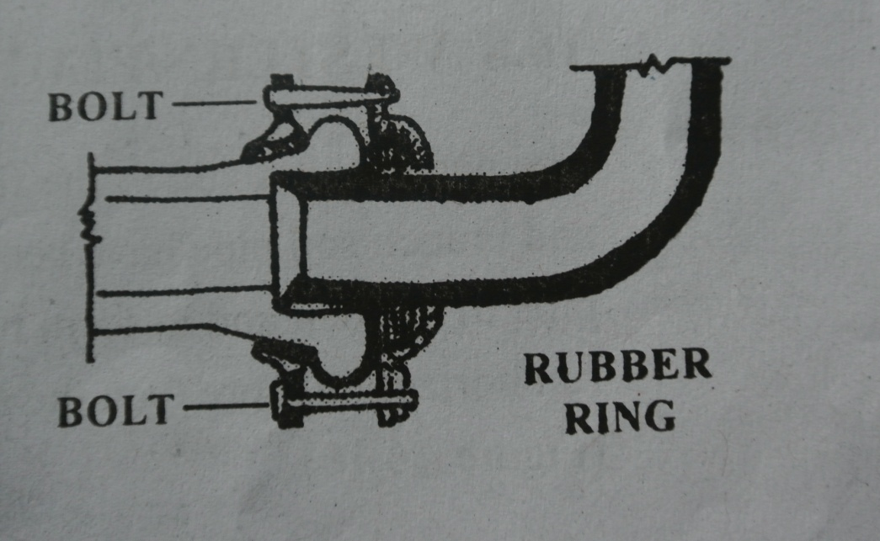
3. Clamp and collar joint.
  Here a rubber ring is used
  to seal the space between
  the pipe and socket. This
  makes the joint water
  tight and is held in place
  by a clamp and bolts.

Slide 10
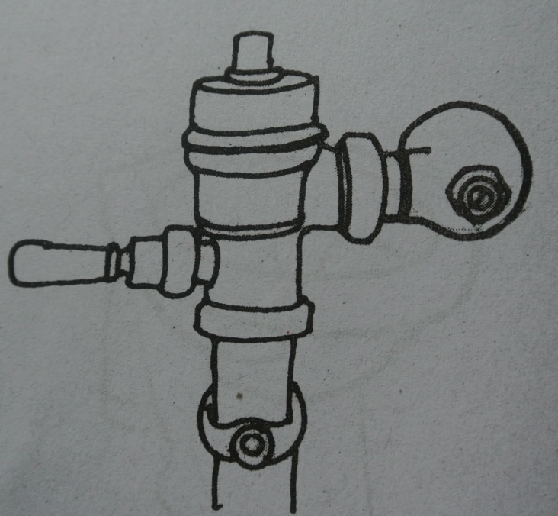
Thanks I now understand cisterns. Can you explain next what a flush valve is and how it works?
This is a silent and economical method of
flushing a W.C. The valve when opened
allows a rapid flow of water into the W.C.
This then flushes the excreta out into the
soil pipe. The valve is operated by a small
lever handle or by a push knob.

Slide 11
Another important component of the W.C is the Water trap.
All W.C’s must have a water trap attached.
Water traps are very important as they
stop the foul gases produced in the
sewer from entering the house.
The trap consists of a bent tube which allows the flow of liquids and floating matter to pass though whilst providing a water seal between the atmosphere and sewer gas.

Slide 12
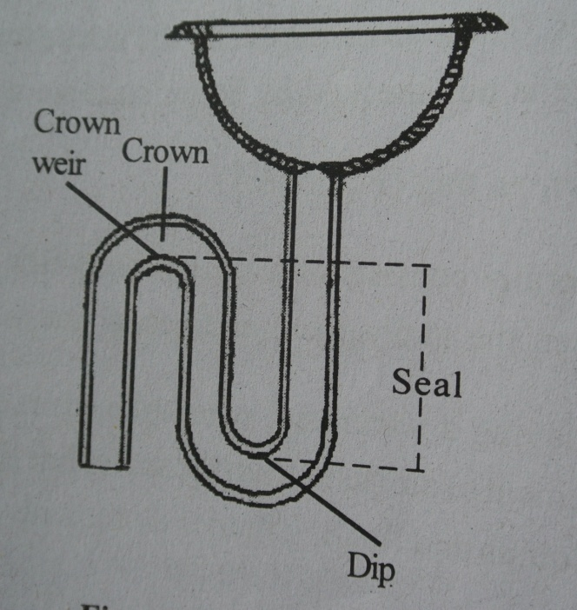
The water seal is the depth of liquid from the crown weir to the DIP. This liquid is clean as it is replaced every time it is used by water from a cistern or flush valve etc. It always remains in the trap and is what prevents the sewage gases from entering the house.
The crown weir is the lowest point in the trap where the liquids must flow in order to leave the trap.
The DIP is the lowest point in the trap where the liquids must sink before air or gas can pass through the tap.

Slide 13
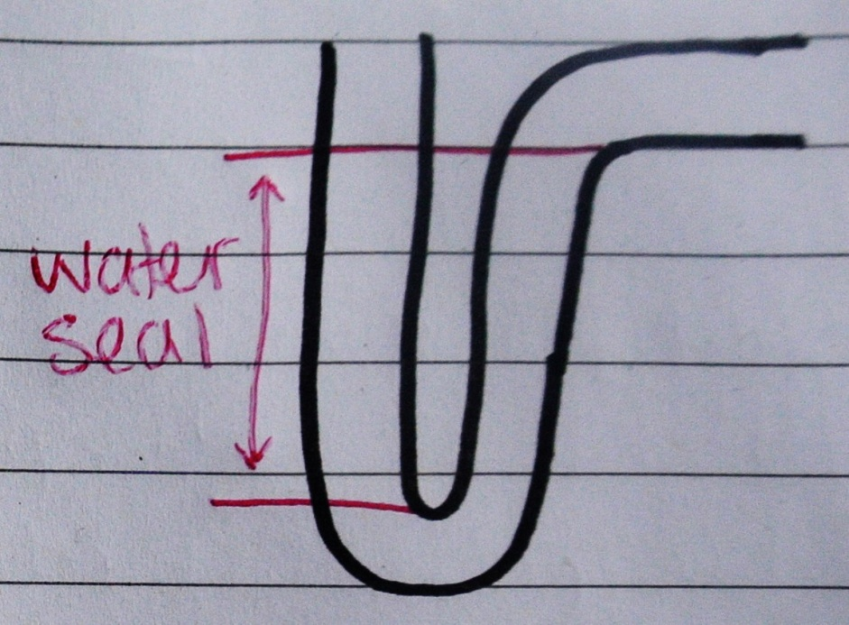
There are 3 types of trap:
P-Traps, S-Traps and Q-Traps. The names are according to their inlet and outlet pipes.
P-Traps: its inlet is vertical and its outlet is at an angle of 95 degrees.

Slide 14
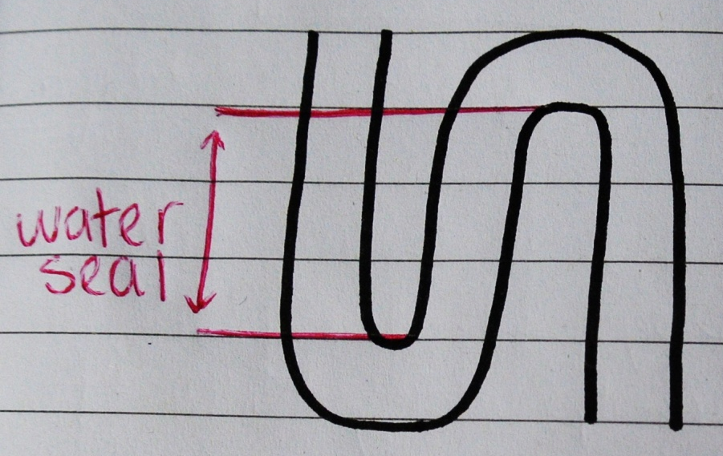
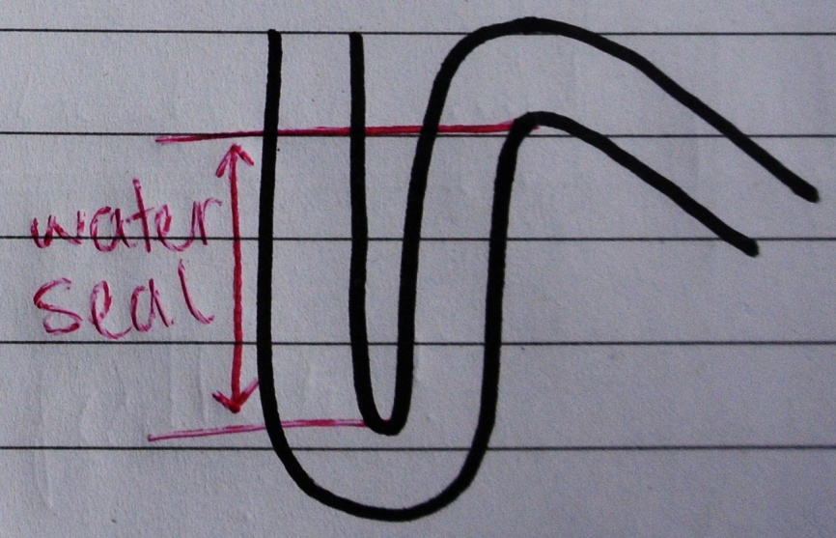
S-Trap: both its inlet and outlet are vertical
Q-Trap: its inlet is vertical and its outlet is steeper than95 degrees but not quite vertical.

Slide 15
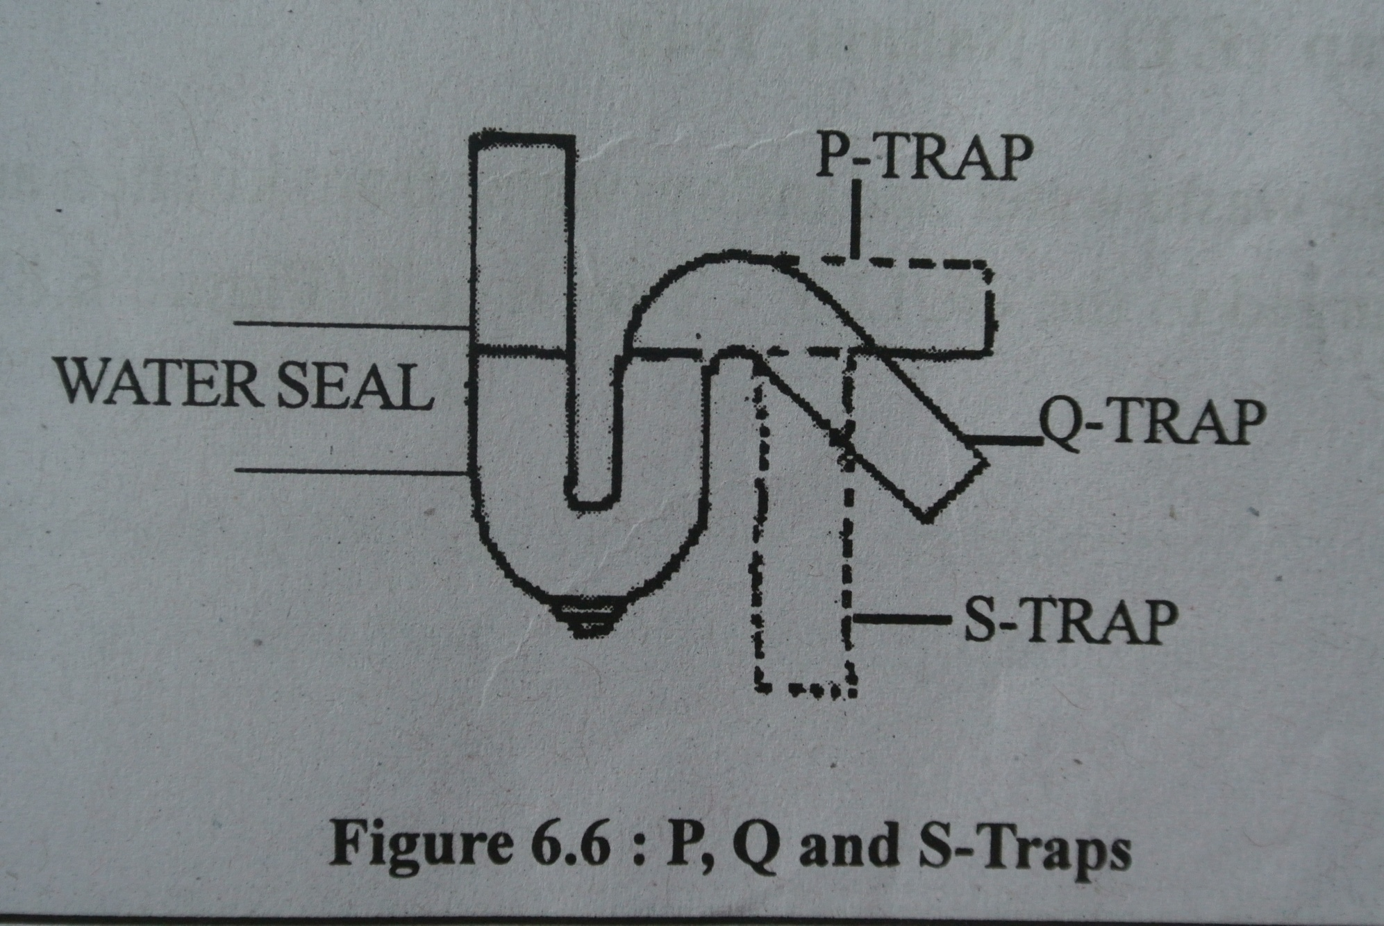

Slide 16

So that is all of the main parts of a W.C explained, did it make sense?
Wow that wasn’t as hard as I thought it might be! Yes I understand how all the parts work now thank you!

