Slide 1
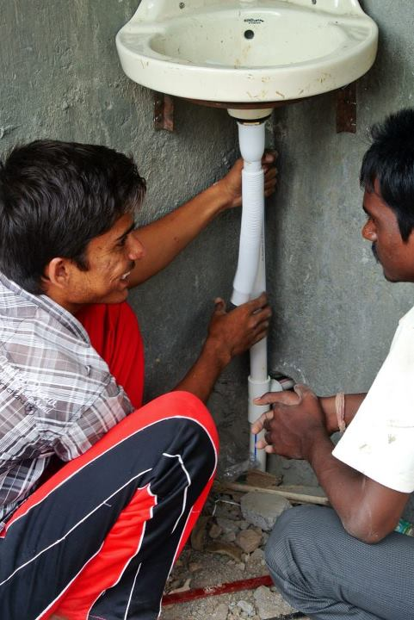
Introduction to Plumbing 3

Slide 2
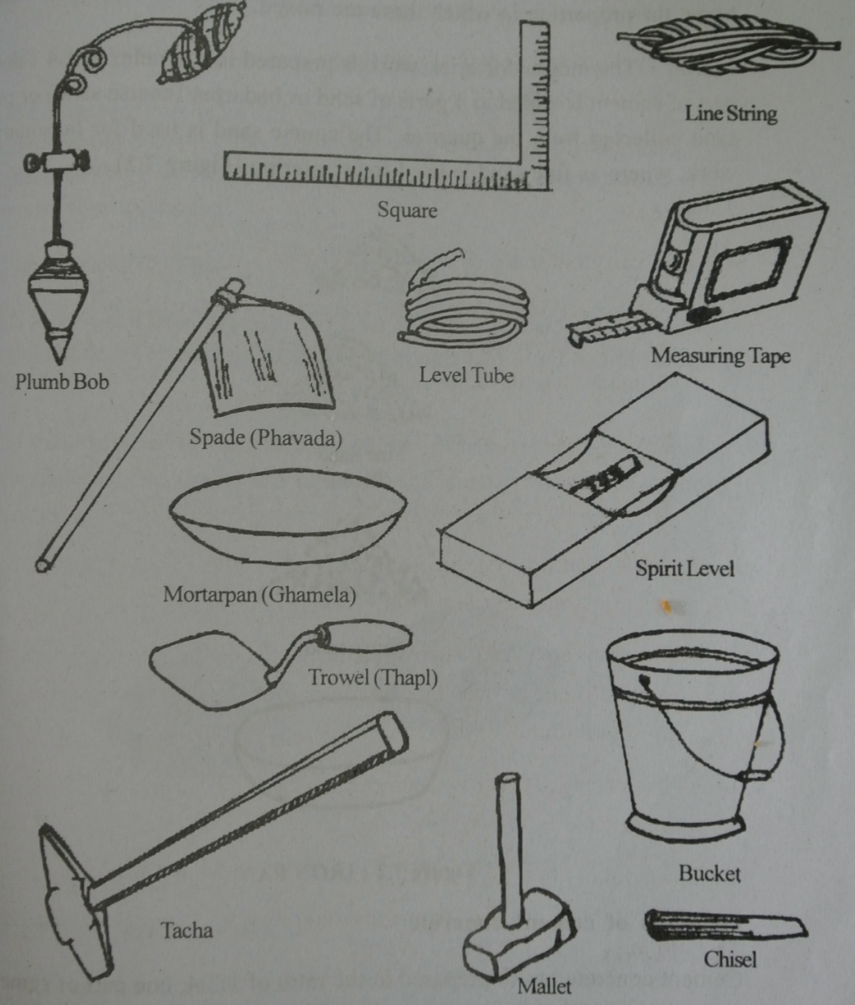
These are the basic principals of plumbing:
Concreting
Soldering
Hammering
Here are the tools we need:
We also need a soldering iron and blow lamp

Slide 3
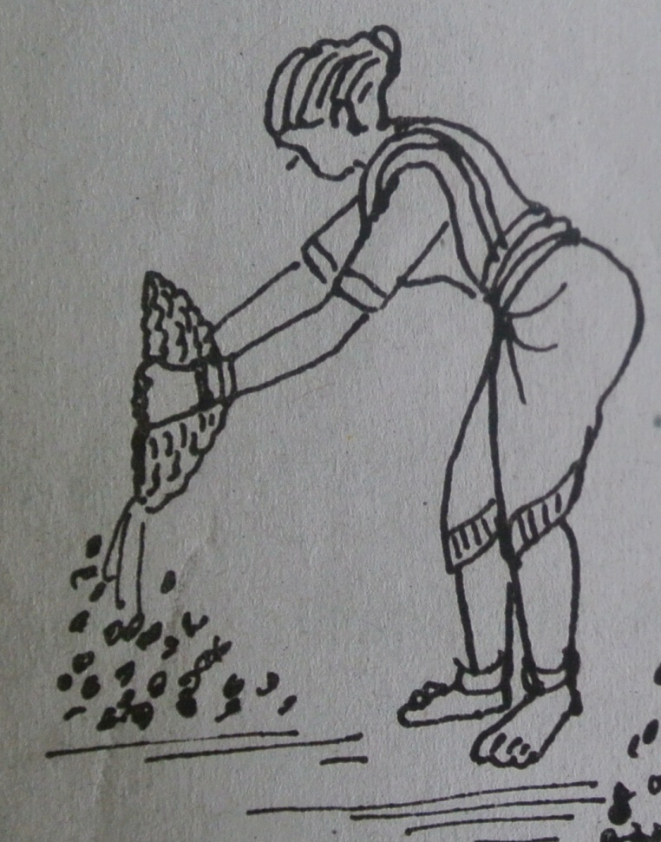
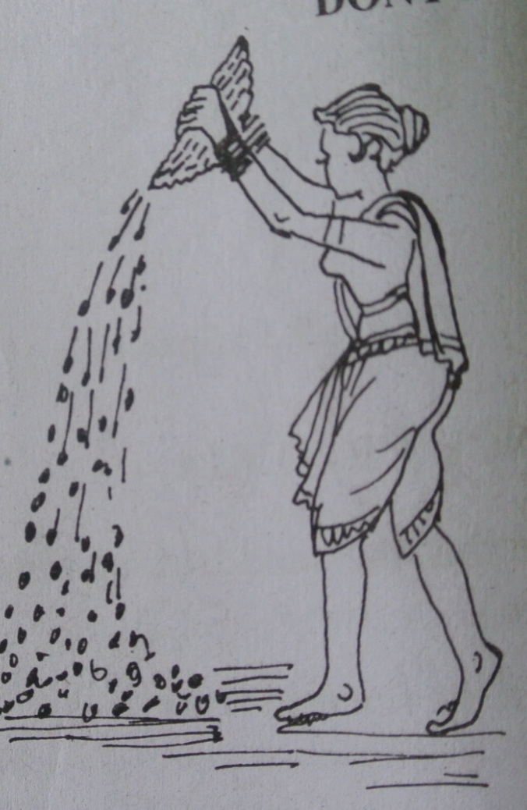
Concrete Pouring
First let’s learn about concreting:

Slide 4
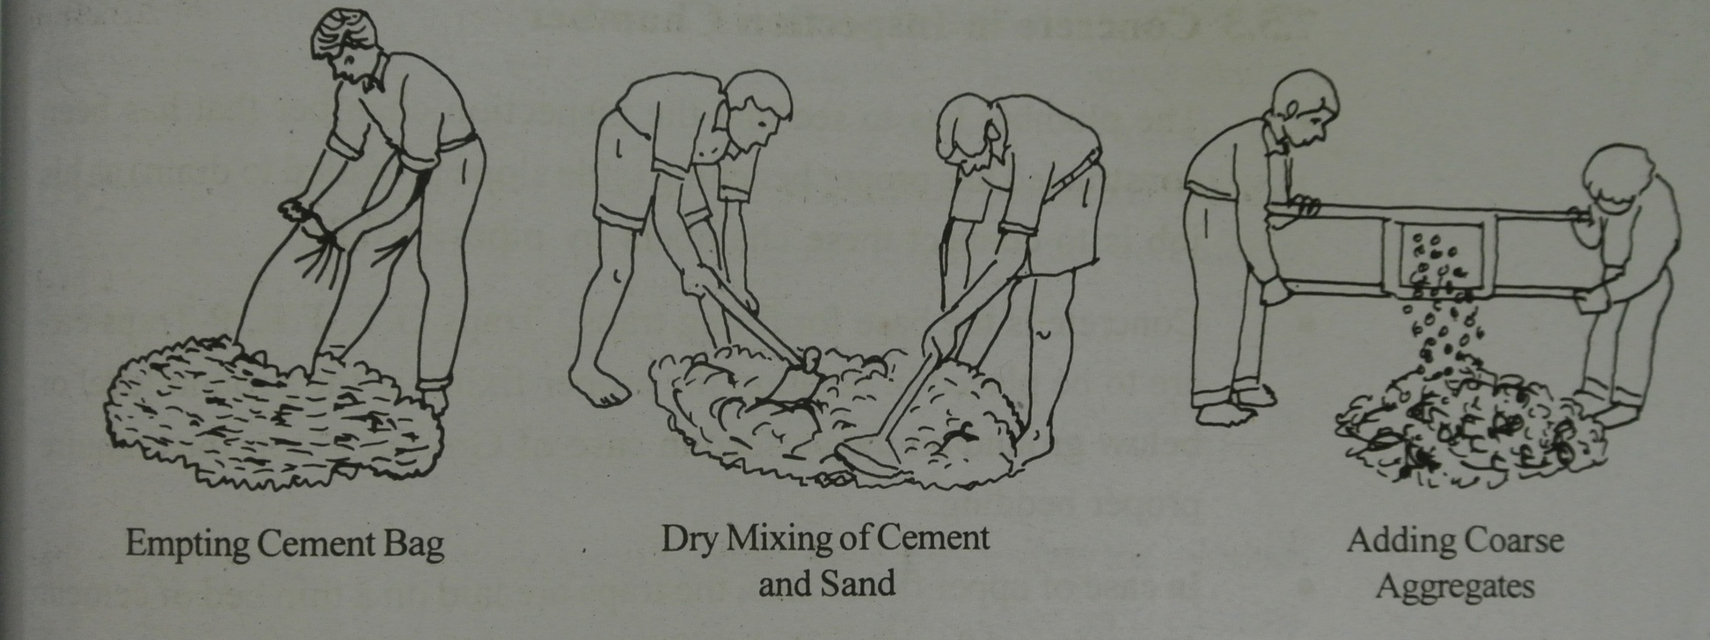
The procedure of making concrete

Slide 5
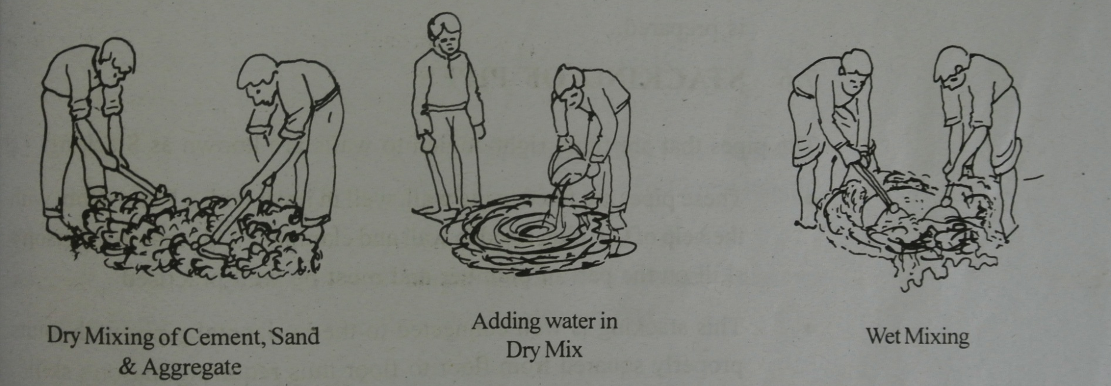
The procedure of making concrete

Slide 6
The procedure of making concrete
Cement, sand and aggregate should be prepared in the ratio of 1:2:4 respectively.
(1 part cement, 2 parts sand and 4 parts stone aggregate.)
Concreting a slab: http://www.youtube.com/watch?v=iHgNnGCgE6E
Concrete Stairs: http://www.youtube.com/watch?v=gpdMrbRHBLU
For extra information visit these websites:

Slide 7
Placing of Concrete
Placing concrete is very important for optimum results.
For example when placing concrete on ground:
All loose earth should be removed.
Roots of trees, if passing through the foundation, must be cut to prevent further growth
The ground should be made wet so that the water from the concrete is not absorbed
If there is seepage of water – effective method of de-watering should be adopted prior to placing concrete.

Slide 8
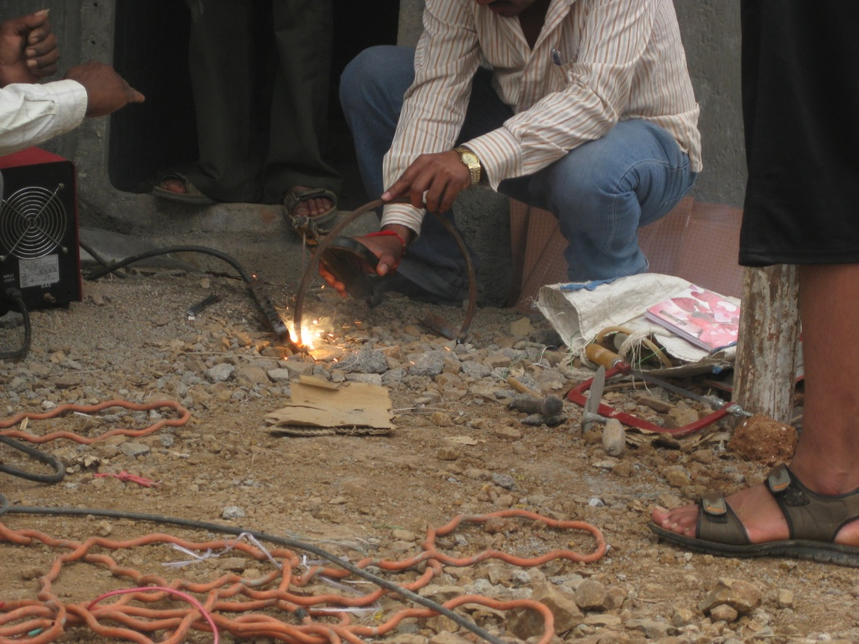
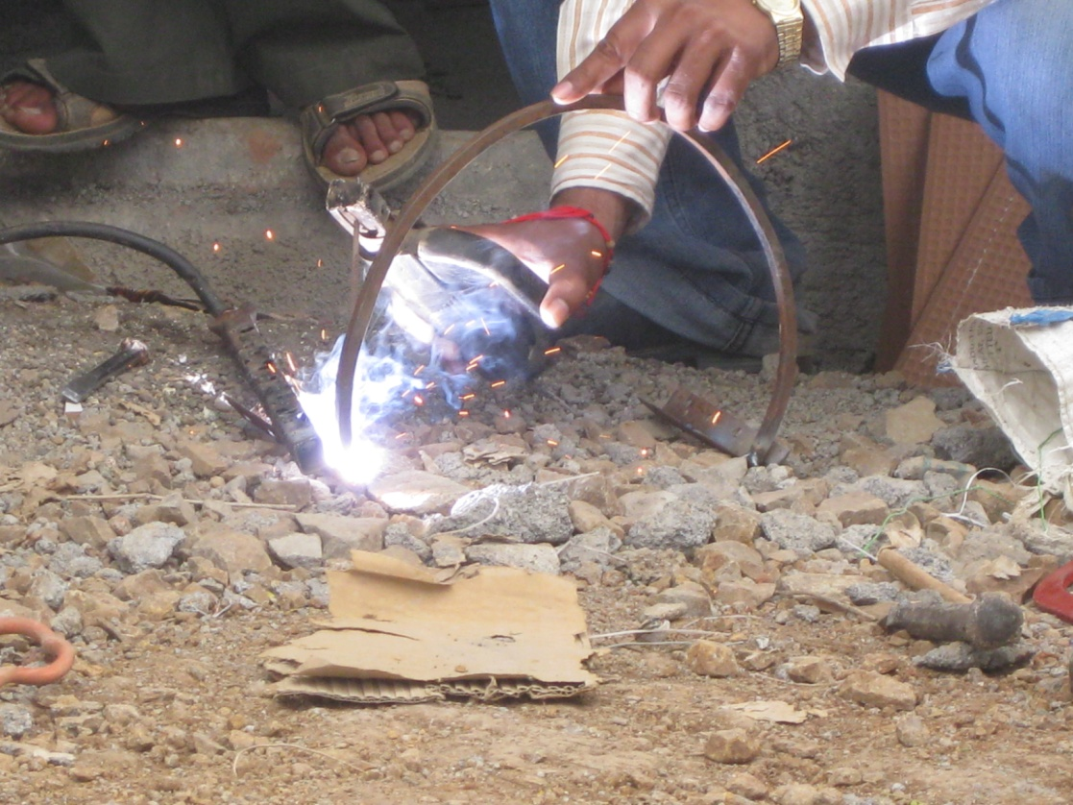
Soldering
Needed for fixing the bracket of the sink.

Slide 9
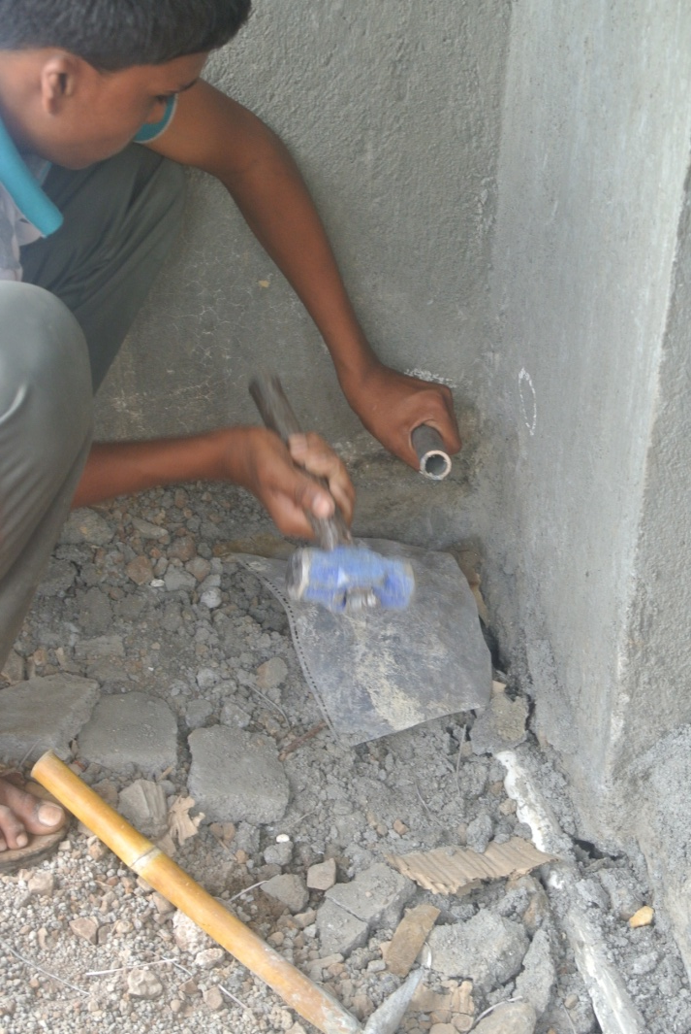
Hammering
Be careful!
Hold handle with right hand (or left hand if left handed)
With other hand, hold other piece of equipment e.g. Chisel, nail etc. Slowly hammer in the object.

Slide 10
Pretend now that you are a teacher, you must explain to your class how to concrete, solder and hammer.

