Slide 1
Mango Pickle Recipe

Slide 2
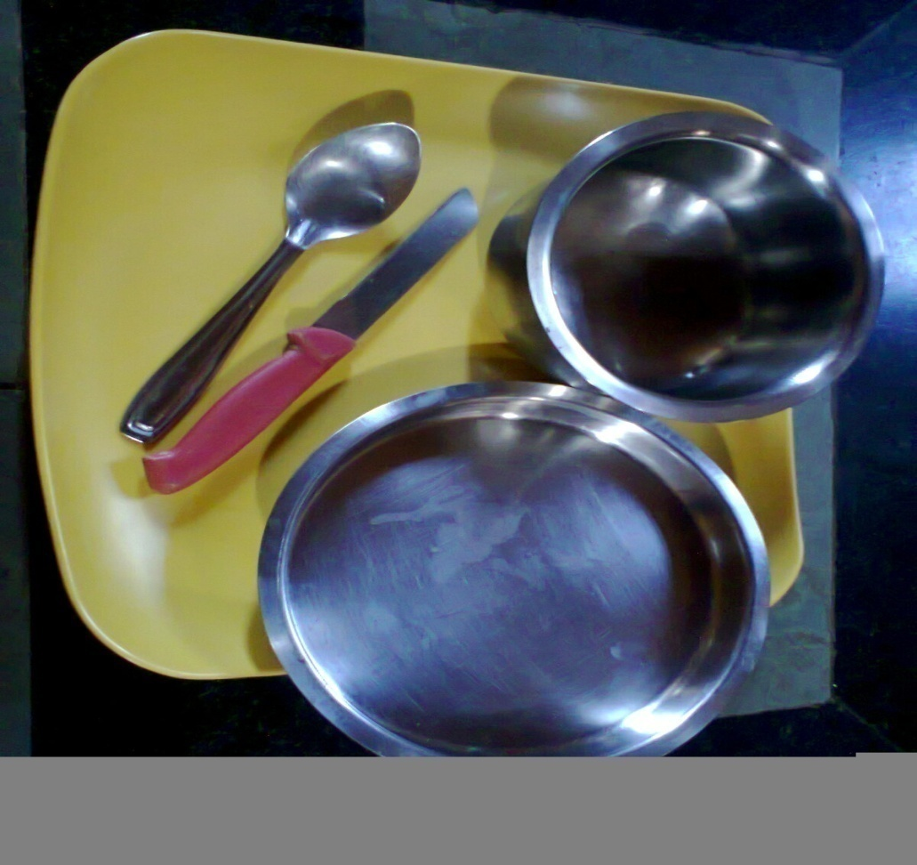
Tools and equipments
Stainless steel knife
Stainless steel Pot
Mixer grinder
Stainless steel plates , etc.
Pan balance with weights

Slide 3
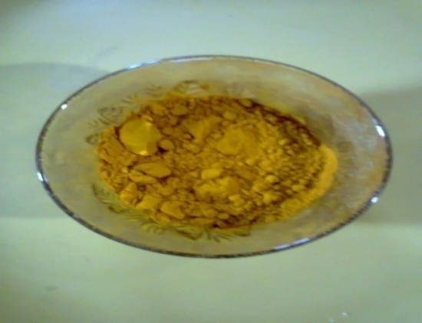
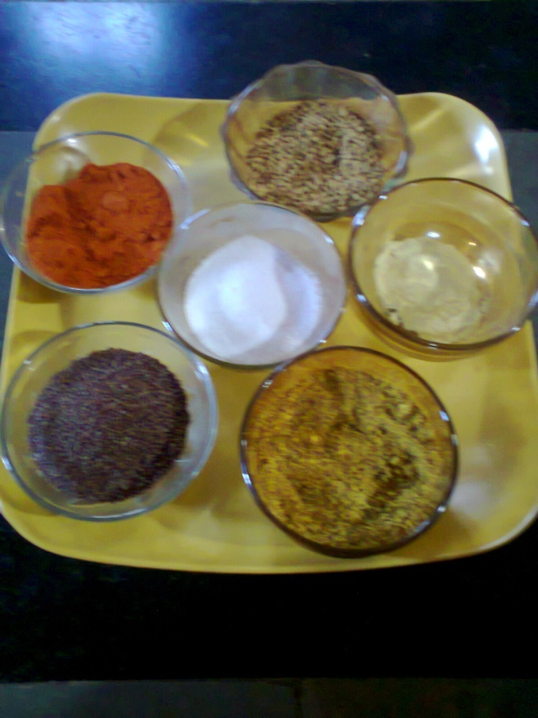
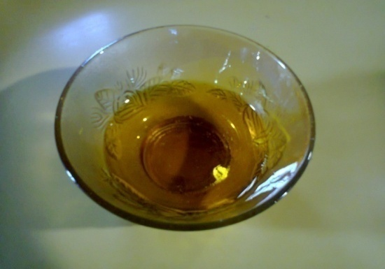
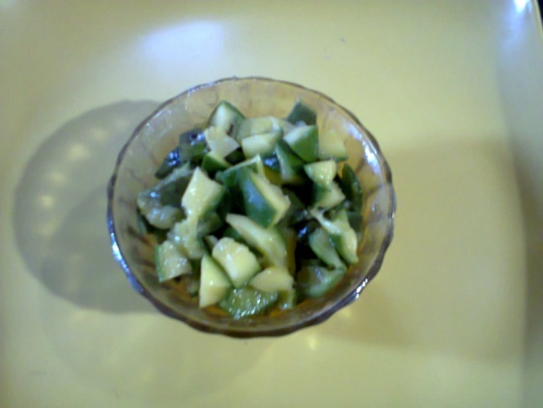
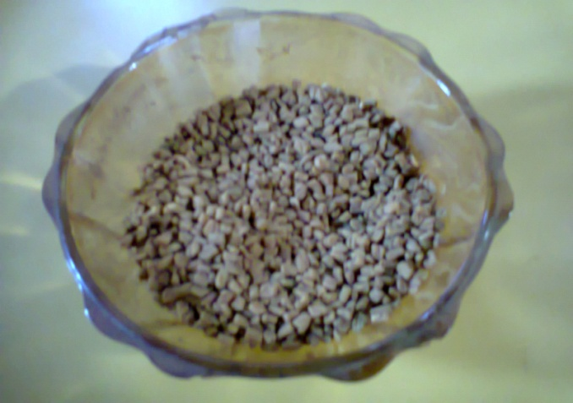
Ingredients
Mangoes
Common Salt
Turmeric powder
Red chili
Edible oil enough to cover the slices of fruits
Black Pepper
Mustard seeds
Fenugreek (methi)
Asafoetida (Hing)
Please refer again the presentation to get to know the role of preservatives we are adding please click the link FOOD PRESERVATION BY SALT, ACID, SUGAR AND CHEMICAL PRESERVATION.pptx

Slide 4
Proportion of Ingredients
Pieces of fruits / vegetables - 1Kgs
Common salt - 100 gms
Turmeric powder - 20 gms
Asafoetida (Hing) - 20 gms
Red Chili powder - 30 gms
Black Pepper(Miri) - 25 gms
Mustard seeds - 125 gms
Fenugreek (Methi) - 30 gms
Edible Oil / Mustard Oil - 250 gms

Slide 5
Procedure
Select under ripe but fully developed varieties of mango fruits. They should be of medium size, sound and free from damages.
Clean the fruits in running cold water.
Wipe the fruits with dry cloth.
Cut the fruits in to 4 halves or suitable size.

Slide 6
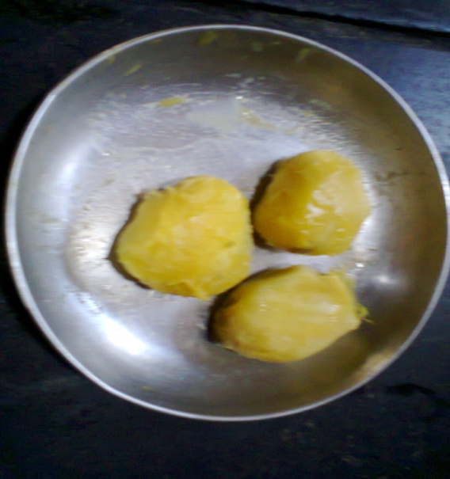
Procedure continued……
Remove the seeds / unwanted parts.
Mix the slices with common salt powder and shake well for proper mixing.

Slide 7
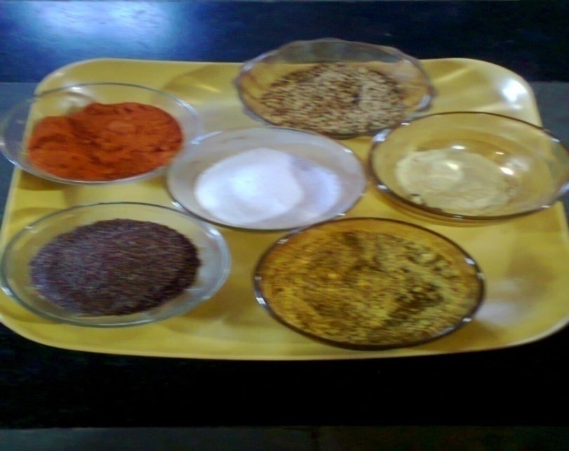
Procedure continued……
Mix all the ingredients with solid slices and smear with a little oil.
Transfer the pickle into clean dry
glass jar and press the lid
thoroughly to remove air
pockets.

Slide 8
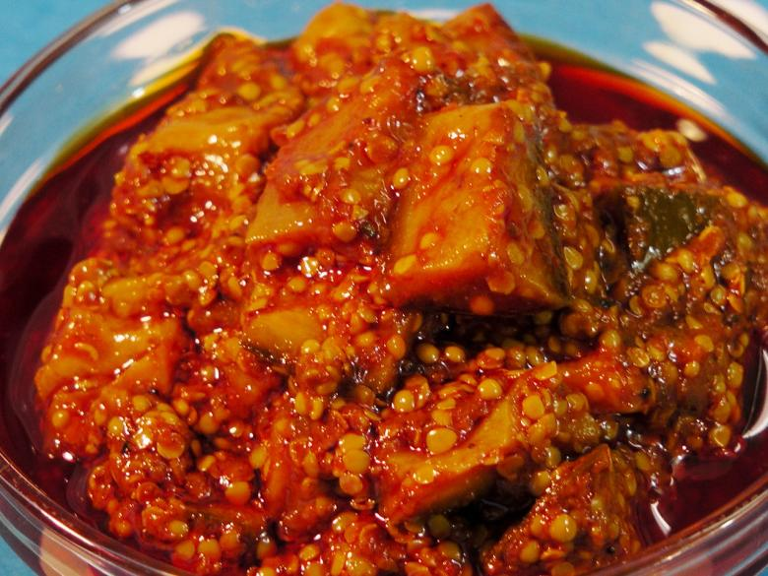
Procedure continued……
Your mango pickle is ready now.
Add hot edible oil sufficient to leave a thin layer at the top.
After 3 to 4 days, examine the pickle and add a little quantity of oil if needed.
Pack the container and store in cool dry place.

Slide 9
Different types of pickles are prepared as per the requirement, availability of fruits, tastes , period of consumption etc.
Pickles are prepared from some fruits and vegetables as under.
Mango, Lime, Cucumber, Carrot, Green chilies, Garlic, Brinjal, bitter gourd, tomato, mixed pickle etc.

Slide 10
Thank You

