Slide 1
Preparation of Peanut(groundnut) brittle

Slide 2
Introduction
Peanut chikki is a healthy, delicious traditional candy made from peanut(groundnut) and jaggery. It can be eaten alone or with snacks and is perfect replacement for chocolates.

Slide 3
Ingredients
Groundnuts : 1 cup
Jaggery : ¾ cup (grated or finely chopped)
Ghee: 1 tablespoon + for greasing

Slide 4
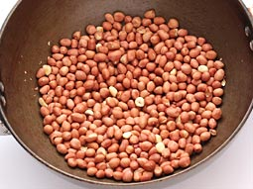
Recipe
Roast peanuts in a pan (preferably heavy based pan) on medium flame for approx. 5-6 minutes. Stir constantly to prevent burning.

Slide 5
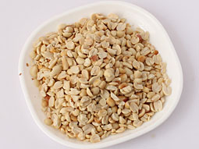
Recipe continued…
Let roasted peanuts cool for 3-4 minutes. Remove its skin while they are little warm and break them into halves.

Slide 6
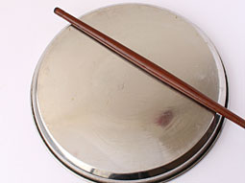
Recipe continued…
Grease surface of counter top or reverse side of a big plate and a rolling pin (belan) with ghee.

Slide 7
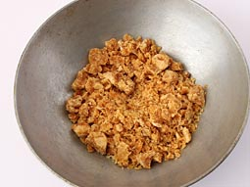
Recipe continued…
Heat ghee in a heavy bottomed pan over low flame. Add jaggery and stir continuously on low to medium flame.

Slide 8
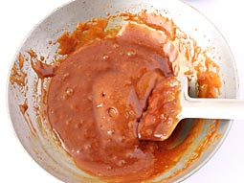
Recipe continued…
When jaggery dissolves, stir and cook for approx. 4-5 minutes on low flame.

Slide 9
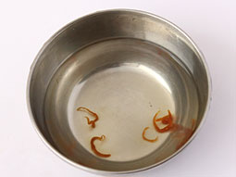
Recipe continued…
Check consistency of dissolved jaggery by dropping a small drop of it in a bowl filled with water. If jaggery drop turns into a solid drop and sits at the bottom of bowl, then it is cooked otherwise cook it for some more time and repeat the check.

Slide 10
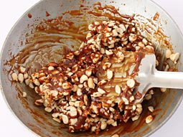
Recipe continued…
Turn off flame and add peanut halves. Mix until all peanut halves are coated with dissolved jaggery.

Slide 11
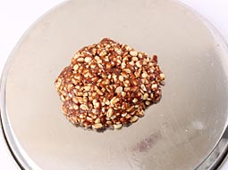
Recipe continued…
Pour mixture over previously greased surface.

Slide 12
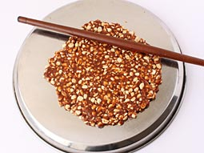
Recipe continued…
Quickly roll the mixture flat using rolling pin. Keep it’s thickness around 1/3 inch.

Slide 13
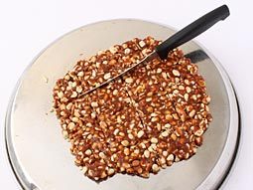
Recipe continued…
Make approx 2 inch apart parallel horizontal and vertical cuts with knife while spread is still hot.

Slide 14
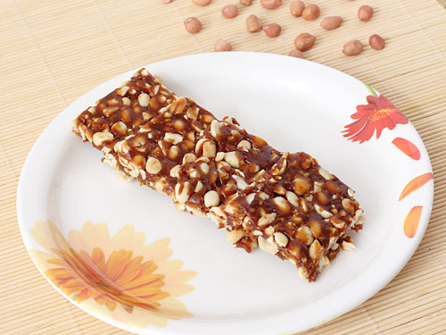
Recipe continued…
When cooled, break into pieces and store in airtight container and enjoy it whenever you like.

Slide 15
Thank You
Source - http://foodviva.com/snacks-recipes/peanut-chikki-recipe/

