Slide 1
Role of Preservatives used in Pickle Preparation

Slide 2
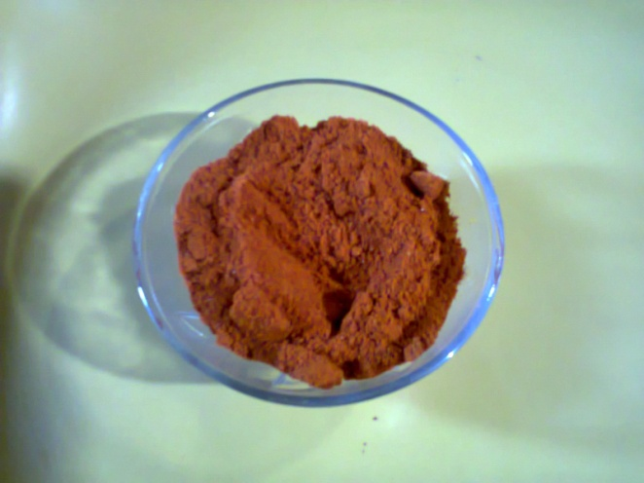
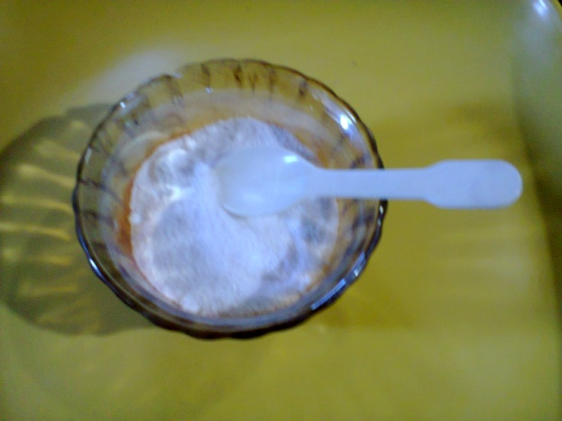
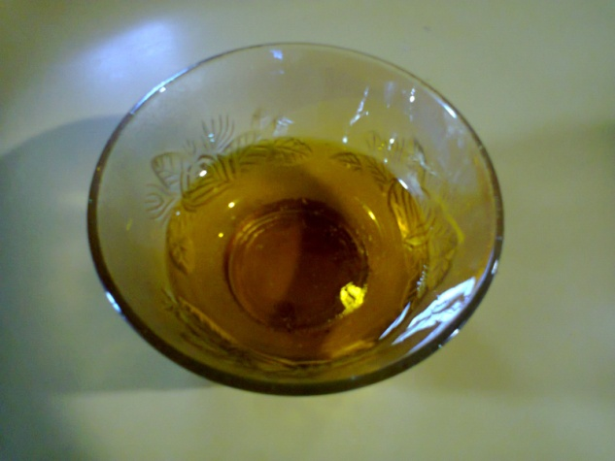
Food Preservatives
Salt
Spices
Oil

Slide 3
Role of Salt
Salt is the well known ingredient as a flavoring agent and food preservative.
Salt has been used by humans to preserve food for many thousands of years, but salt also plays other, lesser known roles in the food we eat.

Slide 4
Role of Salt as Preservative
Salt is an essential nutrient, it provides flavor, texture, and enhances color.
Salt can be found in just about every food item.
Salt acts as a preservative by drawing out moisture from food, which is essential to microbial growth.
Many microbes are unable to grow in the presence of salt.
Salt in food changes composition of the food and osmosis starts in the food which results in water comes out of the food. When there is less water in the food there is less growth of the microorganisms.
Salt is used in pickle, chutney, sauce etc.

Slide 5
Role of Oil as Preservative
Oil acts as a barrier to prevent the pickles from becoming dry (loss of moisture via evaporation).
Oil puts an oxygen exclusion layer over the items being pickled. If the acid content is not sufficient, it provides an environment for pathogen growth.

Slide 6
Role of Spices as Preservative
Spices help to kill pathogenic microbes and control growth of bacteria.
Spices have been used for centuries as preservatives. Spices alone are not sufficient to preserve pickles.
Antimicrobial effectiveness is a function of acids, spices, salt, sugar, oil, fats, proteins, and moisture level.
Spices interact synergistically with the other factors to increase preservation effect. If the other factors held constant, addition of spices increases the effectiveness.

Slide 7
Thank You

