Slide 1
Food Preservation

Slide 2
Products of food Industry are consumed by human beings
Foods are living systems

Slide 3
FACTORS OF SPECIAL IMPORTANCE
SAFETY : Since foods are living systems, biochemical and microbiological changes take place continuously.
NUTRITIVE VALUE: Composition; carbohydrate, protein, fat, vitamin, mineral etc. contents. Changes in these components during processing, storage and other phases of food chain.
ORGANOLEPTIC PROPERTIES:
* Flavor (smell and taste)
* Color
* Texture (perceived mouth feel)

Slide 4
Microorganisms (bacteria, yeasts, moulds, algea, viruses)
Play an important ecological role in realizing geochemical cycles; convert reduced forms of carbon, nitrogen and sulfur in dead plants and animals to oxidized forms required by plants which in turn are consumed by animals

Slide 5
Typical life cycle of living tissues
Development/growth (metabolic,biosynthetic reactions)
↓
Maturation
↓
Ripening
↓
Senescence (catabolic, degradative reactions)
↓
Deterioration

Slide 6
Rate of deterioration is subject to various environmental influences:
Temperature
Humidity
Light
Composition of atmosphere w.r.t. CO₂, O₂, ethylene and some other volatiles

Slide 7
The basic idea behind all forms of food preservation is either:
To slow down the activity of disease-causing bacteria
To kill the bacteria altogether

Slide 8
Enzyme : Proteins in the food which act as catalyst for chemical reaction.
While destroying bacteria using preservation techniques, you may end up in destroying enzyme. Which results in loss of colour/flavour

Slide 9
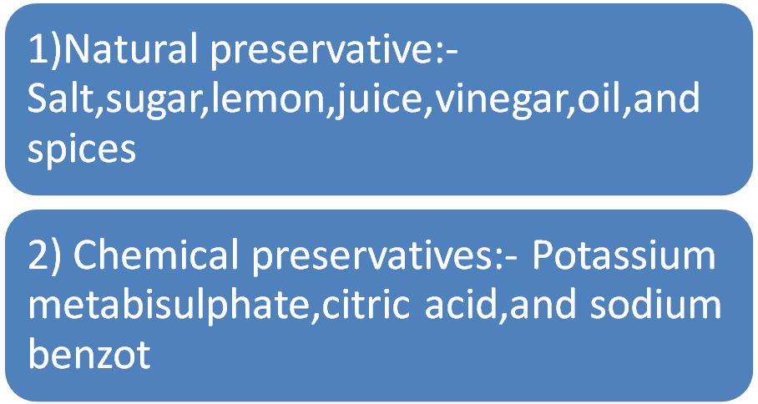
Types of preservation Method

Slide 10
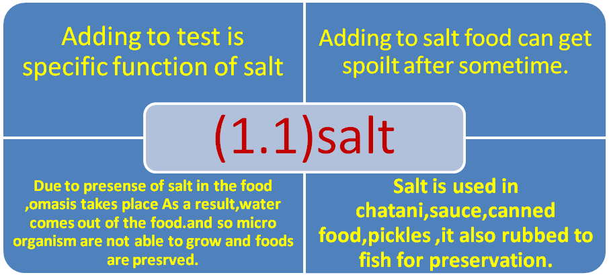

Slide 11
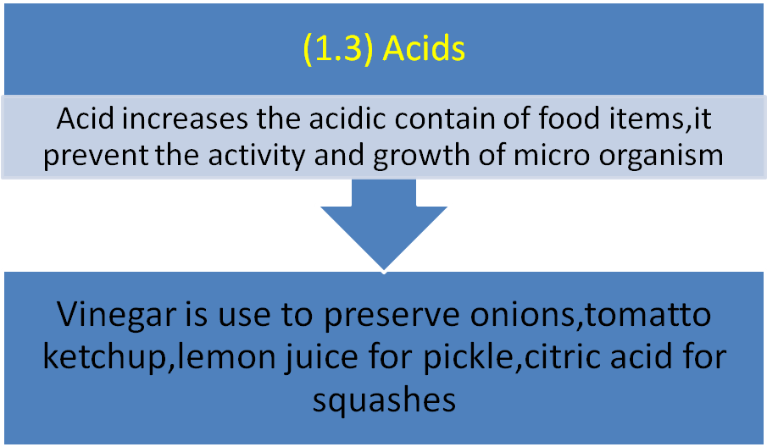

Slide 12
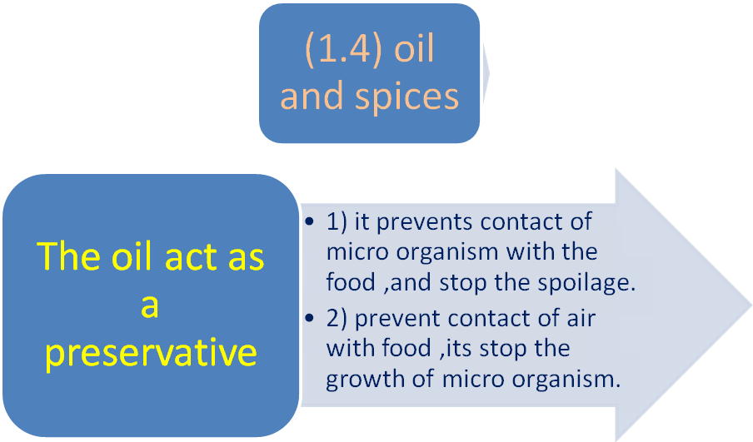

Slide 13
Other Food Preservation Methods
Refrigeration and freezing
Canning
Irradiation
Dehydration
Freeze-drying
Salting
Pickling
Pasteurizing
Fermentation
Carbonation
Cheese-making
Chemical preservation

Slide 14
Refrigeration and Freezing
If the temperature is low, foods are preserve because low temperature slows activity of microbial and enzymes.
The food is prevented from spoilage.
Refrigeration – 4⁰ c to 7º c It Slow down the bacterial action
Cold storage - 1⁰c to -4º c
Freezing -18 º c or below Stop the bacterial action altogether
Freezer has no effect on food but fruits become mushy in freeze

Slide 15
Canning
Boil the food and seal into can.
Sterile until you open the can. Bacteria growth starts afterwards
Canned food changed in colour and texture

Slide 16
Dehydration
Powdered milk
Dehydrated vegetables
Powdered soups
Dried ready to eat product like Halwa mix, pooran poli mix
Since most bacteria die or become completely inactive when dried, dried foods kept in air-tight containers can last quite a long time.

Slide 17
Freeze-Drying
In freeze-drying, food is frozen and placed in a strong vacuum. The water in the food then sublimates -- that is, it turns straight from ice into vapor.
At Vigyan Ashram, we also have de-humidifier.. Which removes the water by passing on dry air

Slide 18
Salting,
The salt draws out moisture and creates an environment inhospitable to bacteria.
- Pickle – Lemon / mango / fish are salted

Slide 19
Pickling
Salting : Soked in salt water for several days.
Acid / Vinegar (Acidic acid) added. Acidic acid inhibits bacteria.

Slide 20
Increasing Temperature
By increasing the temperature enzymes and micro organisms are destroyed. We use two methods for foods preservation by increasing the temperature
1) Pasteurization (2) sterilization
1) Pasteurization:- In this method foods are heated to a high temperature and then quickly cooled. The micro organisms are not able to with stand the sudden change in temperature and are destroyed. E.g Milk
2) Sterilization:- The foods are exposed to high temperature for longer time and in some case under pressure.

Slide 21
Pasteurizing
Heating it to a high enough temperature to kill certain (but not all) bacteria and to disable certain enzymes, and in return you are minimizing the effects on taste
Milk, for example, can be pasteurized by heating to 145 degrees F (62.8 degrees C) for half an hour or 163 degrees F (72.8 degrees C) for 15 seconds

Slide 22
Fermenting
Fermentation uses yeast to produce alcohol. Alcohol is a good preservative because it kills bacteria. When you ferment grape juice you create Wine, which will last quite a long time (decades if necessary) without refrigeration.

Slide 23
Carbonating
Carbonated water is water in which carbon dioxide gas has been dissolved under pressure. By eliminating oxygen, carbonated water inhibits bacterial growth. Carbonated beverages (soft drinks) therefore contain a natural preservative

Slide 24
Cheese-Making
Cheese is way of preserving milk for long periods of time.
milk is inoculated with lactic acid bacteria and rennet
Curd --> Salt --> press --> remove water --> milk + acid + salt = cheese

Slide 25
Chemical Preservation
Benzoates (such as sodium benzoate)
Nitrites (such as sodium nitrite)
Sulphites (such as sulphur dioxide)

Slide 26
Irradiation
Nuclear radiation is able to kill bacteria without significantly changing the food containing the bacteria. So if you seal food in plastic and then radiate it, the food will become sterile and can be stored on a shelf without refrigeration.

Slide 27
Bread
Spongy and tasty
flour, water, sugar, salt, yeast

Slide 28
yeast (a single-cell fungi) will eat sugar, and from the sugar create alcohol and carbon dioxide gas as waste products. The carbon dioxide gas created by yeast is what gives bread its airy texture, and the alcohol, which burns off during baking, leaves behind an important component of bread's flavor.

Slide 29
Jelly, jam are made from fruit mixed with sugar and pectin. The difference between them comes in the form that the fruit takes.
In jelly, the fruit comes in the form of fruit juice.
In jam, the fruit comes in the form of fruit pulp or crushed fruit (and is less stiff than jelly as a result).

Slide 30
Pectin is an undigestible carbohydrate (fiber). It is found in the cell walls of most fruit. When heated with sugar in water, it gels, giving jam, jelly and preserves their thickness

Slide 31
Food Industry
Purchase of raw material
Processing
Storage , packaging
Transport and distribution
Market storage and retail , shelf life

Slide 32
Industries Supplying to Food Sector
Packaging : Cans, jars, pouches, plastics, cartons, papers, wood, metal, laminates, printing houses etc.
Chemical Industries: Additives such as acidulants, preservatives, emulsifying agents, enzymes, stabilizers, coloring materials, fertilizers, insecticides, sanitizing agents, pesticides, various other chemical sprays.
Machines, Maintenance and Repair Requirements: Farming, harvesting machinery, processing lines, distribution vehicles, spare parts, lubricants etc.

Slide 33
Source : These notes are prepared From various internet websites. Especially www.howstuffworks.com
Presentation is prepared for conducting DBRT lesson at Vigyan Ashram

