Slide 1
Cooking Stoves
Energy & Environment

Slide 2


Why is it important to cook food?
Makes it safe to eat
Kills bacteria, prevent illness and disease

Slide 3
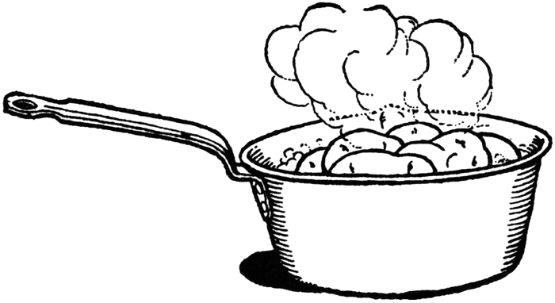
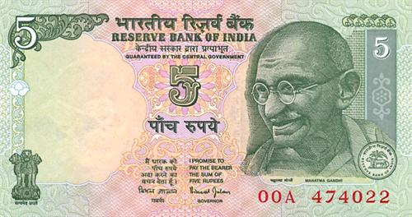
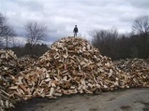
Fuels
Cooking uses over 50% of the energy used by a rural family
The average rural family spends 20% or more of its income purchasing wood or charcoal for cooking
The normal method of cooking uses about 8 kgs of firewood to cook food for a family of five.
8 kgs
Notes:
1 liter of Kerosene for lighting vs. 400-600kgs of firewood per
household per month for cooking.

Slide 4
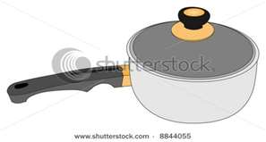
Standard approaches to conserving cooking fuel
40% less fuel
Use a cooking lid
How does this work?
40% less fuel
Use a stove that can heat more than one pan

Slide 5

Revision: Trapping Heat
Prevents convection
Convection is when hot air particles travel to cool areas
Hot air
Warm air
Warm air
Cold air
40% less fuel needed when a lid is used
Notes:
Trapping heat: Air flow will cool the surface. Therefore air inside the cooker is isolated from the outside air. For better efficiency the collected hot need to be trapped

Slide 6
Revision: Trapping Heat
Prevents convection
Convection is when hot air particles travel to cool areas
Warm air
Hot air
Warm air
Warm air
Hot air
Warm air
Cold air
Cold air
Cooking 2 pots separately
Notes:
Trapping heat: Air flow will cool the surface. Therefore air inside the cooker is isolated from the outside air. For better efficiency the collected hot need to be trapped

Slide 7
Revision: Trapping Heat
Prevents convection
Convection is when hot air particles travel to cool areas
Warm air
Hot air
Warm air
Cold air
40% less fuel needed when pots are cooked beside one another
Notes:
Trapping heat: Air flow will cool the surface. Therefore air inside the cooker is isolated from the outside air. For better efficiency the collected hot need to be trapped

Slide 8
Exercise on using a pot lid
Rupal cooks for her family every day of the week
She uses 8kg of wood per day
How much wood does she use in a week?
Total weight of wood used per week
=7 days x 8kg per day
=56 kg per week
She starts putting a lid on the pot so she uses 40% less fuel. How much fuel does she now use in a week?

Slide 9
Exercise on using a pot lid
Total weight of wood used per week
=7 days x 8kg per day
=56 kg per week
40% saved so still uses
100%-40%= 60% of total fuel
60%= 60
100
So we want to find 56 kg per week x 60
100
56 x 60 =3360 = 33.6 kg per week
100 100
By using a lid Rupal has reduced her fuel use from 56kg to 33.6 kg a week

Slide 10
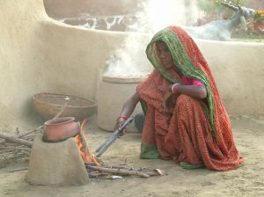
Traditional stone cooking fire-Problems?
Smoke entering into the kitchen room leads to ‘Indoor air Pollution’( IAP)
Every year IAP is responsible for the death of 1.6 million people - that's one death every 20 seconds
Only one cooking pot can be used at a time.
Fire touches bottom of pan
Fire spreads out of cooker
The smoke makes the cooking pots dirty this increases the work load of women.
Thermal efficiency is 5 to 15 %.
Take more time to cook so needs lots of fuel.
This creates a risk of burns and scalds.

Slide 11
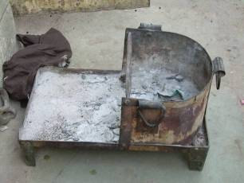
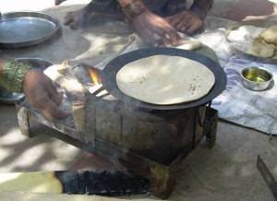
Traditional Urban Chulha
Chula used in urban slum areas
Only cook one item at a time
Exposed flame losing heat to surrounding air.
Same smoke and fuel problems as traditional stone cooking fire

Slide 12
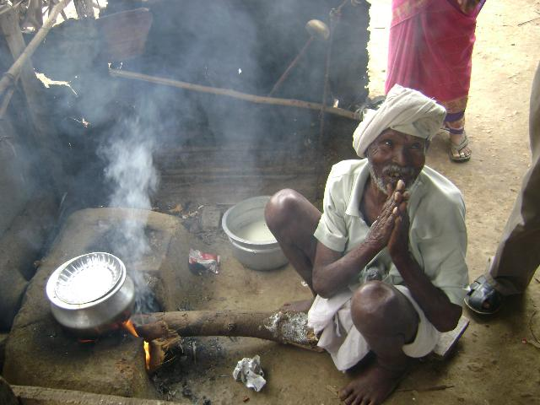
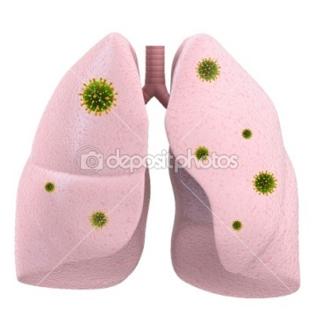
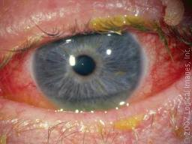
Problems with Traditional Chulha: Smoke
Every year 500,000 women and children die in India due to long term exposure to smoke in rural kitchens.
The smoke causes:
Eye problems
Lung problems
User and family exposed to smoke
Family members often need to climb on the roof to clean the chimney. This has been blamed for many accidents.
Notes:
Insert picture of lung and eye

Slide 13
Problems with using wood as a fuel: Time & Money
Women and children have to spend time collecting wood.
Women could be earning money and children could be at school
  The cost of wood is going up in urban areas
This means less money to spend on food, education, and medical care. An improved cooking stove can help boost a family's income

Slide 14
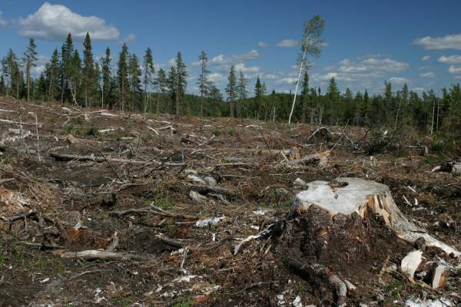
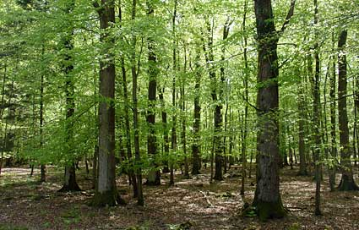
Problems with using wood as a fuel: Deforestation
Quality of the land will decrease
Erosion will increase
Flooding may increase
Diversification will decrease
Reduced quality of air
Runoff is increased so ground water recharge is minimised
  The main goal of most improved cooking stoves is to reduce amount of wood the stoves consume

Slide 15
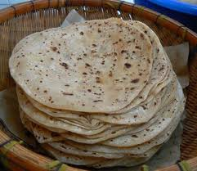
A better cook stove needs to:
Minimse fuel usage
Cook two things at once
So we have seen the problems with using a traditional wood stove and what is needed to make it better….
Reduce the smoke emitted towards the user
Use different biomass fuels
Easy to build from local materials
Accept different cooking vessels
Now lets look at some improved stoves
Cook different things rice, chipatti etc

Slide 16
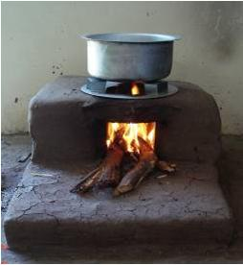
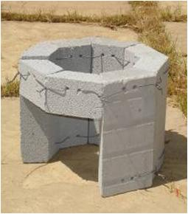
Bharatlaxmi stove
Fixed improved single pot hole stove
No behavioural change required
50% less fuel
Affordable to rural population
Price of stove: INR 500
30% less cooking time
8 bricks of insulating cement
Metallic pot holder
metallic wire for tying the bricks together
The stove needs to be installed in a mud and brick platform.
Notes:
http://www.samuchit.com/index.php?option=com_content&view=article&id=1&Itemid=3

Slide 17
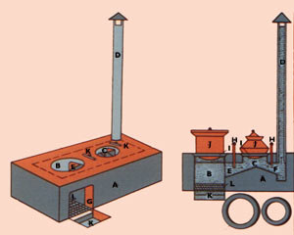
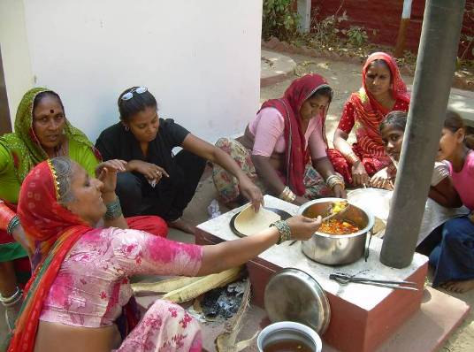
The Smokeless Chulha
Vent lid to stop rain and animals entering
Vents smoke out of room with a chimney
Two pot holders
80% of heat
cooking
It traps smoke and heat inside
20% of heat
Keeping food warm
Notes:
http://blog.indicorps.org/wp-content/uploads/2009/11/Shaila.pdf.

Slide 18
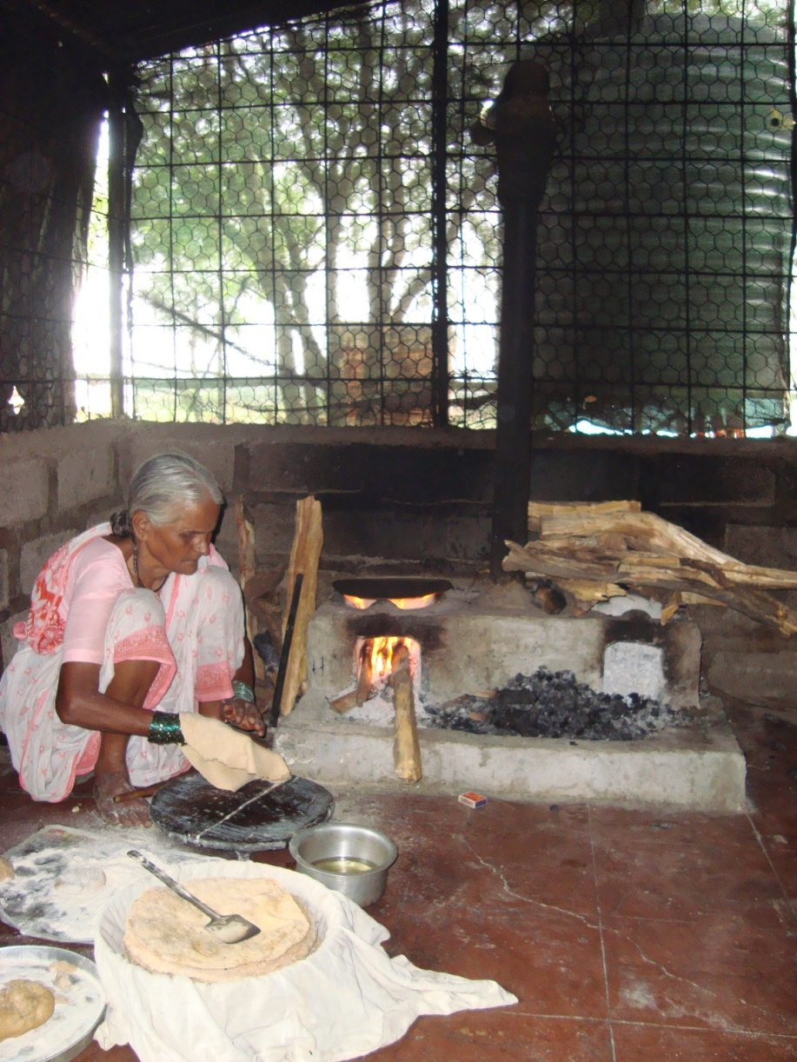
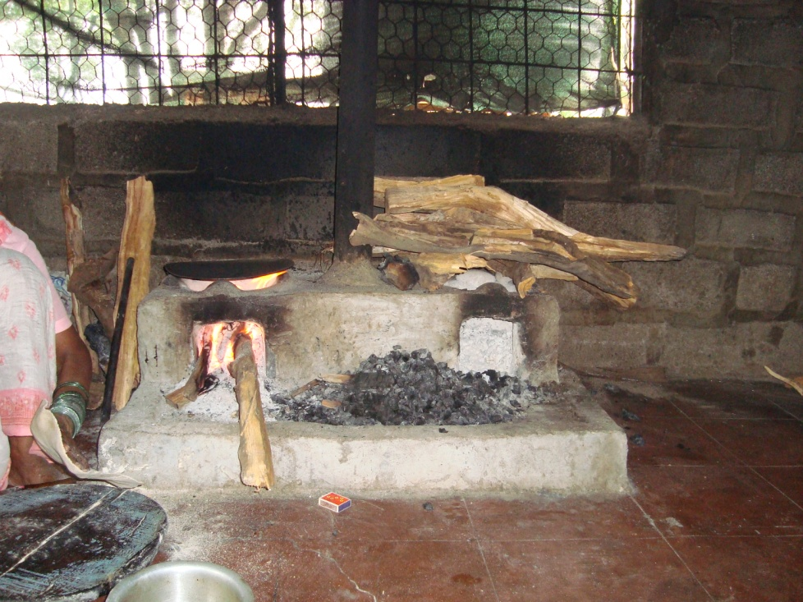
Smokeless Chulha at Vigyan Ashram

Slide 19
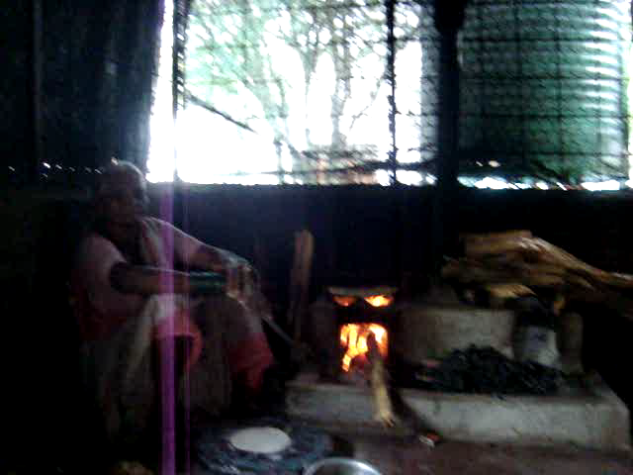
Smokeless Chulha at Vigyan Ashram

Slide 20
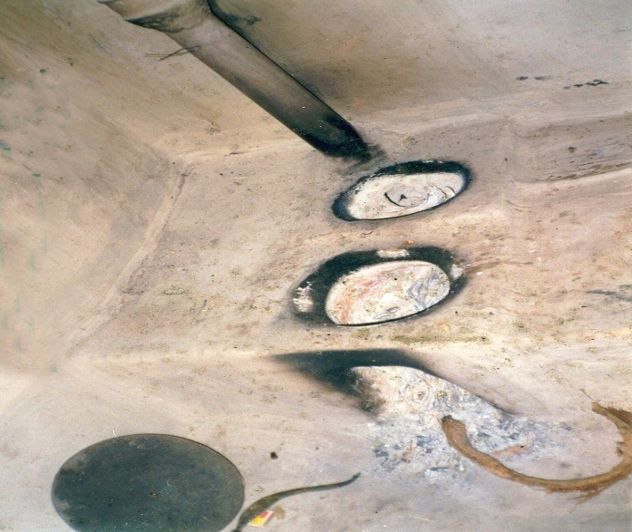
Materials needed for Smokeless Chulah construction
Bricks or mud made out of
  Clay – 1 Part
  Sand – 5 part
  Bhoosa or paddy husk or cow dung.
Chimney made from cement pipe.
(Metal pipes will get too hot and plastic pipes may melt)
Cap on the chimney top, to protect from rain, animals and sparks

Slide 21
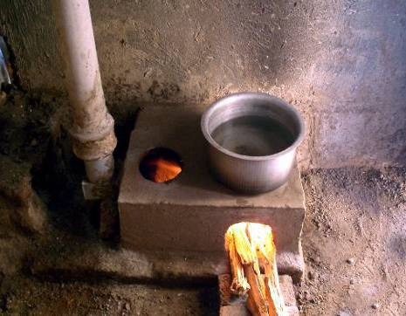
Laxmi Stove
50% less fuel
50% less smoke
Two dishes can be cooked at same time
Any household pot can be placed on top of the stove
Chimney
60% heat
40% heat
Pots sit flush on the potholes, so the gases do not escape into the kitchen
Manufactured by local worksphops that own a mold
Price of Mold: INR 2000
Fixed Cement stove

Slide 22
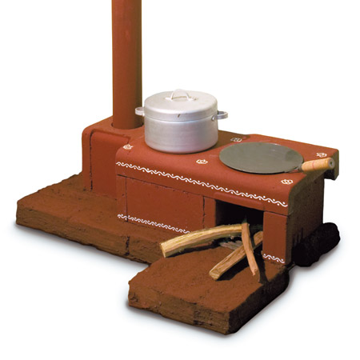
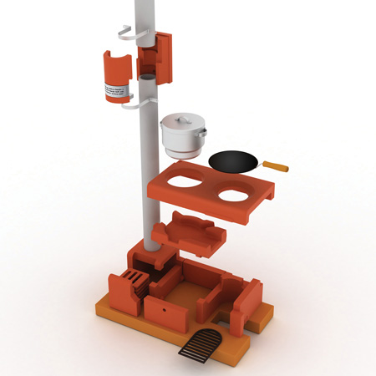
An Improved Sampoorna Smokeless Chulha from Philips
Indoor access for cleaning
Chimney made from several sections, easier to manufacture and transport and clean
90% less smoke
Stack of clay tablets that clean the exhaust
Notes:
•

Slide 23
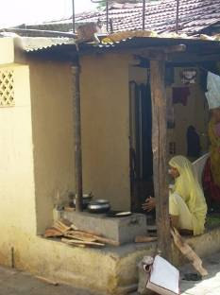
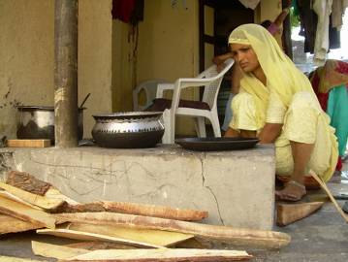
This smokeless chulha was constructed but can you see anything wrong?
The pipe is cut too short. The smoke will collect under the roof
The pans expanded with the heat of the fire and cracked the stove
This can be prevented by placing a metal sheet on the top of the stove

Slide 24
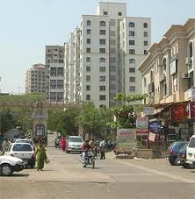
Now popular in urban areas too!
Many people living in cities miss the food cooked on chulhas.
The modified chulhas can be easily installed in flats or urban homes, as they do not emit smoke and require less fuel.

Slide 25
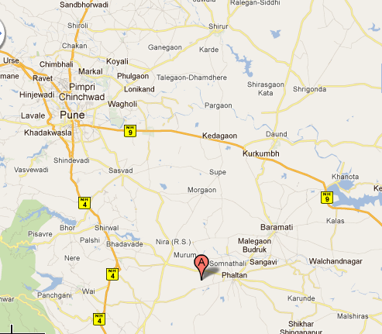
Case Study of Good Use
30% less fuel
80% less smoke
Village Nandal is now a smoke free village. Every family in this village is now a proud owner of a Bharatlaxmi Stove.
30% less cooking time
Notes:
Need to check this photo

Slide 26
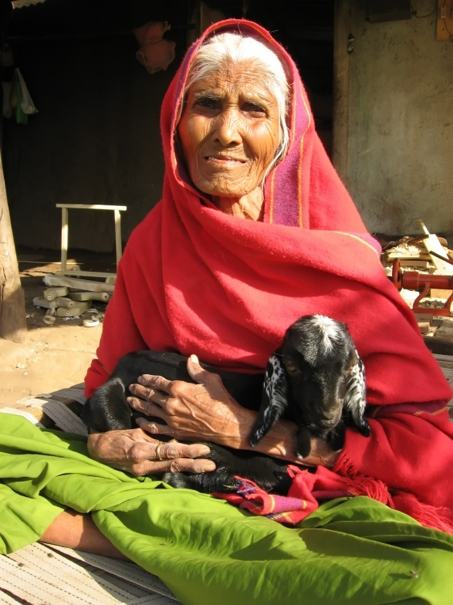
Benefits of Smokeless Chulha
Reduces deforestation
I don’t need to clean my house as much
I use 30% less wood
My eyes used to water
Reduced risk of carcinogenic fumes
Cooking is finished within half the time
No smoke in the house
Reduced risk of eye injuries
Thermal efficiency increased by 25%
Risk of burns reduced from open flames
Affordable and made with local materials

Slide 27
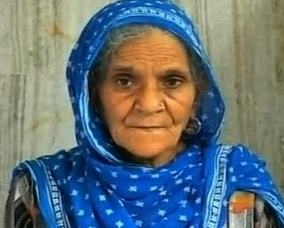
But some people don’t want them
I do not want a permanent structure.
I do not have enough money
I do not have enough room in my home
I am planning to upgrade to gas in a few years

Slide 28
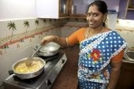
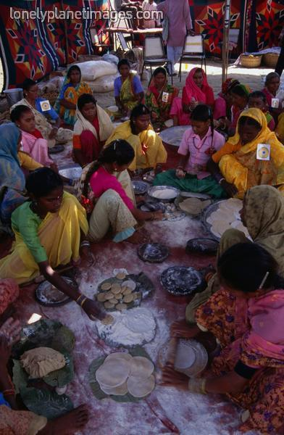
Other types of stove….

Slide 29
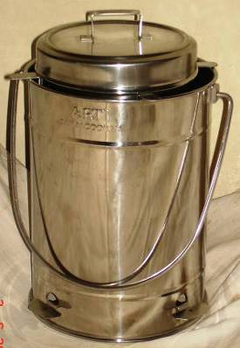
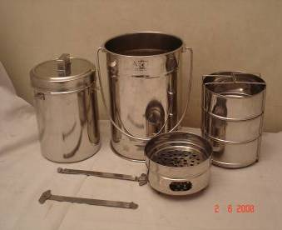
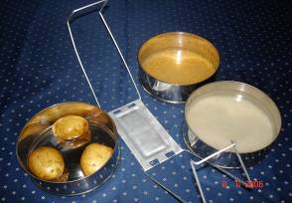
Sarai Cooking System
Portable even when cooking
Cooks by steam & retaining heat
Can be left unattended
Keeps food warm for 3 hours
Cleanest ways of using charcoal for household cooking
Price of Stove: Medium: INR 1150

Slide 30
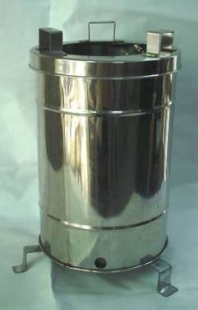
Sampada Gasifier Stove
Fuel=dry twigs & wood chips
Portable metallic stove
Can cook for 1hr
Charcoal is left behind in the fuel holder after cooking
Price of Stove: INR 1500
Notes:
Emission Results
(for cooking 2.5 lit of food)
CO = 8.1 gm
Particulate Matter = 69 mg
Already about 500 stoves sold, growing demand from all over the state.
Price of Stove: INR 1500 (USD 38, Euro 25)

Slide 31
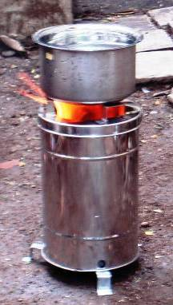
Sampada Gasifier Stove Excersise
After cooking, charcoal is left behind in fuel holder.
Burning 1 kg of wood, leaves 250gm of charcoal.
Cost of fuel wood (1 kg) = Rs. 2
Value of charcoal (250 gm) = Rs. 3
What is the profit gained every time this stove is used?
Profit=value earned-value spent
=Rs. 3-Rs.2
=Rs. 1
If you used the stove 3x a day. How many days would it take to break even? The stove costs Rs. 1500

Slide 32
Sampada Gasifier Stove Exercise
Profit gained every time used=value earned-value spent
=Rs. 3-Rs.2
=Rs. 1
If stove used 3x a day. Then profit gained every day
=3 times x profit per use
=3 x Rs. 1
=Rs.3 profit per day
Days to pay for stove
=Price of stove ÷ profit per day
=Rs. 1500 ÷ Rs.3
=500 days
Years to pay for stove
=500 days ÷ 365
=1 year and about 5 months

Slide 33
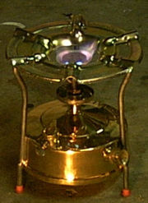

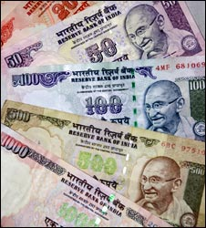
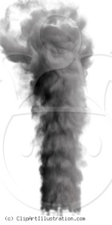

Kerosene Burners or Primus stove
Factor | Kerosene | Wood
Cost | Subsidized by the Government of India | Cheap in rural area but expensive in cities
Availability | Subsidized fuel is not always available | Usually available
Pollution | Burns cleaner | Smokey
Taste | ok | Better Taste

Slide 34
Kerosene Burners or Primus stove Exercise
If a family buys 14 litres of kerosene a month. How much does this cost a year?
Buying from government shops Rs.9 per litre
14 liters
x Rs.9/liter
Rs. 126 . Per month
Rs. 126
x 12 months
25 2
+ 1260
Rs. 1512 Per year

Slide 35
Kerosene Burners or Primus stove Exercise
The black market sells kerosene for Rs. 30 per litre. How much would it cost if the family bought their kerosene from the black market 20% of the time?
14 liters
x Rs.30/liter
Rs. 420 . Per month
Rs. 420
x 12 months
840
+ 4200
Rs. 5040 Per year

Slide 36
Kerosene Burners or Primus stove Exercise
For a years supply of kerosene from the government shop it costs Rs. 1512
For a years supply of kerosene from the black market it costs Rs. 5040
The family buy their kerosene from the black market 20% of the time
80% of time from Government shops
=Rs 1512 x 80% =1512 x 80 = 120960 = Rs. 1209.6
100 100
20% of time from the Black market
=Rs 5040 x 20% =5040 x 20 = 100800 = Rs. 1008
100 100

Slide 37
Kerosene Burners or Primus stove Exercise
80% of time from Government shops= Rs. 1209.6
20% of time from the Black market= Rs. 1008
Total cost for 1 year
= 1209.6
+ 1008.0
Rs. 2217 .6
% increase = change in cost x 100
original cost 1
= 2217.6- 1512 x 100
1512 1
= 705.6 x 100
1512 1
=0.47 x 100
1
=47%
So now we can work out the % increase in their annual fuel bill
So even if the family buy their fuel from the black market only 20% of the time. Their annual fuel bill goes up by almost 50%!

Slide 38
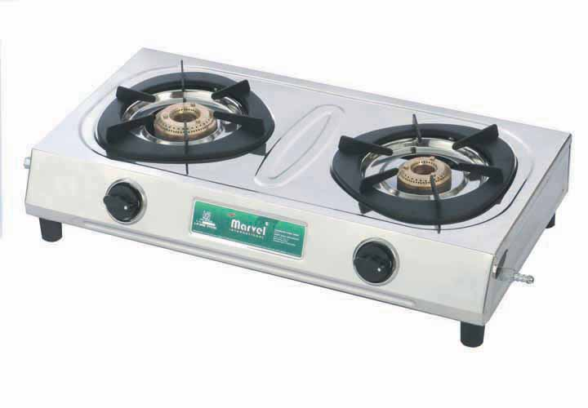
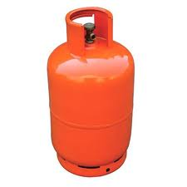
Gas Cooking Stove
Non permanent
Rs. 3,500
From a health and environmental view this is the best option for cooking
A family of 4 cooking uses about 50% less fuel when using gas rather than wood
LPG is subsidized by the government
Many people prefer the taste of food cooked on a wood stove

Slide 39

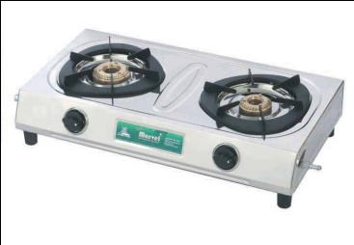
Class Stove Exercise
Calculate the % of the class that have each of the following cook stoves in their homes. Present your findings in a pie chart.
What is the most popular and why do you think this is?
Traditional stone stove
Sampada Gasifier Stove
Gas Cooking Stove
Smokeless Chulha
Kerosene Stove
Traditional urban stove
Sarai Cooking System

