Slide 1
MAKING OF KHICHADI
खिचडी बनवणे

Slide 2
MAKING OF KHICHADI खिचडी बनवणे
Place of Origin of Khichadi – South Asia
Regions & states – Bangladesh, India, Pakistan, Nepal
From 15th century –
khichadi was popular with mughals – especially Jahangir.
In 16th century -
Very popular an anecdotal story – featuring Akbar, Birbal & khichadi.
Very famous as “Campfire food”

Slide 3
MAKING OF KHICHADI खिचडी तयार करणे
A sticker version of rice (khichadi) – is traditionally serve to children & sick people.
It is the first solid that babies are introduced to.
Regional Variations :
In Bengal – Khichadi served with achar, ghee accompanied with curries & fishes specially in rainy days.
In Costal Maharashtra – Khichadi made with Prawns.
In Gujarat – Khichadi serves with Kadhi.
In Bihar - It’s a custom to eat khichadi every Saturday , & also at dinner during Makar sankranti.

Slide 4
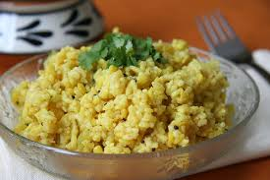
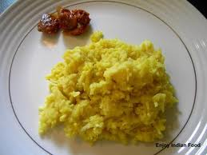
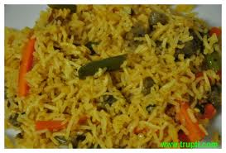
TYPES OF KHICHADI खिचडीचे विविध प्रकार
According to the ingredients used in
वापरल्या जाणाऱ्या पदार्थांवरून

Slide 5
खिचडी बनवताना वेगवेगळ्या इंधनाचा वापर
We can use following as fuel –
Kerosene, Wood, LPG gas.
खिचडी बनवताना आपण पुढील ऊर्जा साधनांचा इंधन म्हणून वापर करू शकतो. त्या आधारे आपल्याला काय फरक जाणवतो त्याची नोंद करून ठेवूयात.
उदा.- रॉकेल, लाकूड, स्वयंपाकाचा गॅस.

Slide 6
Which things need to be consider…? खिचडी बनवताना घ्यावयाची काळजी
Wash your hands
Measure all the ingredients which used
Wash the rice & serials before cooking
Make sure that before cooking utensils are cleaned.
Cook the khichadi with lid.
After cooking keep your food covered.
Use cleaned chopped vegetables for cooking
Use clean, pure water for cooking.
हात स्वच्छ धुतलेले असावेत.
लागणारे सर्व पदार्थ मोजून घ्यावे.
खिचडीसाठी वापरण्यात येणारी धान्ये स्वच्छ पाण्याने धुवून घ्यावीत.
सर्व भांडी स्वच्छ आहेत ना याची खात्री करूनच त्याचा वापर करावा.
अन्न नेहमी झाकून ठेवावे.
खिचडी शिजवताना त्यावर झाकण टाकून शिजवावी.
त्यासाठी वापरलेल्या भाज्या निट धुवून मग चिरलेल्या असाव्यात.
स्वयंपाकासाठी वापरण्यात येणारे पाणी शुद्ध असावे.

Slide 7
Calorific Values of Fuel
Definition of the calorific value :
It can be defined as the amount of heat
liberated in KJ or Kcal by the complete combustion of 1 Kg of fuel.
How to calculate the calorific value : ???

