Slide 1
Welding
Vigyan Ashram, Pabal

Slide 2
What is welding?
Joining of 2 or more metal parts together is called as welding
Permanently joining metal – usually steel, using heat to bring the base metal to its melting temperature.
There are many types of methods in welding but primarily followed are
Pressure Welding
Fusion Welding

Slide 3
Types of Welding Methods
See video of Arc Welding
See video of Gas Welding

Slide 4
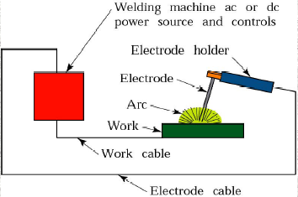
Arc Welding
Two electrodes having electric charge are joined together and seperated .The spark produced due to this is known as arc. Following is the diagram of Arc Welding

Slide 5
Gas Welding
In this type, Cylinders of Highly inflammable gases like Acetylene is used for making a strong flame and the metals are cut or joined through heat produced by these flames.
In this process, Inflammable gas like acetylene is combined with oxygen to enhance the process

Slide 6
Equipments in Gas Welding
Oxygen Cylinder
Acetylene cylinder
Rubber Hose Pipe
Welding Rods
Welding flux
Apron
Wire brush
Hammer
Goggle

Slide 7
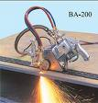
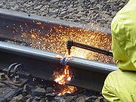
Gas Cutting
Automatic Manual

Slide 8
Gas Welding

Slide 9
Welding Positions
INCREASING DIFFICULTY
FLAT
HORIZONTAL
OVERHEAD
VERTICAL

Slide 10
Types of Joints
BUTT JOINT
FILLET JOINT
STRAP JOINT
CORNER JOINT
LAP JOINT

Slide 11
Reason for accidents in welding
Wrong information
Carelessness in handling equipments
Insufficient lighting at workplace
Congested place
Not using safety equipments

Slide 12
Welding Precautions
Check the Machines conditions regularly
Use of proper safety equipments
Welding should not be done in a congested place
Welding Machine and Main Switch distance must be less

Slide 13
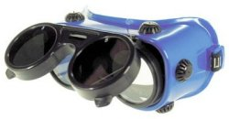
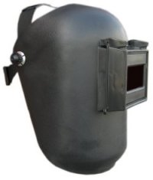
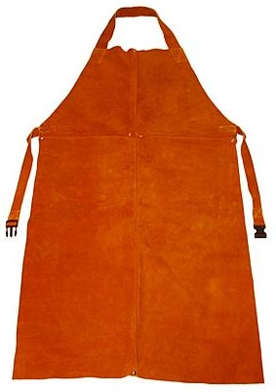
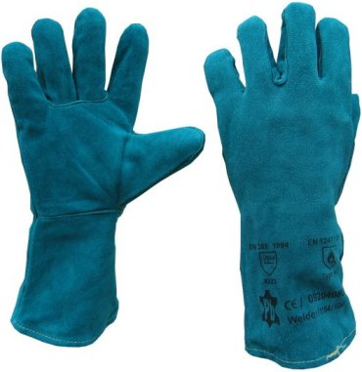
Welding Safety Equipments

