Slide 1
Public speaking and community

Slide 2
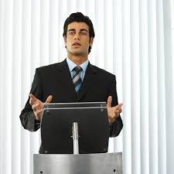
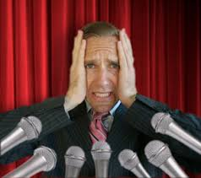
Public speaking
Do you feel confident speaking in public?
Yes
No
Stand this side
Stand this side
Notes:
This lesson has 2 themes: Public speaking and community. They are more related than you think!
Do you feel confident speaking in public? To stand in front of the class and make a speech?
Ask class and direct to opposite sides of the room

Slide 3
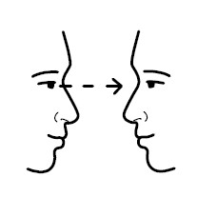
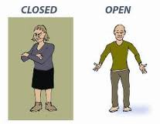
What makes a good speech?
What you say
How you say it
Notes:
What you say: Content – interesting/not boring, speak from the heart, make it funny, engaging, passionate, confident
Get the students to come up with ideas
How you say it
Voice: loud, clear, avoid ums, ahhs
Body language – eye contact, gestures, open body language vs. Closed lang., confident!
Could so a small example speech – bad, then good

Slide 4
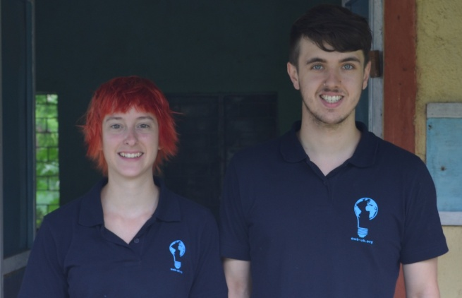
Public speaking
?
?
We will make a speech!
Choose a topic!
We really want feedback!
What did we do well?
What could we improve on?
Notes:
Let the students choose who to do a speech, and what topic on. Speak for 60 seconds. Or could just do communities
Get students to say what we did well, and what we could improve on for next time.
Reinforce the importance of giving feedback – we want to know!
Giving feedback is very important – we need to know how to better next time.

Slide 5
Your turn!
Theme: Community
Everyone will speak for 60 seconds about their community:
One thing you like about it
One thing you would like to change about it
Take a few minutes to think of some ideas
Notes:
Exercise time: 20-25 mins
Sam and I wander about the groups and listen in
Optional extra: Get 3-4 volunteers to stand in front of the class and do their speech.
Catch – they need to be from the ‘not confident’ side of the room!

Slide 6
Your turn!
Get into groups of 6, find some space
Everyone will speak for 60 seconds about their community
Everyone gets feedback after their speech:
2 things they did really well
2 things to improve for next time

Slide 7
Your turn!
Can we have some volunteers to do their speech in front of the class?
Some people that were not confident at the start of the lesson!

Slide 8
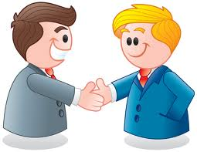
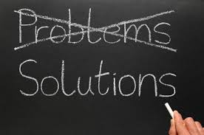
Community
Why is it important for us to contribute to our communities?
What can you gain?
How will your community benefit?
Notes:
Pics: learning, friends, feeling good, part of the community, solving problems, nicer place to live (utopia)
Why is important for us to contribute to our commuities?
What can we gain? – new skills, friends, experiences, feel good, create the community that you want, feel more part of the community, help others, help you get a job
What can they gain? Community is brought closer together, solve real problems, better place to live
Give an example of a young person changing the community
What you wanted to change about your community – who thinks it is in their power to achieve?
This project will give you experience contributing to your community

Slide 9
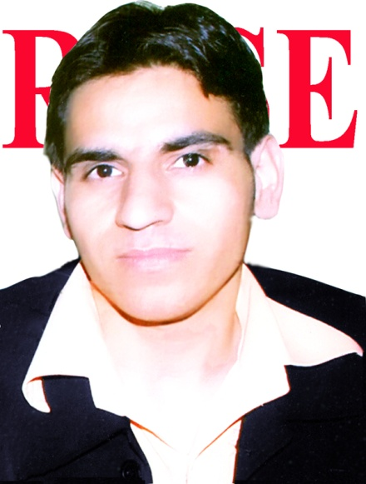
Amit Kataria
“I became an entrepreneur, because I wanted to contribute to the betterment of my village!”
After winning a competition, Amrit started his own business, a computer school, when he was just 19
He realised the potential of making the community more independent by spreading computer literacy
So far, more than two hundred students have successfully completed their courses, and two women have opened their own enterprises
Amrit wants to open branches all over India so every child can be computer literate
Notes:
Amit won the All India ICT Business Competition Award organized by YES and started his own business, a computer school, when he was only 19 years old.
He runs computer courses, and so far more than two hundred students have successfully completed their courses and two women have opened their own enterprises.
I learnt computers and realized its potential in making my community more independent, That’s why I opened ROSE Computer Academy in my village
In the near future I want to expand our and open 2 or 3 more branches near by the villages. My dream is “Literate India”, I want to open ROSE’s branches all over in India so that I can give education every child of my country as well as I want to spread computer literacy all over in India. My aim is to train them in such manner that they can earn their livelihood easily.

Slide 10
Do you feel more confident?
Public speaking – do you feel more confident than before?
Yes
No
Everyone will be giving a presentation in a couple of weeks as part of your project
We will continue to work on these skills
Reminder – stay behind for waste management catch up
Notes:
Mention that everyone will be giving presentations as part of this course
Tell them they all did well!
Homework

