Slide 1
Teamwork and Problem Solving
टीमवर्क आणि समस्या सोडवणे

Slide 2
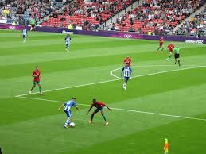
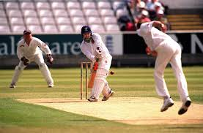
Teamwork टीमवर्क
Why is it important? हे का महत्वाचे आहे?
What makes a good team?
कशामुळे एक चांगला गट तयार होतो?
It helps us to achieve goals!
Notes:
Why is it important? [5mnis]
Achieves goals, different people can contribute different strengths
Sports are a good example of everyone having to work together. Everybody has a different role but is working towards a common goal.
What makes a good team?
Listening, supporting each other, communicating openly, resolving conflict

Slide 3
Problem Solving
समस्या सोडवणे
We have a problem. How do we solve it?
Identify the problem समस्या शोधून काढा
Think of solutions त्यावरील उपयान्संबंधी विचार करा
Make an action plan त्याचा एक कृती आराखडा तयार करा
Evaluate मग त्याचे मूल्यमापन करा
Implement तो प्रत्यक्षात वापरा
Notes:
[5mins]
Pic – us looking worried!

Slide 4
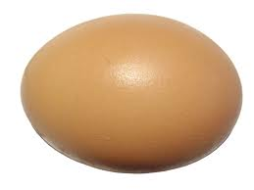
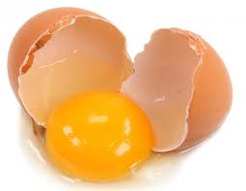
The problem
The task: You will be dropping an egg from table height
एक कृती : तुम्ही टेबल च्या उंचीवरून अंडे खाली टाकत आहात
The problem: The egg will break unless you do something about it!
समस्या : ते अंडे फुटणार आहे जर तुम्ही त्याविषयी काही केले नाही तर.
We are going to eat them for dinner and will go hungry if they all break!
आपल्याला ती अंडी रात्रीच्या जेवणासाठी हवी आहेत जर सगळी अंडी फुटली तर आपल्या सगळ्यांना उपाशी राहावे लागेल.
Notes:
[Slide 4 and 5 – 5 mins]

Slide 5
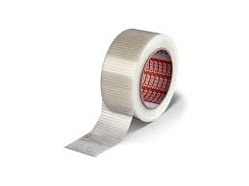
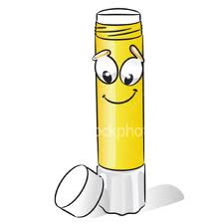
The goal
The goal: Using the materials provided, build a device to stop the egg from breaking.
उद्दिष्ट : देलेल्या साहित्याच्या आधारे एक अशी वस्तू बनवा ज्यामुळे अंडी फुटायची थांबवता येतील.
Get into teams of 6
Will you choose roles?
You could have a leader, a timekeeper etc...
Materials:
Notes:
Have the materials be worth tokens! Limited supply of tokens per team
Cardboard, newspaper, toothpicks, glue, tape, scissors - pictures

Slide 6
Creating solutions: त्यावरील उपयान्संबंधी विचार करा
Brainstorming ideas: अतिशय वेगळ्या कल्पना
Write down as many ideas as you can
Make sure everyone contributes.
Evaluating ideas: मूल्यमापनाच्या कल्पना
How will the idea to put into practice?
Do you have enough time and resources?
Choose the best idea
2 minutes!
5 minutes!
Notes:
Brainstorming – don’t discuss in depth, just write them all down!
Who has the best ideas? – The person who shouts the loudest? No anyone can – make sure everyone gets heard

Slide 7
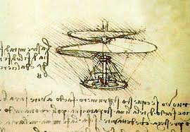
Making a plan! त्याचा एक कृती आराखडा तयार करा
What materials will you use to build your device?
How will you build it?
Make a quick sketch of your solution
10 minutes!
Notes:
Get the students to ‘buy’ materials with tokens

Slide 8
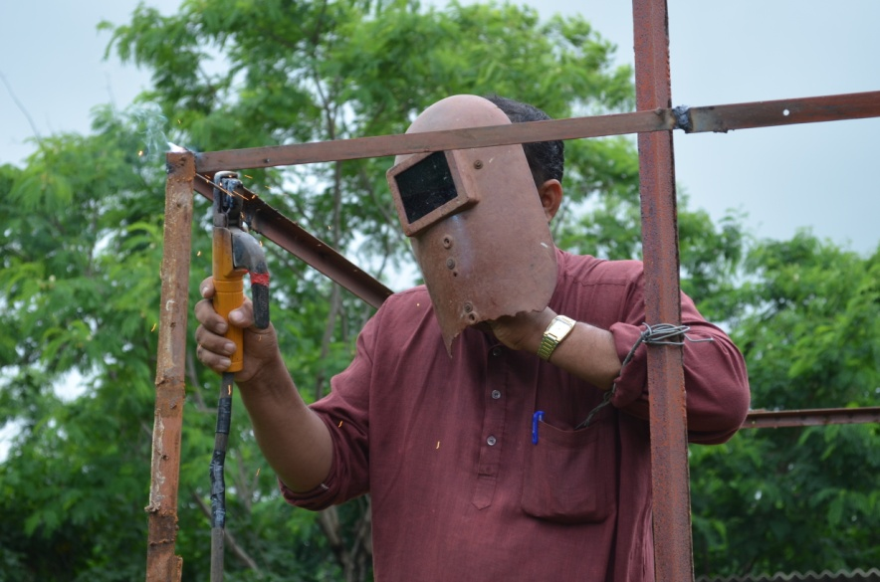
Implementing तो प्रत्यक्षात वापरा
You have 10 minutes to build you egg protecting device.
Remember to work as a team!
Lets test!
10 minutes!

Slide 9
Reviewing पुनर्विचार करणे
Discuss in teams:
What went well?
काय छान झाले?
How did you work as a team?
तुम्ही एक गट म्हणून कसे काम केले?
What could you improve for next time?
पुढील काळात तुम्ही काय सुधारणा करू इच्छिता?
What was your role in the team?
तुमच्या गटात तुमची भूमिका काय होती?
10 minutes!
Notes:
Have a team discussion, get the teams to talk about the following:
(What went well?) How well did the team work together? What could you improve for next time?
Ask the teams how they worked as a team/what they could improve
Role in the team
Get everyone to say what their role in the team was.
Ask people at random to say how they contributed
Did you put ideas into action?
Did you make sure the project was finished on time?
Did you coordinate team members to work together?
Did you act as the leader?
Did you present new ideas?
Did you analyze the options?

