Slide 1
Grey Water - 3

Slide 2
Presentation Scope
In this presentation you will learn:
  Basic terminologies used in grey water treatment

Slide 3
Important terminologies used in grey water treatment
Important terminologies used in grey water treatment process :
Storage and Sedimentation
Aeration
Coagulation
Roughing Filters

Slide 4
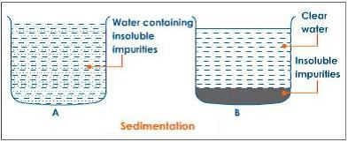
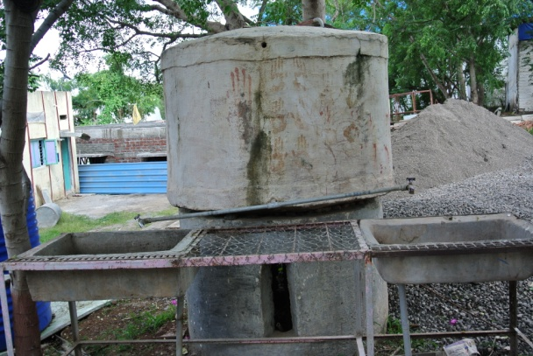
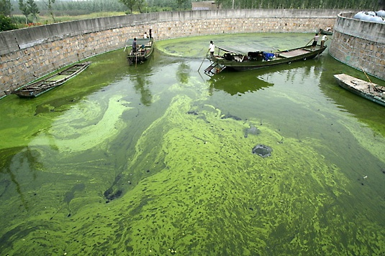
Storage and Sedimentation
Sedimentation
Natural settlement of solids
Natural die off of pathogenic bacteria.
Maximise settlement time
Sunlight can reduce bacteria in open storage tanks. However in the presence of organic matter it can encourage growth of algae.

Slide 5
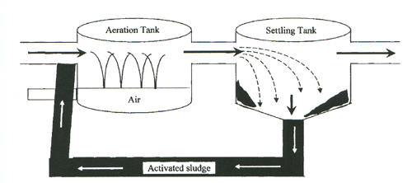
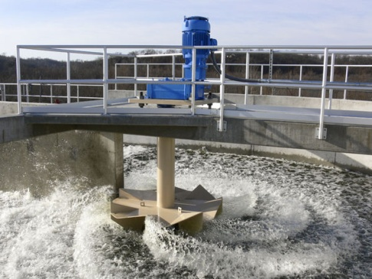
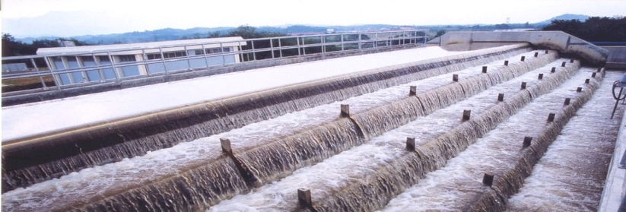
Aeration
Tastes and smells are commonly due to the presence of hydrogen sulphide in the groundwater or decaying organic and bacterial matter in surface water. These tastes and smells can be reduced by aeration.
Maximise air/water contact area.
Discharge in a spray into tank.
If space is available then let water fall down steps of perforated tiles or steps.
Aeration process

Slide 6
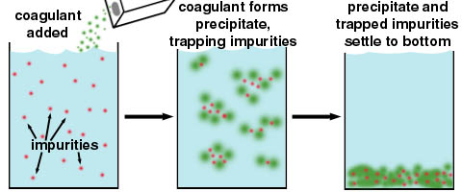
Coagulation
Some particles in water are quite small and do not settle to the bottom of the tank during sedimentation.
These particles must be encouraged to combine together to create heavier
Coagulation Process
particles and then they can settle. This process is called coagulation (and flocculation)
Chemicals used : Most common coagulant is alum (aluminium sulphate)
Natural: Alum rock, crushed seeds of some plants but may provide organic matter for the growth of bacteria.
Stages: Rapid mixing and Flocculation

Slide 7
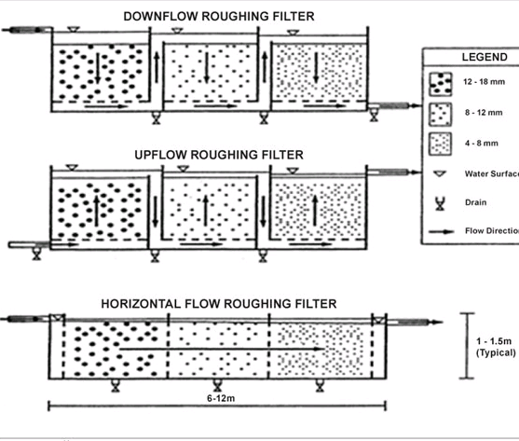
Roughing Filters
Roughing filters are often used to pre-treat water by removing suspended solids from the water that could rapidly clog a slow sand filter.
Roughing filters can also considerably reduce the number of pathogens in the water, as well as the amount of iron and manganese.
There are many types of roughing filters with different flow directions (downflow, upflow and horizontal flow filters), and with different types of filter medium (e.g. sand, gravel, coconut husk fibre).

Slide 8
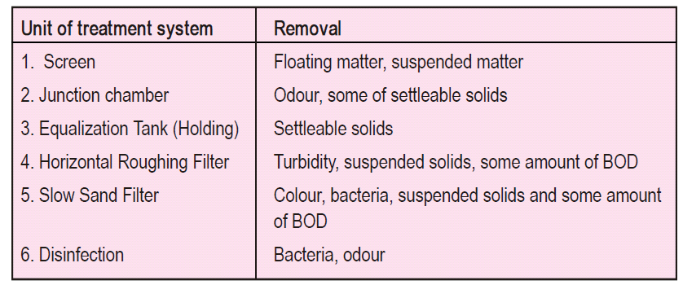
The function of various treatment units
* BOD : Biochemical oxygen demand

