Slide 1
Grey Water - 1

Slide 2
Presentation Scope
In this presentation you will learn:
  Few interesting facts about water
  Importance of water
  Water Classification (White, black and grey)

Slide 3
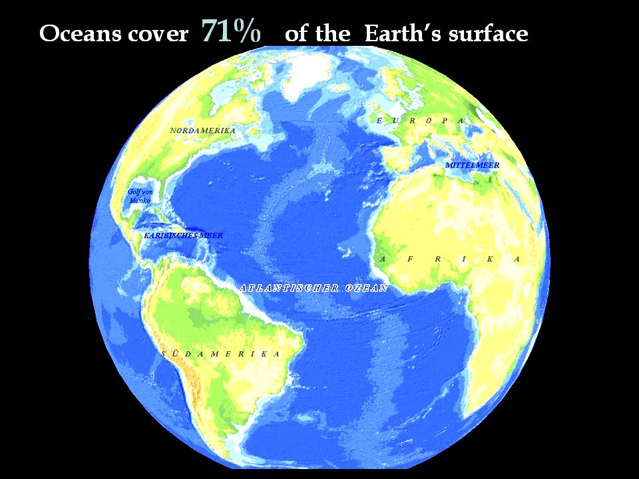
Fun Facts about Water
Human body is 66% water
A living tree is about 75% water
Almost 80% of the earth’s surface is covered with water
Notes:
Nearly 80% of the earth’s surface is covered with water and you are 66% water. Even the trees that surround you are primarily water.

Slide 4
Water is everywhere, so why do we need to conserve it?
What do you think, how much of the earth’s water is suitable for drinking ???
Answer is : 1%
Notes:
So, if 80 percent of the earth is water then why do we need to conserve it?

Slide 5



Why only 1 %?
Even though 70% of the earth’s surface is occupied by water; 97% of this water is salty
2% is fresh water locked in snow and ice.
Therefore only 1% of the earth’s water is available for drinking.

Slide 6
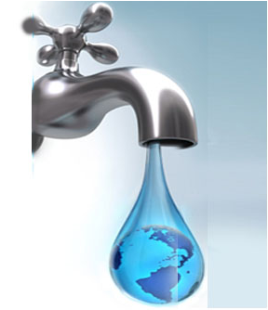
Every Drop Counts: Conserve WATER
Obviously, if only 1% of the water on earth is drinkable and the population continues to grow, we have to reduce use or find ways to use the “non-drinkable” water. Water is relatively cheap, so we tend to waste it.

Slide 7
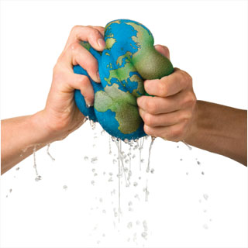
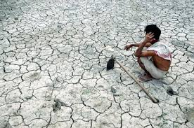
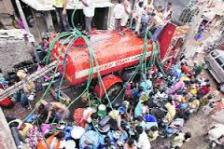
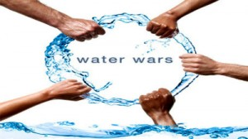
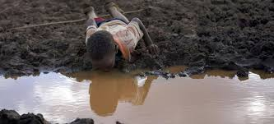
If we fail to conserve water ...
Yes. It is in our hands to avoid all these situations

Slide 8
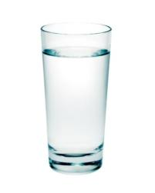
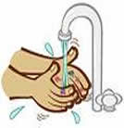

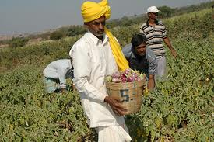
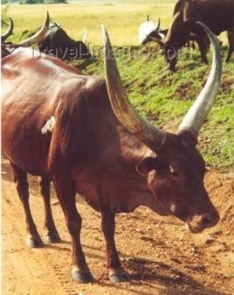
Where do you use this 1% water?
Drinking
Cooking
Washing
Feeding animals
Growing crops
And many more other applications …..

Slide 9






Ways to conserve water

Slide 10
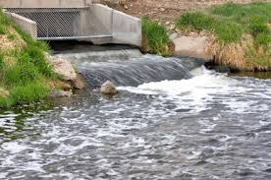
Reusing water
Is it possible to reuse all the water we daily use in different ways ???
Yes, by using waste water treatment it is possible to re-use this water
Chemical Water from factories
Waste water from home

Slide 11
Waste water treatment
Before knowing about the waste water treatment, first understand the water classification types
According to the levels of cleanliness, the water we use can be classified into three types :
White water : White water is fresh, completely clean and potable.
White water is water with nothing but H2O.
White water sources :
Surface level : lakes, reservoirs and rivers
Ground level : Can be accessed through wells

Slide 12
Water classification
2. Black water : Black water is used water which is heavily polluted by chemicals and/or biological contaminants. It is basically non-useable sewage water.
Black water carries pathogens that are too strong and unsafe for either animal or plant consumption.

Slide 13
Water classification
3. Grey water : Grey water is in between the two in terms of sanitation. It frequently appears to be cloudy, but it can be filtered and reused. Grey water gets its name from its cloudy appearance and from its status as being between fresh potable water (known as "white water") and sewage water (black water)
Grey water is water that has been used once for non-toxic cleansing.

