Slide 1
Introduction to your project
तुमच्या प्रोजेक्ट विषयी माहिती सांगणे.

Slide 2
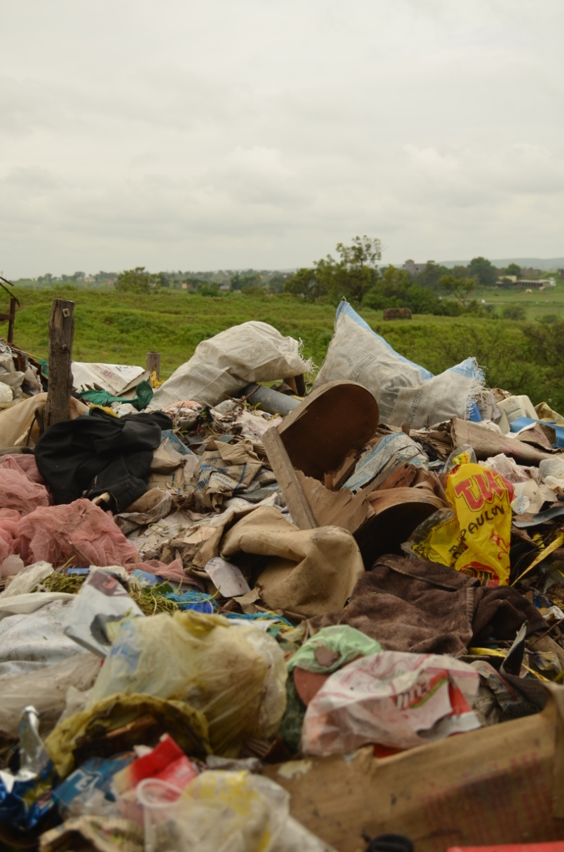
Your project! तुमचा प्रोजेक्ट कोणता आहे
Waste management
कचरा व्यवस्थापन आणि त्याचा पुनर्वापर
Waste
problems
Vigyan Ashram
Pabal
India
The world
We all have the power to do something about this issue!
Notes:
The project will be about waste management and recycling. There are many problems that Pabal faces to do with this, and they don't end in Pabal, they affect the whole world. Luckily, we all have the power to do something about this ourselves.

Slide 3
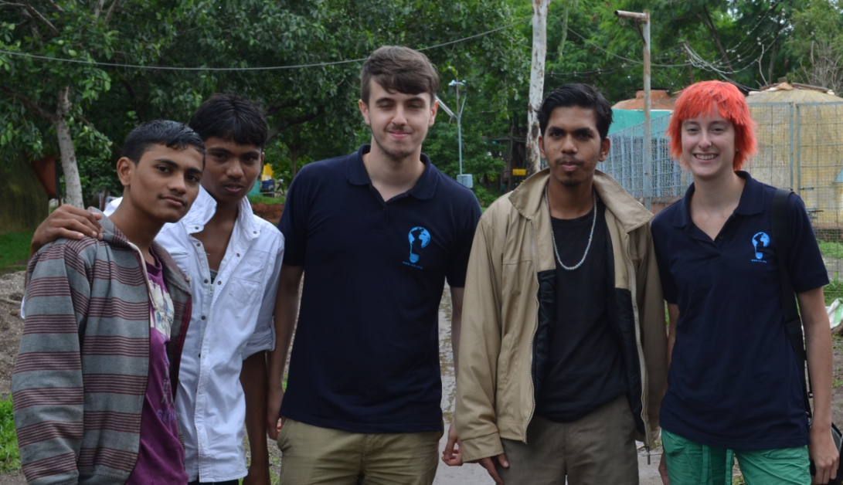
Your project! तुमचा प्रोजेक्ट कोणता आहे
1
Learning new concepts and skills नवीन संकल्पना व तंत्रे शिकणे
2
Designing your project प्रोजेक्टचे स्वरूप
3
Doing your project प्रत्यक्ष प्रोजेक्ट चे काम करणे
Who will...
Think of the ideas?
Learn new skills?
Solve problems?
Who will...
Support you?
Guide you?
Give you advice?
YOU!
This will be your project
US!
Notes:
Hi everyone! (Learning/designing/doing) For the next few weeks we will be giving you the skills you need to design and implement you own project in the community. You will all be working in teams to solve problems, come up with new ideas and get other people on board.

Slide 4
This week: Learning new ideas and skills
या आठवडयात : नवीन कल्पना व तंत्रे शिकणे
Community
Teamwork – how can we all work together?
Waste management
What are the problems?
What can we do to solve them?
What is waste management?
Problem solving
Public speaking
Notes:
This week we will be talking about waste management (the problems, how we can solve them), community, teamwork (how we can work together), public speaking, and more!

Slide 5
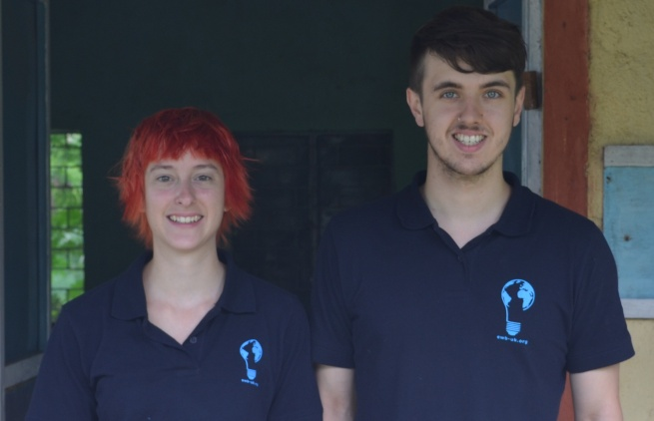
What waste problems does Pabal face? पाबळ गावात कचऱ्याची काय समस्या आहे?
For your project, you will need to think about:
तुमच्या प्रोजेक्ट साठी : पुढील गोष्टीचा तुम्ही विचार केला पाहिजे.
What waste problems does Pabal face? पाबळ गावात कचऱ्याची काय समस्या आहे?
How can we prevent them? त्याचा आपण कसे निरसन करू शकतो?
How can we help to solve them? हे प्रश्न सोडवण्यासाठी आपण काय मदत करू शकतो?
Notes:
We are going to go to Pabal village. Take your notebooks! Think about the following questions:
We will talk more about this next lesson

Slide 6

Let’s investigate! चला तर मग शोधून काढूयात.
Get into teams of 3
सर्व प्रथम प्रत्येकी तीन लोकांचा एक असे गट करून घ्या.
Each team will answer 2 questions: प्रत्येक गटाने २ प्रश्नांची
उत्तरे द्यायची आहेत.
What types of rubbish are there in Pabal?
पाबळ गावात कोणत्या प्रकारचा कचरा जमा होतो?
Where is it concentrated?
तो कचरा कोठे साठवला जातो?
1
Where do people put their rubbish?
गावातील लोक त्यांचा कचरा कोठे टाकतात?
Do they segregate their rubbish?
लोक कचरा टाकताना त्याचे वर्गीकरण करतात का?
2
Notes:
We want you to be investigators. Like Sherlock Holmes! [pic] You will need to spend about an hour in the village collecting this information. Make notes, talk to people, take pictures – be creative!
Ask them who has cameras that they can get pictures off.

Slide 7
Let’s investigate! चला तर मग शोधून काढूयात.
Who collects the waste? कचरा गोळा कोण करते?
How often is it collected? तो किती वेळा गोळा केला जातो?
3
Has the waste problem got worse in recent years?
अलीकडे काही वषात कचर्याचा प्रश्न बिकट होतो आहे असे वाटते का?
How is it affecting the village?
त्याचा गावावर काय परिणाम होताना दिसतो?
4
Spend one hour in Pabal collecting this information
Make notes, talk to people and take pictures
Report this information back to us

