Slide 1
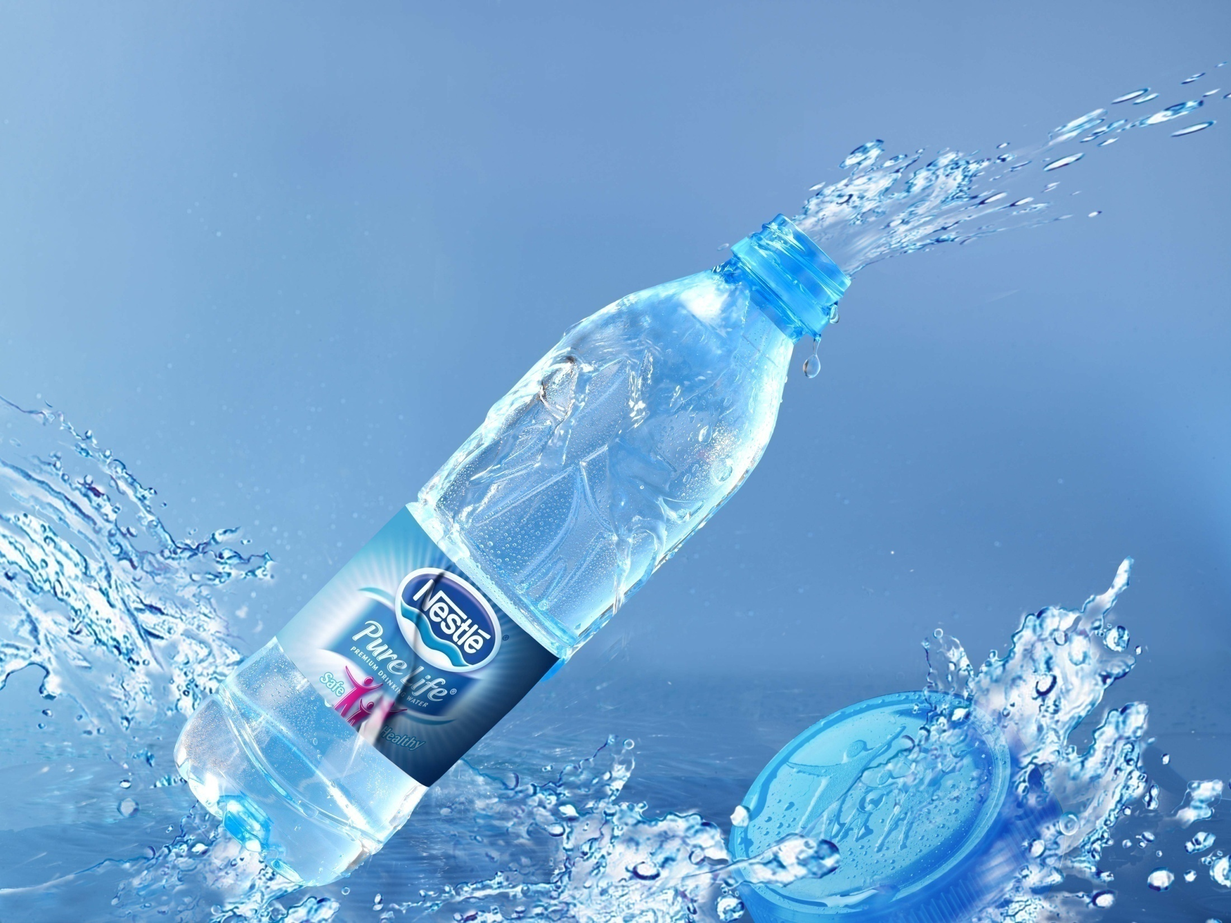
Disadvantages of Plastics!!

Slide 2
Intro!
Plastic bottles are certainly ubiquitous--they bring us everything from household cleaners to soft drinks to things so readily available as water. These bottles, while convenient, do have disadvantages when used on as wide a scale. While most of these disadvantages are environmental in nature, the consequences could have widespread economic consequences in the long-term.

Slide 3
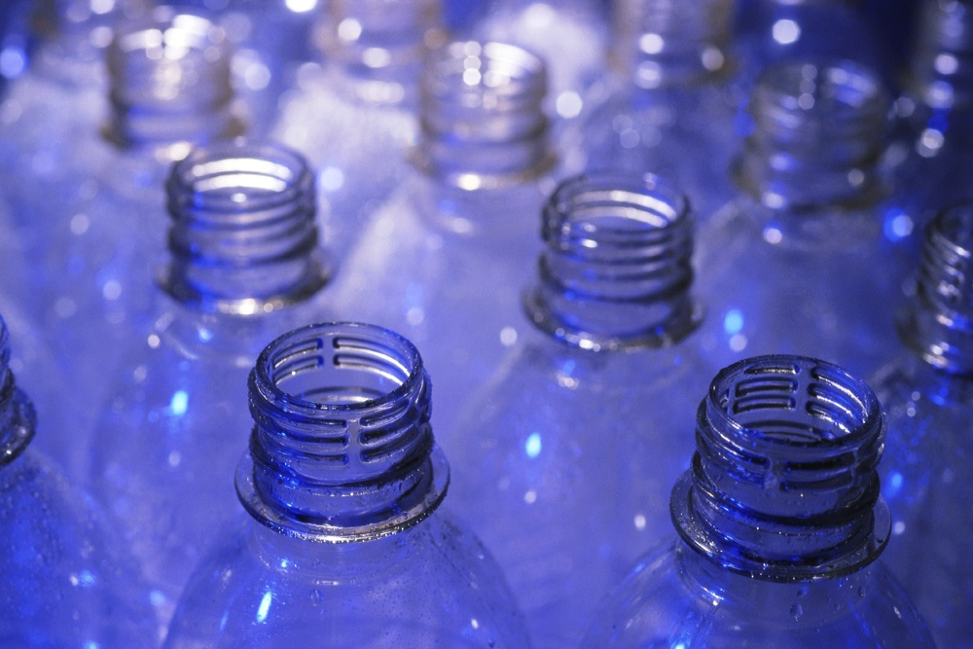
Disadvantages of Plastic Bottles
Decomposition
Non-Renewable
Toxic
Threat to Animals
Difficult to Recycle
Hard to Reuse

Slide 4
Decomposition
The main disadvantage of plastic bottles is the shear amount of time they take to decompose--the average plastic bottle takes 500 years. Plastic's decomposition can be affected by various factors, such as the type of plastic, the climate and acids in the landfill; plastic still lasts a long time, filling landfills for an indefinite period.

Slide 5
Difficult To Recycle
Glass bottles can be melted and easily reused, as can tin cans. Recycling plastic is not so simple. Much of the plastic placed in recycling boxes is not recycled at all, as most plastic cannot be recycled. Those bottles that are recycled are not used to make new bottles. Instead, recycled plastic bottles are used to make non-recyclable products, such as T-shirts, plastic lumber or parking lot bumpers. This means more raw materials need to be used to create new plastic bottles than is the case with easily recycled material, such as glass or tin.

Slide 6
Hard To Reuse
The standard disposable plastic bottle is meant for one use, not many. Recycled plastic bottles are not refilled in-mass the way glass beer bottles are, and flimsy plastic bottles do not lend themselves well to at-home re-usage. Water bottles, for example, are often reused in the home but become less and less sturdy over time and are ultimately thrown away.

Slide 7
Non Renewable
Plastic is manufactured using oil by-products and natural gas, materials that could be used in numerous other applications or conserved were plastic usage lower. Natural gas, for example, can be used to heat houses and cook food. Using plastic in the volume we currently do reduces the availability of these resources, which are gone forever when used up.

Slide 8
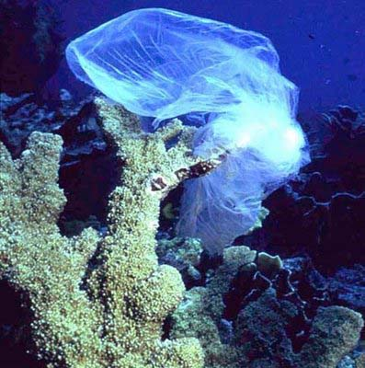
Omg! Threat To All!
Discarded Plastic usually ends up within marine sources. The Pacific Ocean has one of the largest dumping ground for plastics, unknown numbers of sea birds marine mammals and fish ingest plastics which causes a variety of negative health effects.
As plastics break down by wave action, photic
or biological means generation of
microplastics also occurs.
Microplastics have the potential
to harbour persitant organic pollutants and
polyaromatic hydrocarbons which are
highly toxic to all known living creatures.

Slide 9
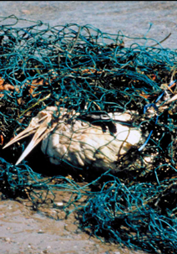
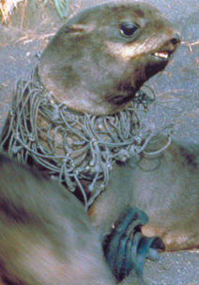
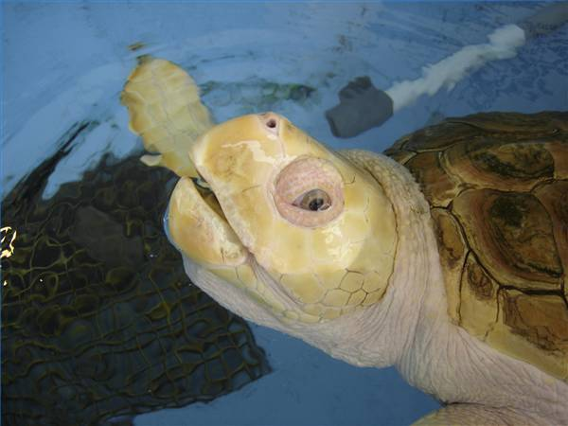
Help Us!!

Slide 10
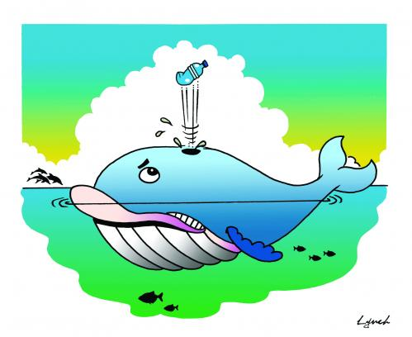
Whales hail for help!!
As per Marrickville Council of Australia, as many as 100,000 whales, turtles and birds die have been reported to die every year, mainly because of plastic in their environment. Plastic bags not only have adverse effects on our natural habitats, but have also been found to be responsible for the death of many animals, mainly on account of the suffocation encountered on eating them.

Slide 12
Things You can do !
The two best things you can do is to use less (or no) plastic and to reuse plastic when possible. Many products that come in plastic bottles are also available in glass bottle or tin cans; use these whenever possible. Instead of buying bottled water buy a refillable water bottle and fill it with tap water. Generally, try to waste less by using less and reusing when possible.

Slide 13
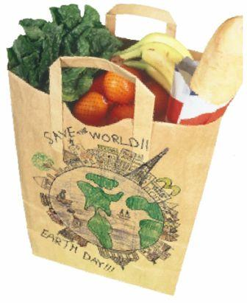
ALTERNATIVES
Plastic bags take between 15 to 1000 years to degrade. The detoxins and other chemical pollutants released from them are a Serious Threat to be Tackled. Designing eco-friendly, biodegradable plastics is the need of the hour. Though partially biodegradable plastics have been developed and used, completely biodegradable plastics based on renewable starch rather than petrochemicals have only recently been developed and are in the early stages of commercialization.
Paper , Cloth, Jute, Cane, etc., are the most preferable but still controversial

Slide 14
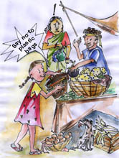
To save your environment and thereby your self
Say NO to plastic check-out bags whilst shopping and buy reusable bags or bring your own for your shopping instead
Use of Glass / Ceramic instead of plastic in Microwave. • Replace plastic travel mugs with stainless steel for hot beverages. • When you can’t avoid plastic, check container bottoms for recycling codes (in triangle with chasing arrows). Choose those easily recycled.

Slide 15
OUR RESPONSIBILITY
It's impossible to eliminate most plastic from daily life, but it's prudent for our health and that of our environment to curb the use of some. Overall reduction in plastic usage, proper management for disposal and public awareness would bring a great difference in present situation.
Separate .. Store..and hand over for proper recycling or disposal.
Do not let plastic litter the environment.
SAVE EARTH

Slide 16
Future of Plastic

Slide 17
The future of plastic is ‘not’ in jeopardy
“Everything’s plastic, we’re all gonna die” says Elizabeth Wurtzel. I do not agree with the statement. Biodegradable plastic seems to show some light, however, they too come with certain disadvantages. When degraded, these emit harmful Co2 and methane.
However, here comes recycled plastic curbstone, which acts as a substitute to building materials. In addition, “oxo-biodegradable” plastics are eco- friendly as when degraded they emit no methane. It’s time we change our opinion.
Many developing countries like India are banning plastic bags. Instead of banning them, the plastic bags should be utilized elsewhere.

Slide 18
Let’s discuss about a few recent developments:
• Plastic used in construction: Plastic building material is strong, flexible, water- and heat - resistant. Recently, a UK-based company has launched a recycled plastic curbstone, which can replace building materials like steel, wood, etc. The plastics are light weight and require little maintenance. Novacem Company has developed a new formula of locking CO2 into construction materials. The CO2 can be recycled with other plastic and glass from torn out buildings.

Slide 19
Making Plastics from Plants!! Wow!
• Scientists have come up with a new technology of making plastic from plant. Three bacterial enzymes have been introduced by the scientists in the model plant Arabidopsis thaliana. When the two enzymes are combined with the plant, an organic polymer known as polyhdroxybutyrate-co-polyhydroxyvalerate, or PHBV is produced. PHBV is extensively used to produce variety of products like grocery bags, soda bottles, flatware and disposable razors. The plastic when discarded are easily degraded.

Slide 20
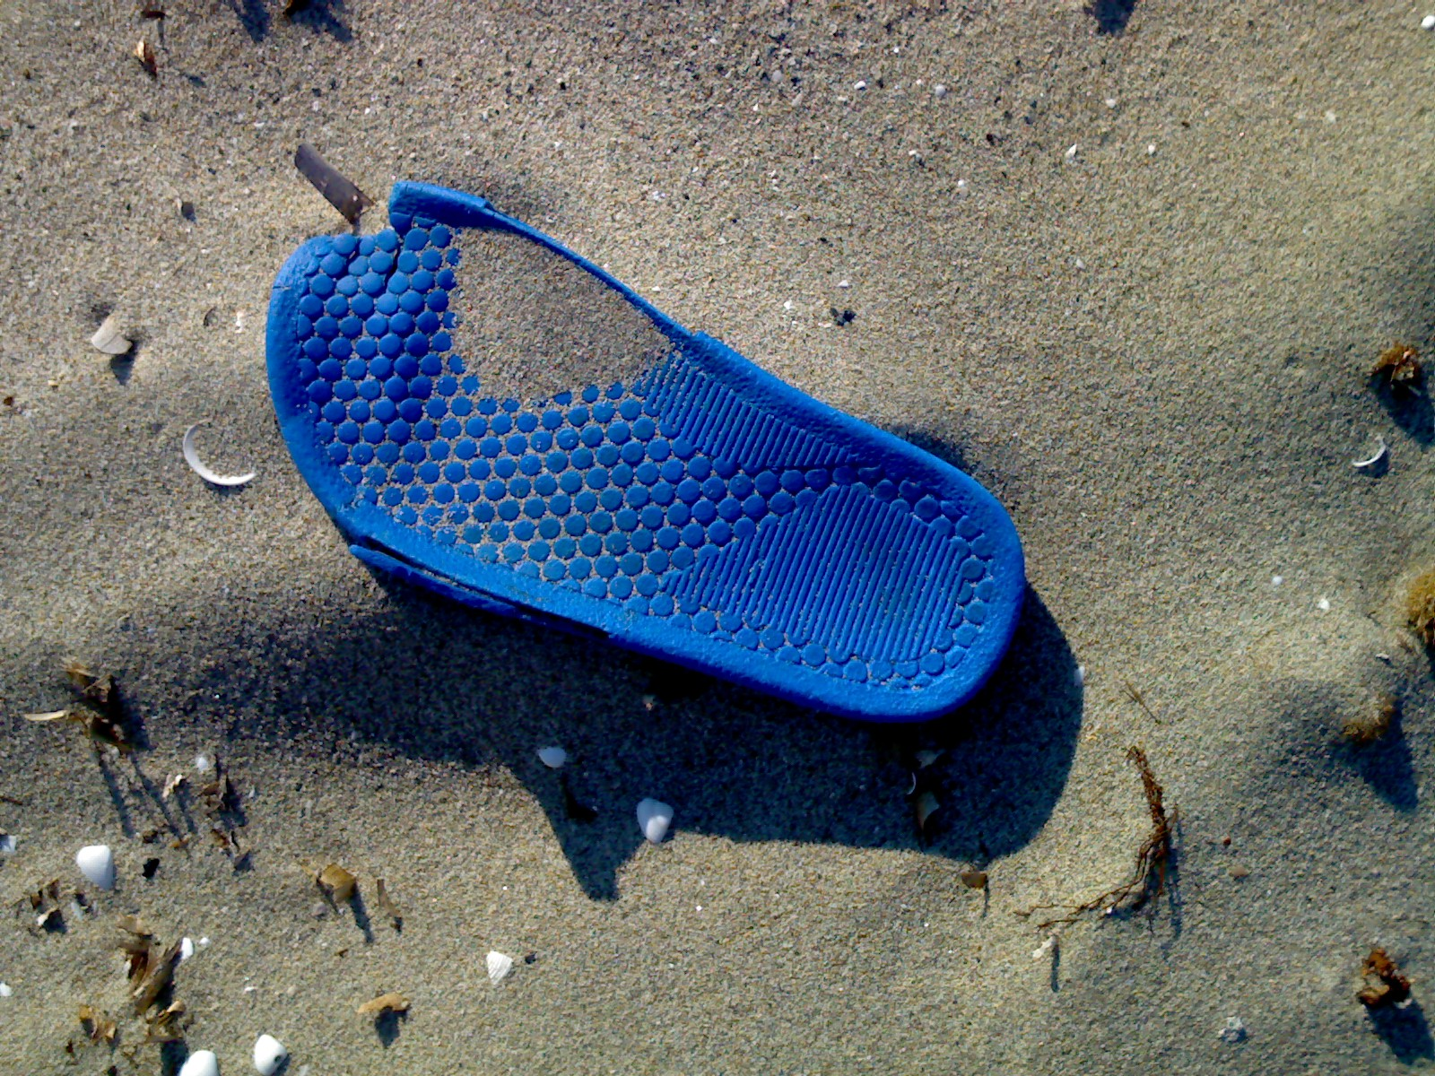
Plastics From Garbage!
Recently scientists have made a green polymer from plastics thrown in the garbage which will prevent dumping of post consume plastics in the landfills.
Banning plastics is not the real motto to save the environment but the motto is to make plastics in producing wide varieties of products.

Slide 21
What a mess!!

Slide 22
Dumped!
Depicts two million plastic beverage bottles:
the number used in the U.S. every five minutes

Slide 24
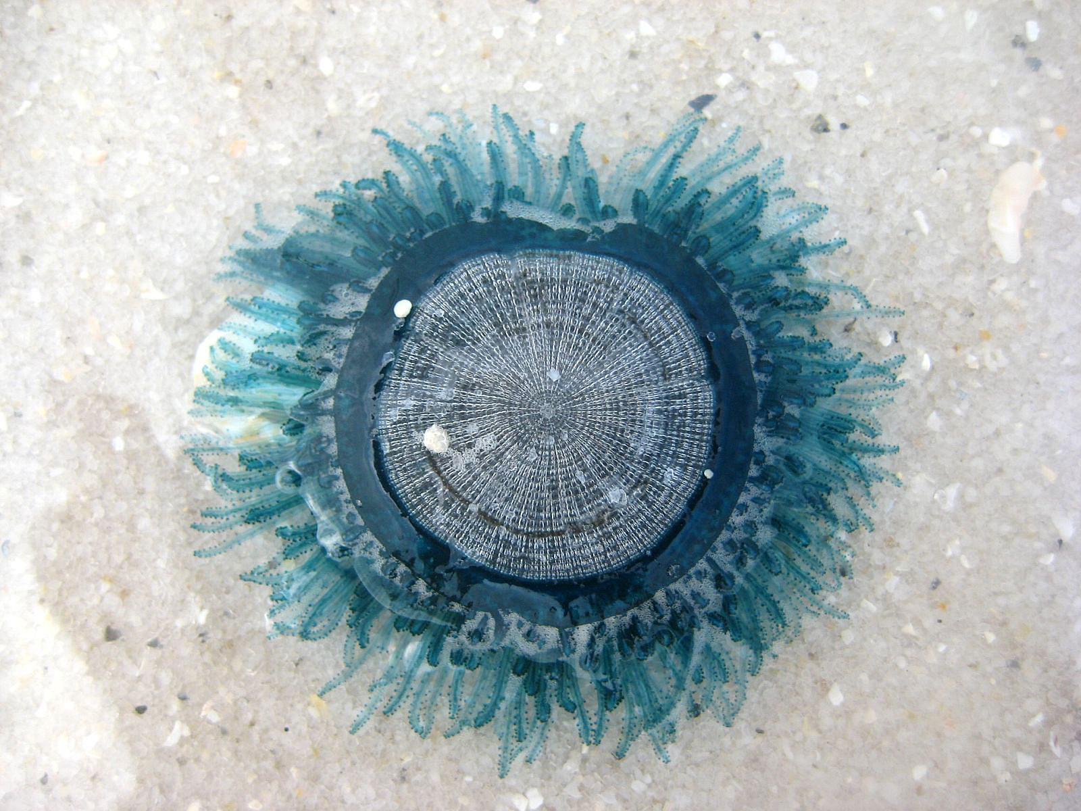
Plastics Recycling
.

Slide 26
Advantages of Recycling
Waste reduction
Conservation of energy
Save money
Create new jobs
Generate revenues

Slide 27
Disadvantages of Recycling
Recyclable materials might be in contact with radioactive materials
The chemical bonds (toughness)
Impossible to recycle at 100%

Slide 28
Growth in plastic bottles Recycling
Plastic bottle recycling increased since 1990

Slide 29
Conclusions on Recycling
Recycling
- save money
- use less raw materials
- no landfills- plastics take about 20 to 30 years to decompose

Slide 30
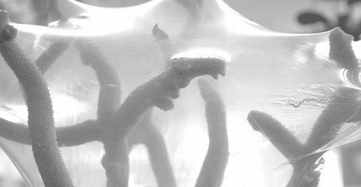
5-R for Plastics!!
Refuse
Reduce
Reuse
Recycle
Rebuy

Slide 31
QUESTIONS
?

