Slide 1
Mural

Slide 2
The design
Notes:
Previous design used everybody’s ideas – landscape
Space given to us much smaller, went for a simpler design drawn by Sachin
If this works well, perhaps you can do another mural in the village or at VA!

Slide 4
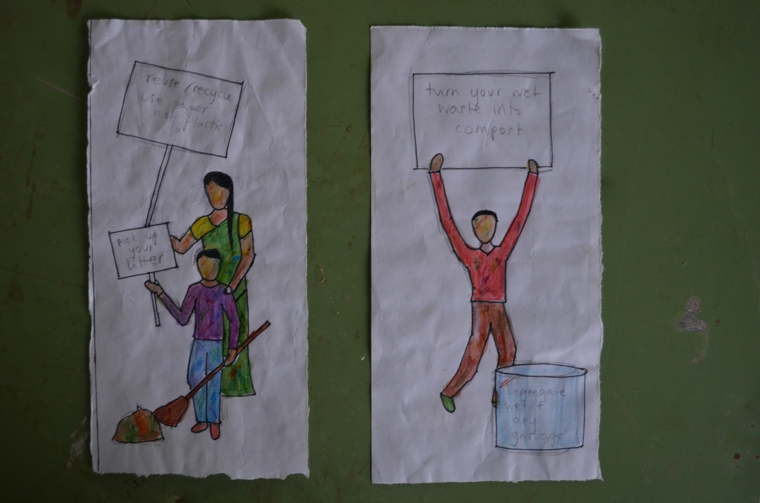

Slide 5
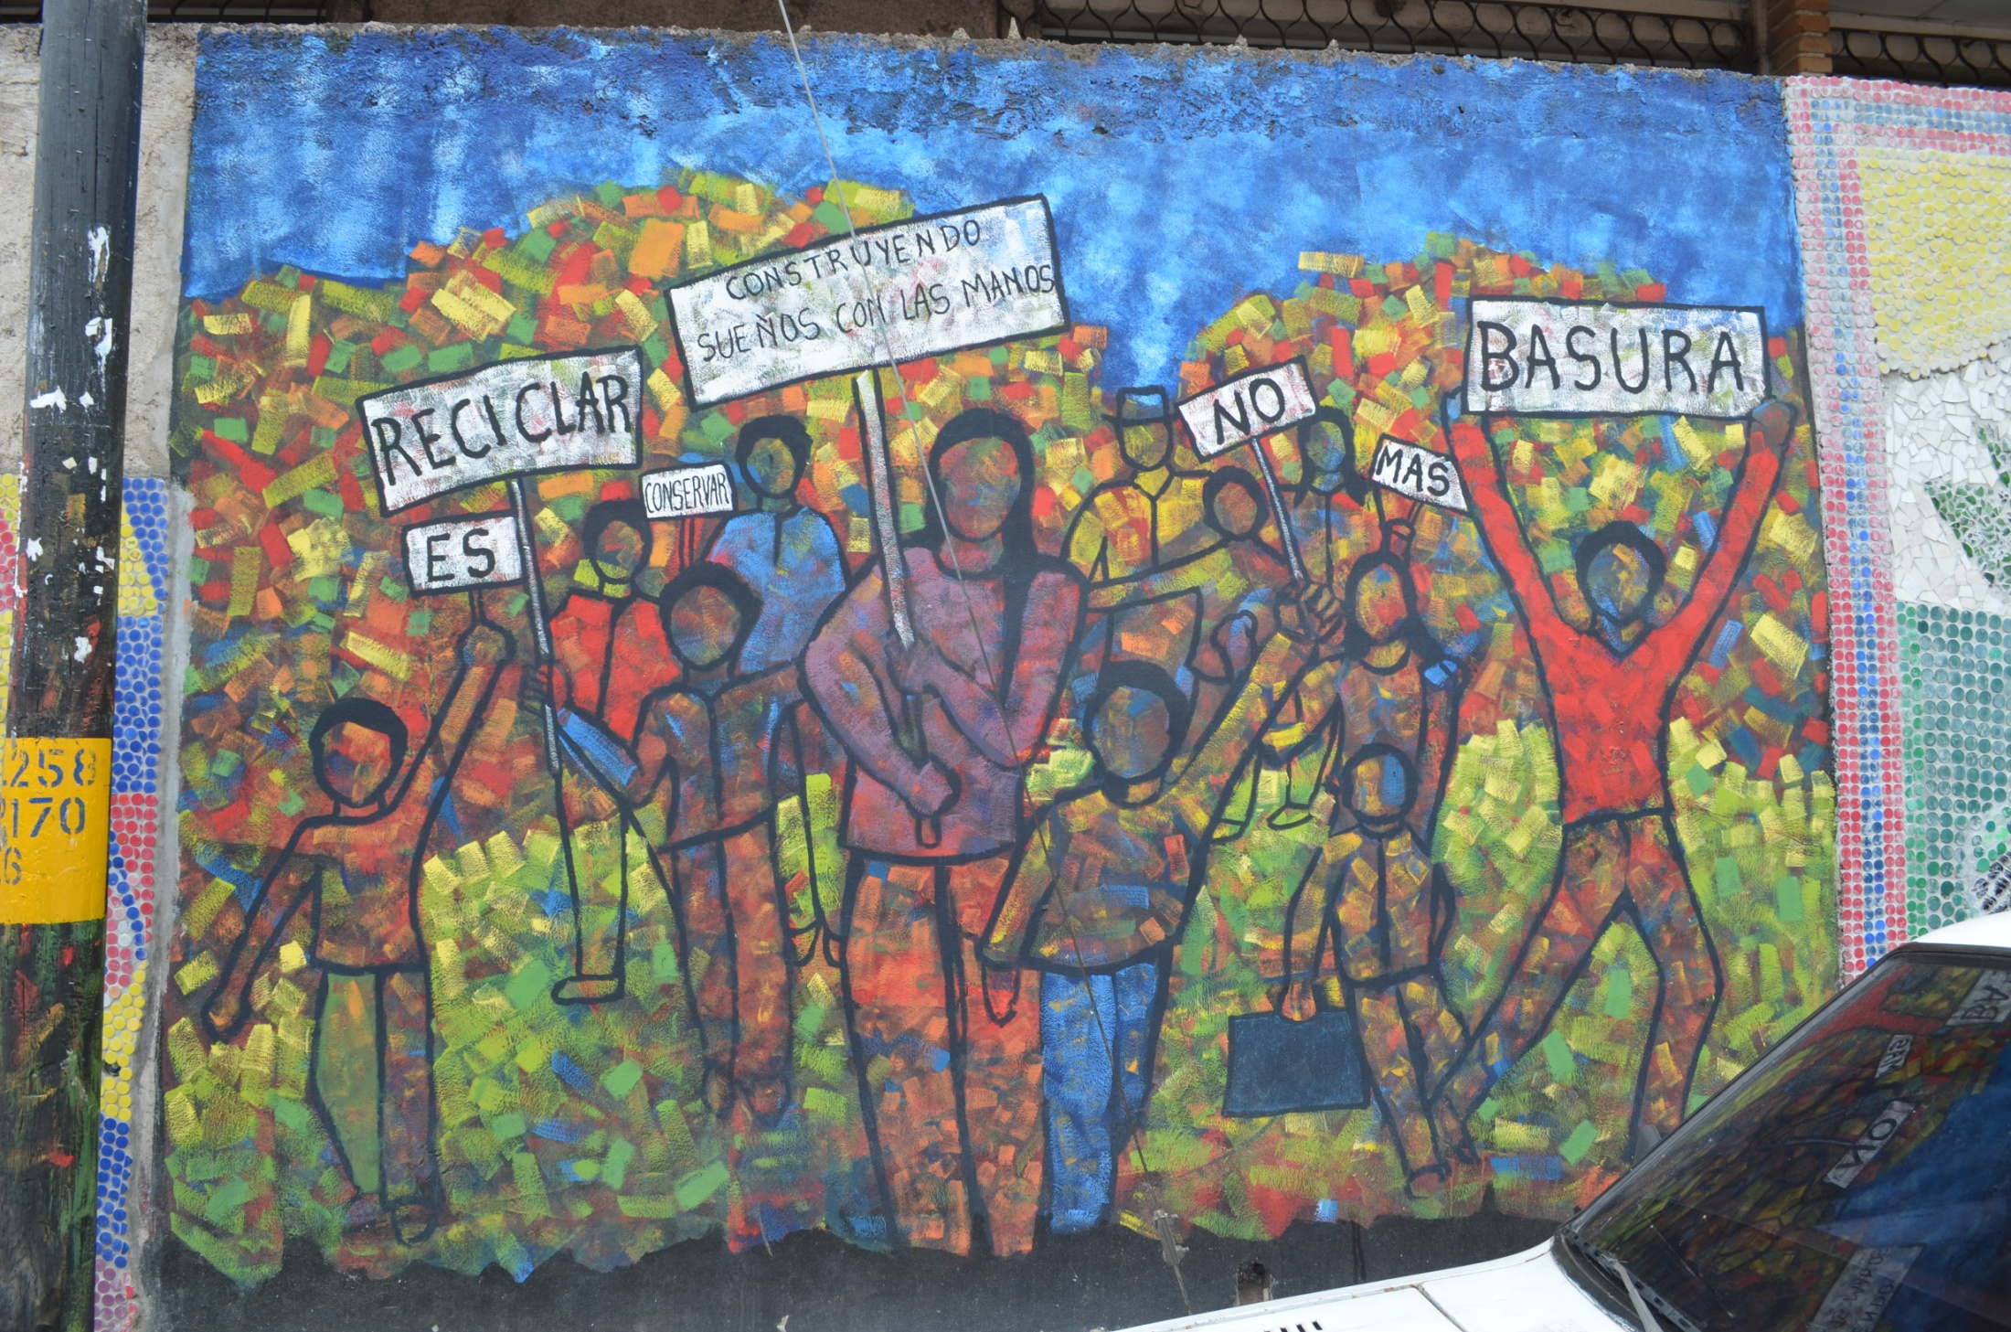

Slide 6
Mural space

Slide 7
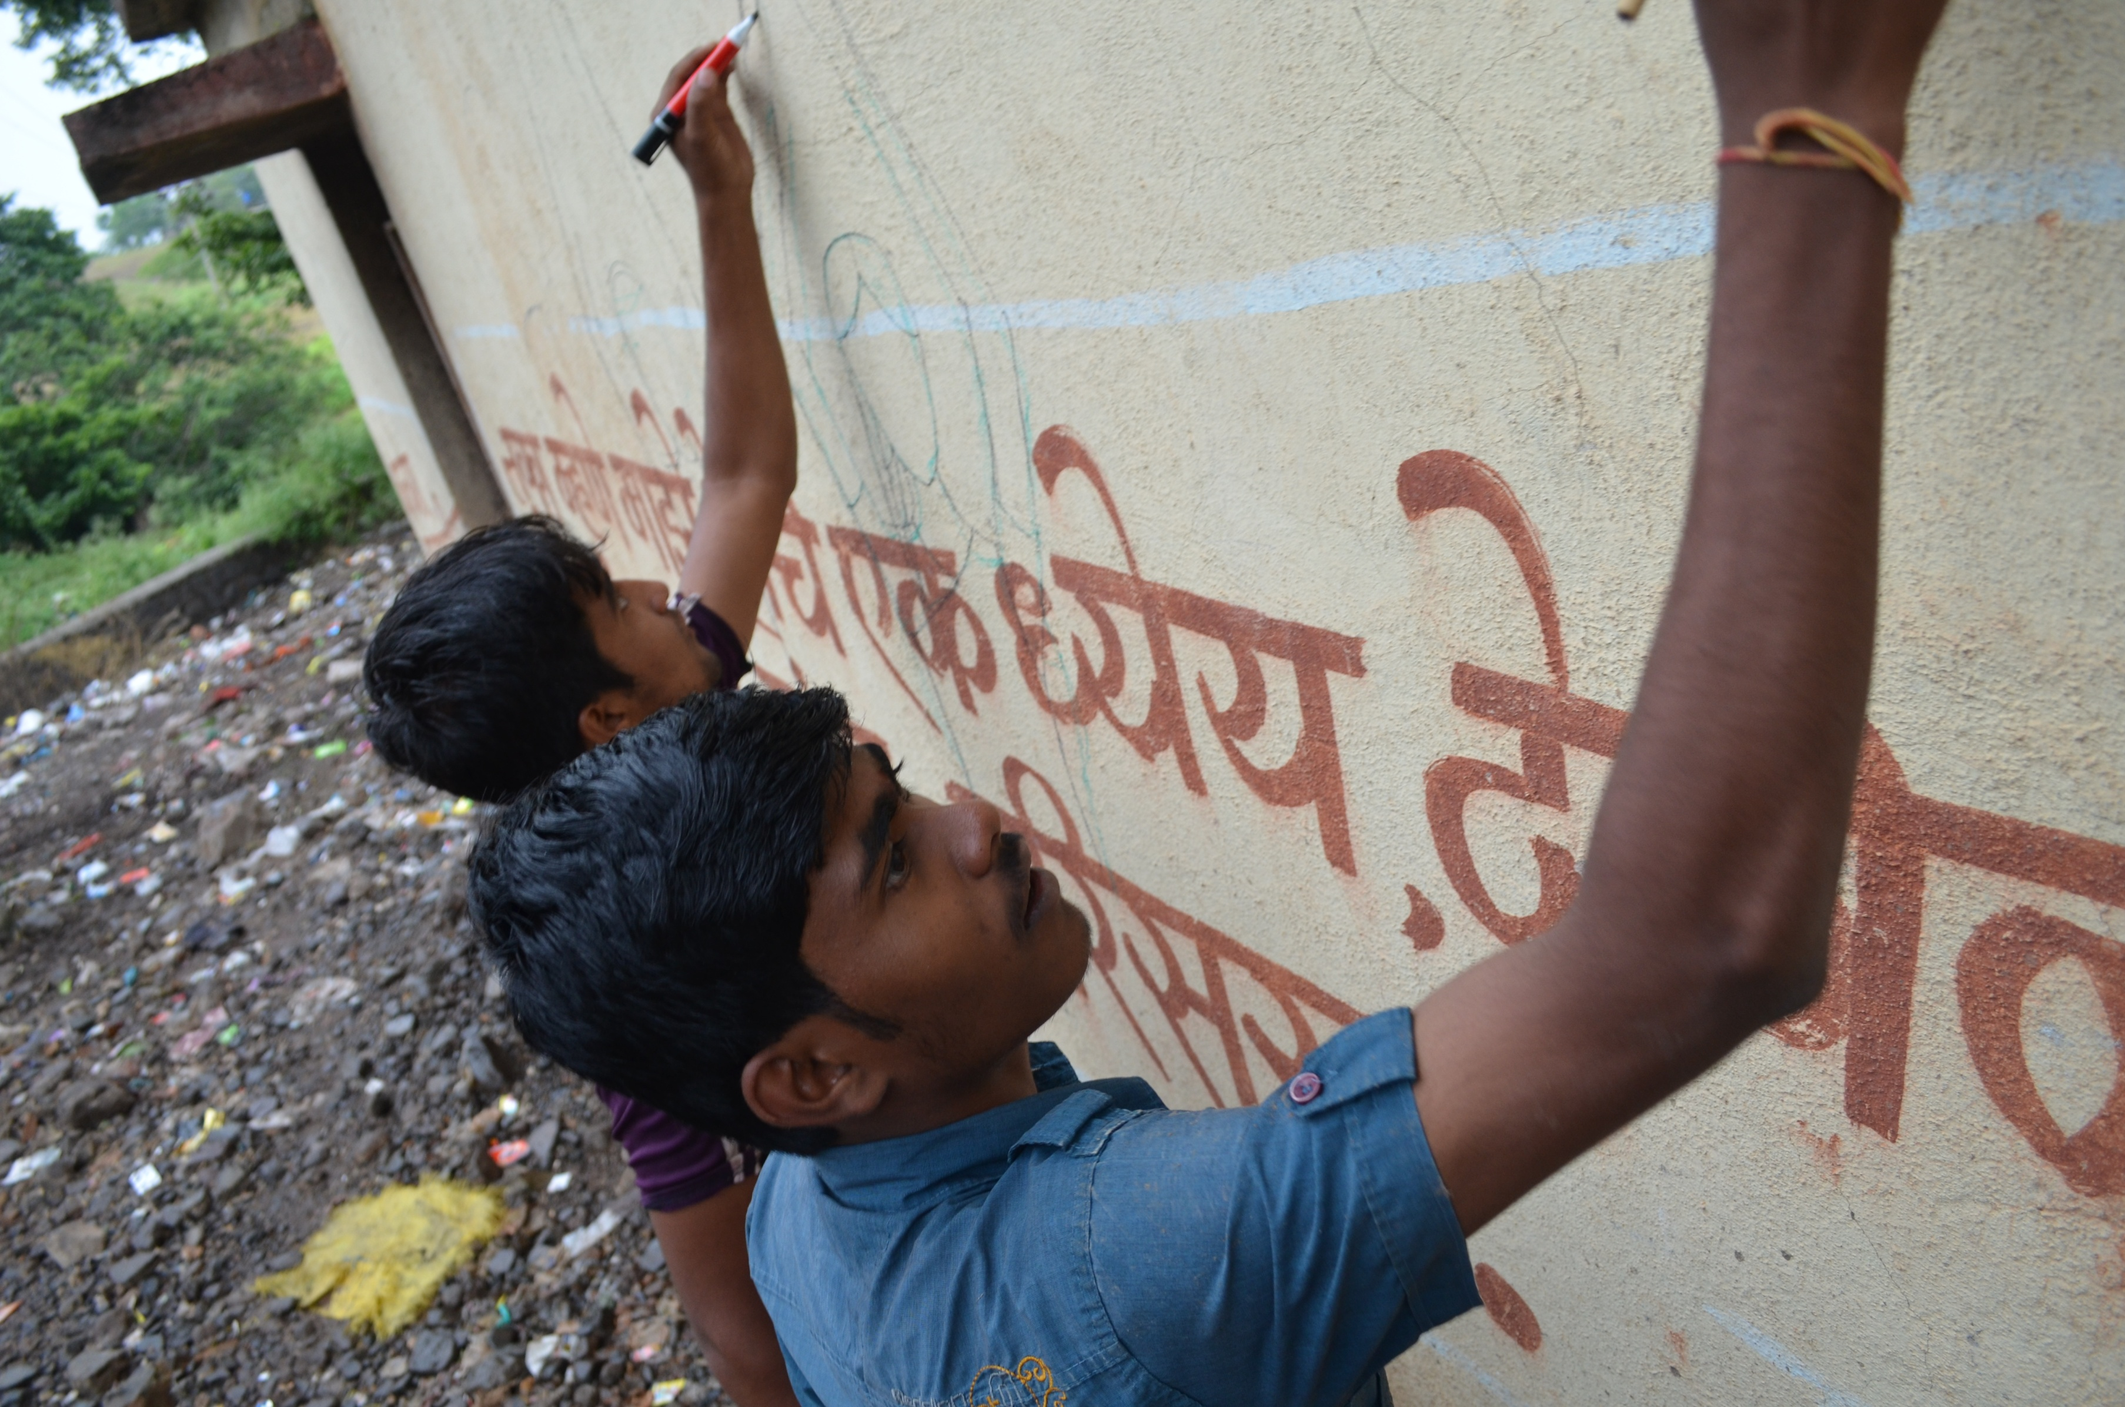

Slide 8
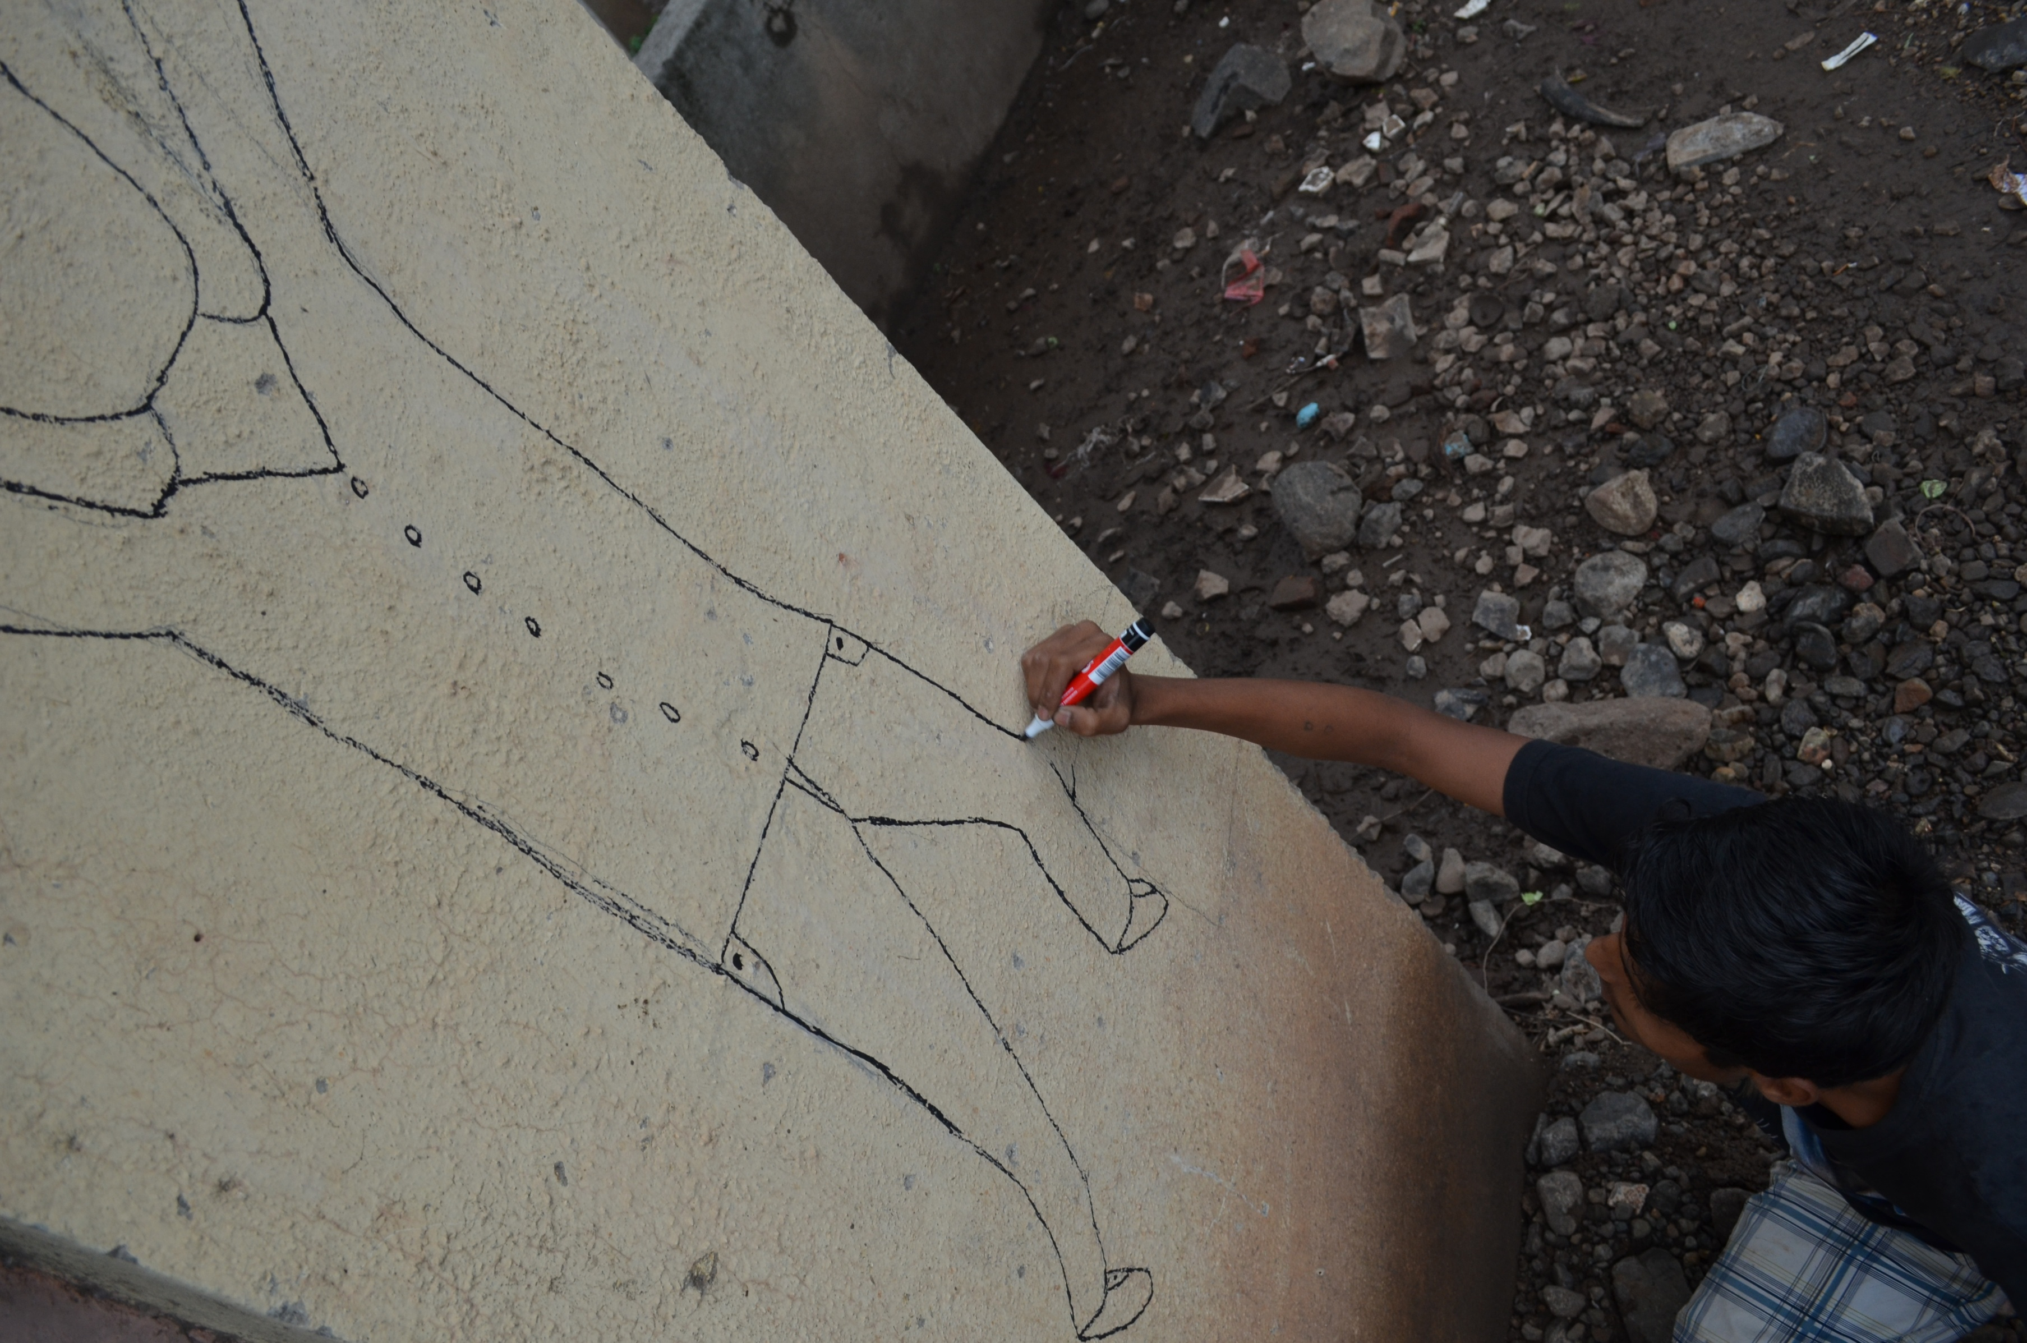

Slide 9
Slogans
Can you think of a slogan to go at the top if the mural?
It must:
Be clear and to the point
Relate to the mural’s design
Write down any ideas now!

Slide 10
Waste managment information
What information would you give to someone about waste?
Examples:
Segregate wet and dry waste
Burning plastic harms the environment
Pick up your litter
Make compost from wet waste
Write down some ideas!!

Slide 11
Timetable
Everyone will get a chance to paint the mural
If you have any ideas about slogans, information, colours, design or anything else, please see your team leaders!

