Slide 1
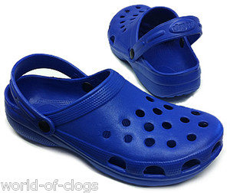
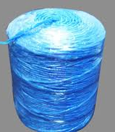
Recycling Plastic रिसायकलिंग करणे प्लास्टिक

Slide 2
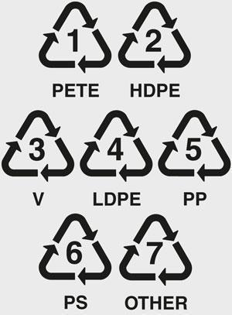
Types of plastic
Notes:
On most plastics there is a recycle sign which carries a number from 1 - 7
Each number represent specific types of plastics, with the exception of 7 which is anything that cannot be categorized in the first 6.
Different plastics react differently to fire, some catch on fire, some melt, and others will barely do anything.
Most plastics carry some signs of toxicity due to the creation process being as such. But some are significantly safer than others.

Slide 3
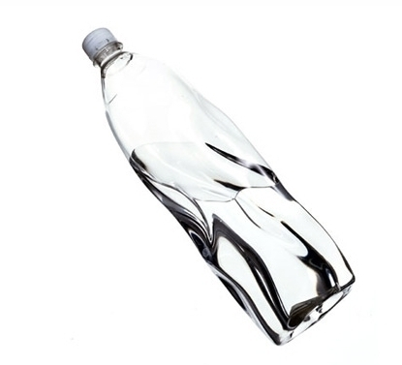
NOT SAFE!
Contains high amounts of antimony and carcinogens that it can leach into water (best not to re-fill too often)
These toxic fumes can be released by burning and melting
DO NOT MELT

Slide 4
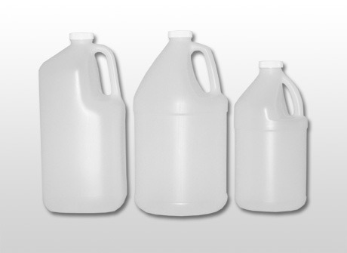
SAFE!
Good for re-filling with water (does not leach toxics)
Very strong
Difficult to melt

Slide 5
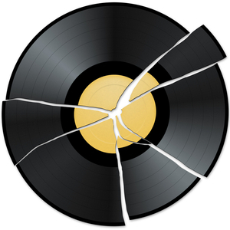
(PVC)
NOT SAFE!
MOST DANGEROUS PLASTIC
leaches Carcinogens as well as Lead
When heated, exposes Dioxin (most dangerous toxin!)

Slide 6
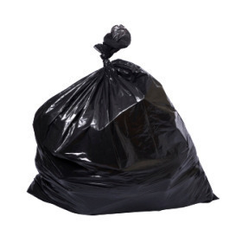
SAFE!
Plastic bags, food wrappers etc.
Melts at boiling point (safe to melt in boiling water!)
Use caution while trying to burn loser LDPE products such as bags, because they do catch on fire

Slide 7
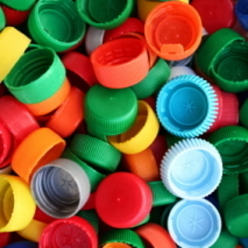
SEMI-SAFE!
Bottle caps, storage bins, plastic dishware etc.
Does not melt easily but heats quickly
Certain PPs leach Biocide

Slide 8
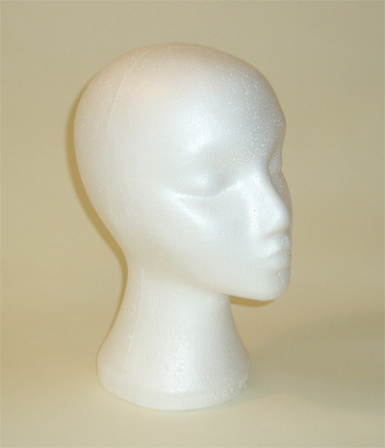
NOT SAFE!
2 forms – styrofoam; another mimicking other plastics
Leaches Carcinogens related to styrene and an estrogen disruptor

Slide 9
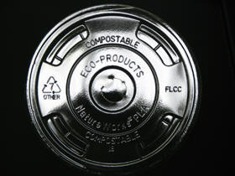
OTHER
Examples:
PLA – biodegradable plastic – SAFE
PC – very toxic – NOT SAFE

Slide 10
Plastic Road Making

Slide 11
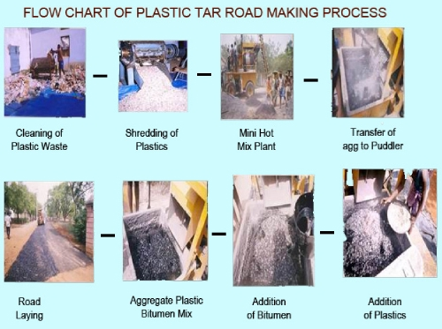
Notes:
Simple but innovative - mixing plastics (8%) with bitumen (92%) for road surfaces
Shredded plastic waste acts as a strong binding agent for tar
makes the asphalt last longer by rendering it more impervious to water
Increases road life by a factor of 3 (Centre for Transportation Engineering and Civil Department of Bangalore University)
3 times as strong (Indian Roads Congress)

Slide 12
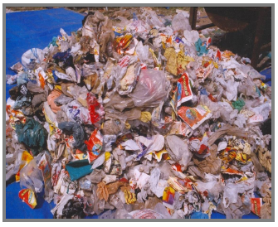
Plastic Wastes used in process:
The following types of waste plastic can be used in the construction of rural roads:
Films ( Carry Bags, Cups) thickness up to 60micron (PE, PP and PS)
Laminated Plastics thickness up to 60 micron (Aluminum coated also) – packing materials used for biscuits etc.
Hard foams (PS) any thickness
Soft Foams (PE and PP) any thickness.
Poly Vinyl Chloride (PVC) sheets or Flux
sheets should NEVER be used.

Slide 13
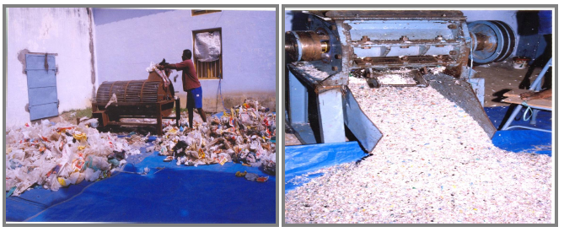
Process Step 1: Cutting
Plastic is cut into small pieces
2mm – 5mm thick

Slide 14
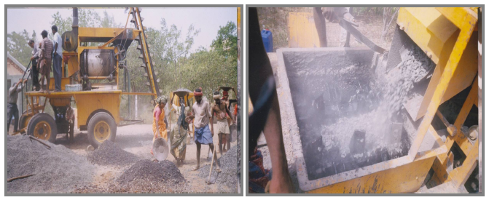
Process Step 2a: Heating aggregate
Aggregate mix is heated to 165°c
Transferred to mixing chamber

Slide 15
Process Step 2b: Heating bitumen
Bitumen is heated to 160°c
(Essential for good binding and to prevent weak bonding)

Slide 16
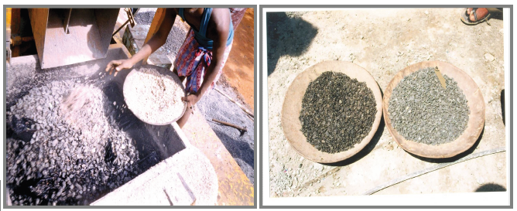
Process Step 3: Mixing plastic
Shredded plastic added at mixing chamber
Coated uniformly over aggregate giving oily look

Slide 17
Process Step 3: Mixing plastic
Shredded plastic added at mixing chamber
Coated uniformly over aggregate giving oily look

Slide 18
Process Step 3: Road Laying
Plastic coated aggregate is mixed with got bitumen
Mix is used for road laying (110°c to 120°c)

Slide 20
Process Characteristics
Easy process without any new machinery
Simple process without any industry involvement
In situ process
Use of lesser % of bitumen and thus savings on bitumen resource
Use of plastics waste for a safe and eco-friendly process
Both Mini Hot Mix Pland and Central Mixing Plant can be used
Only aggregate is polymer coated and bitumen is not modified
Use of 60/70 and 80/90 bitumen is possible
No evolution of any toxic gases like dioxin
Fly ash can also be used to give a better performance

